Slide 1
BORE-GENERATED PRECIPITATION
AHEAD OF AND BEHIND COLD FRONT
PUSHING INTO VERY STABLE AIR?

Slide 2
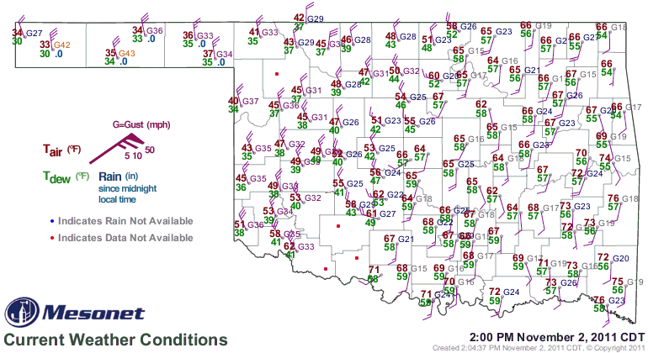

Slide 3
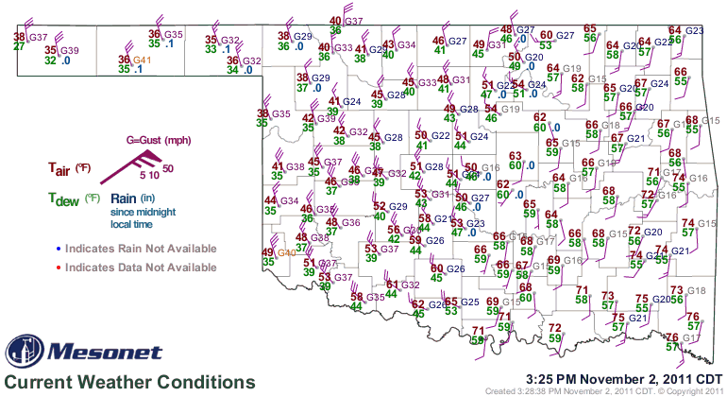

Slide 4
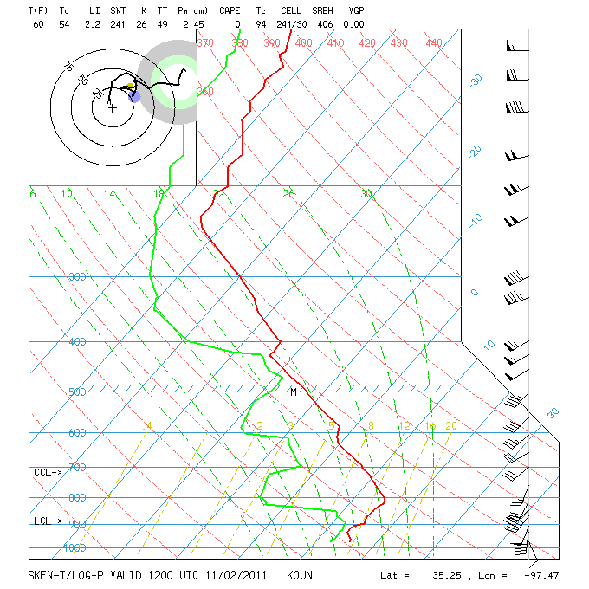

Slide 5
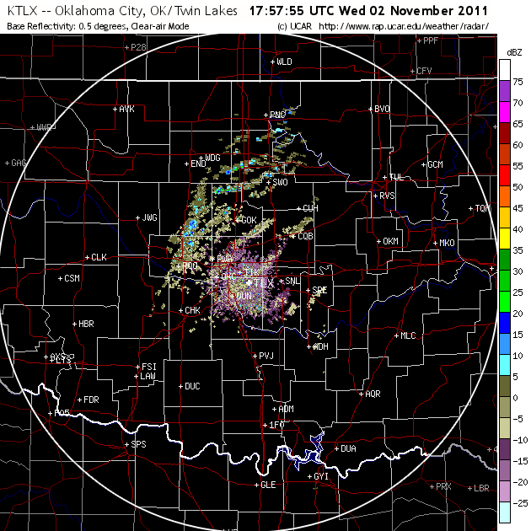

Slide 6
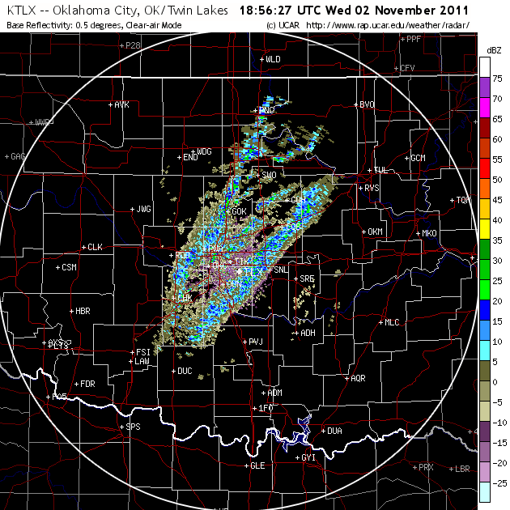

Slide 7
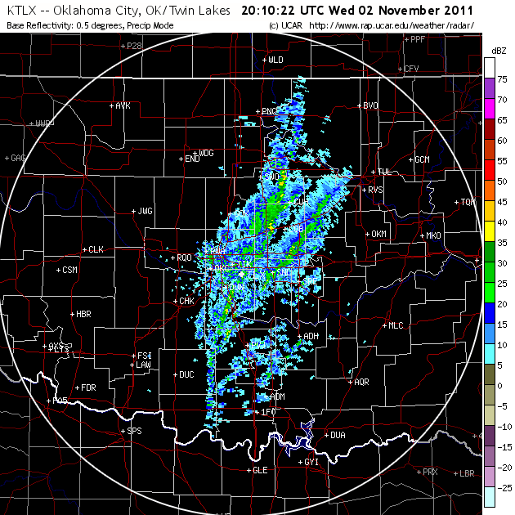

Slide 8
