Slide 1
BORES (YAWN!)

Slide 2
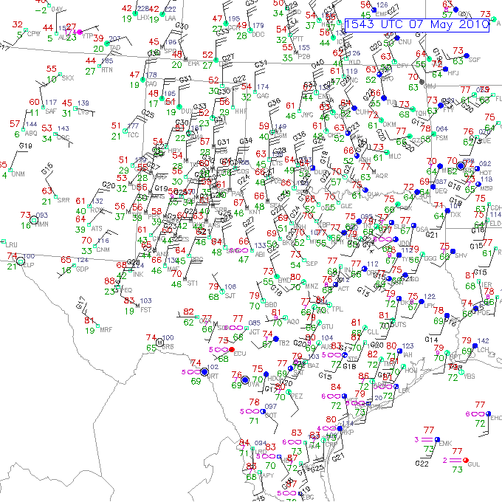

Slide 3
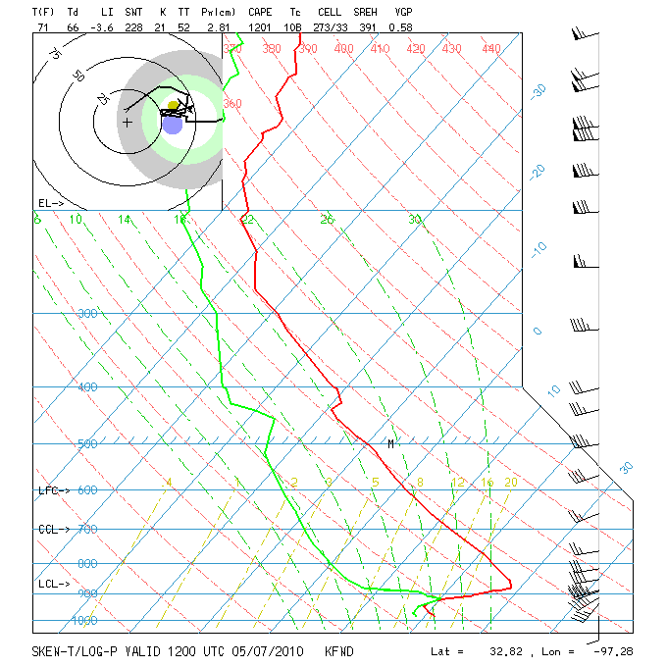

Slide 4
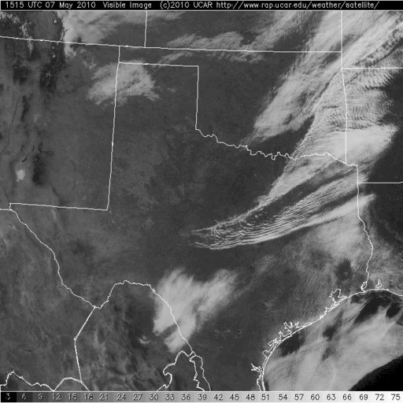

Slide 5
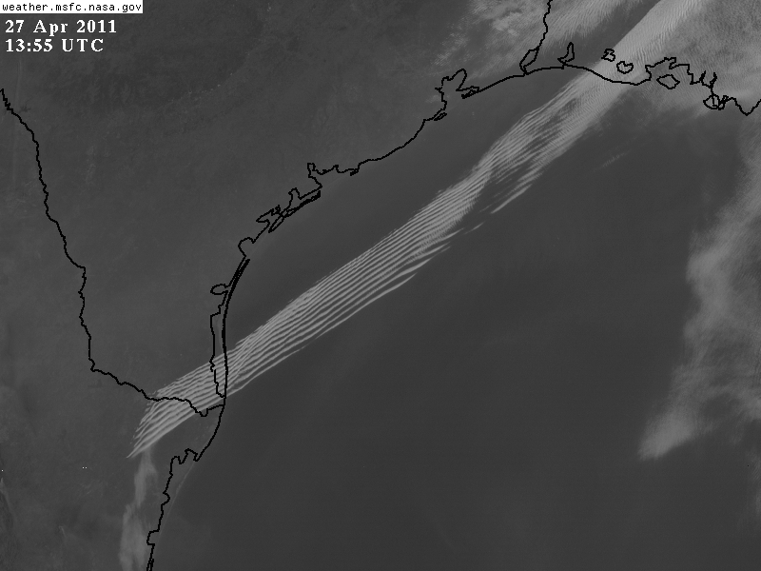

Slide 6
Christie et al. (1978)

Slide 7
Doviak and Ge (1984)

Slide 8
Doviak and Ge (1984)

Slide 9
Doviak and Ge (1984)

Slide 10
Rottman and Simpson (1989)

Slide 11
Koch et al. (1991)

Slide 12
Coleman et al. (2009)

Slide 13
Coleman et al. (2009)

Slide 14
Tanamachi et al. (2008)

Slide 15
Koch et al. (2008)

Slide 16
Koch et al. (2008)

Slide 17
Koch et al. (2008)

