Slide 1
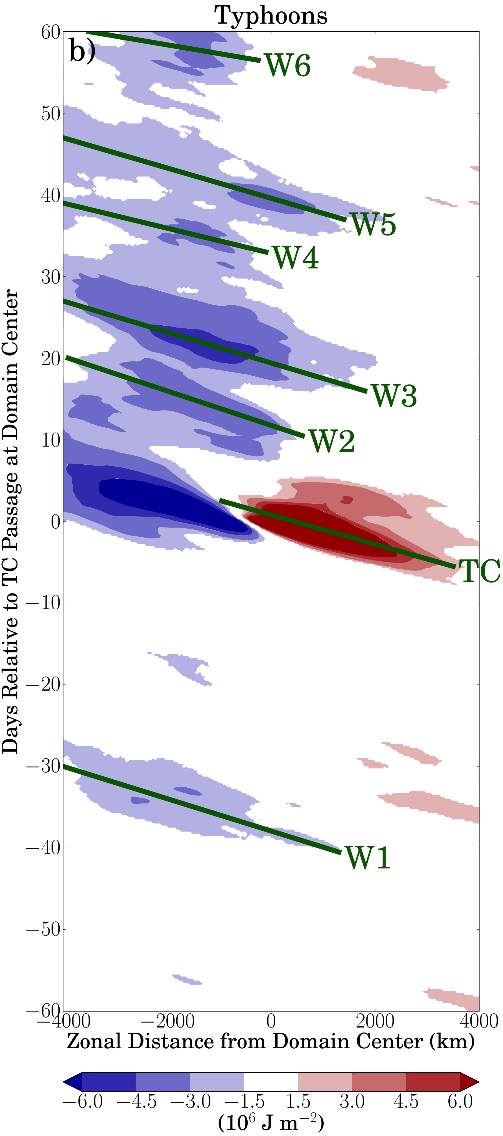
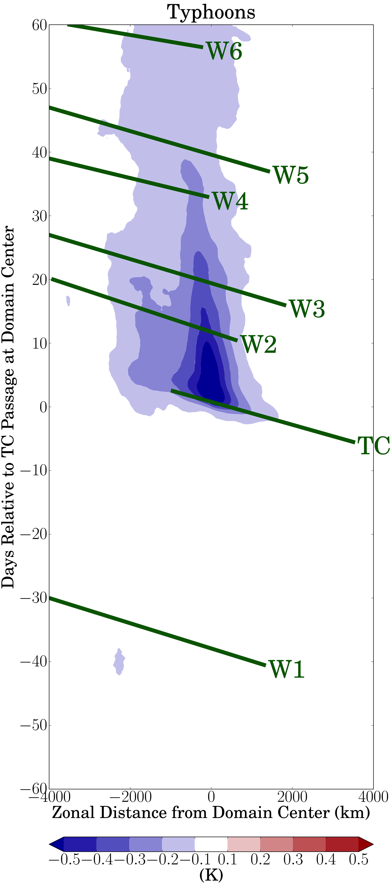
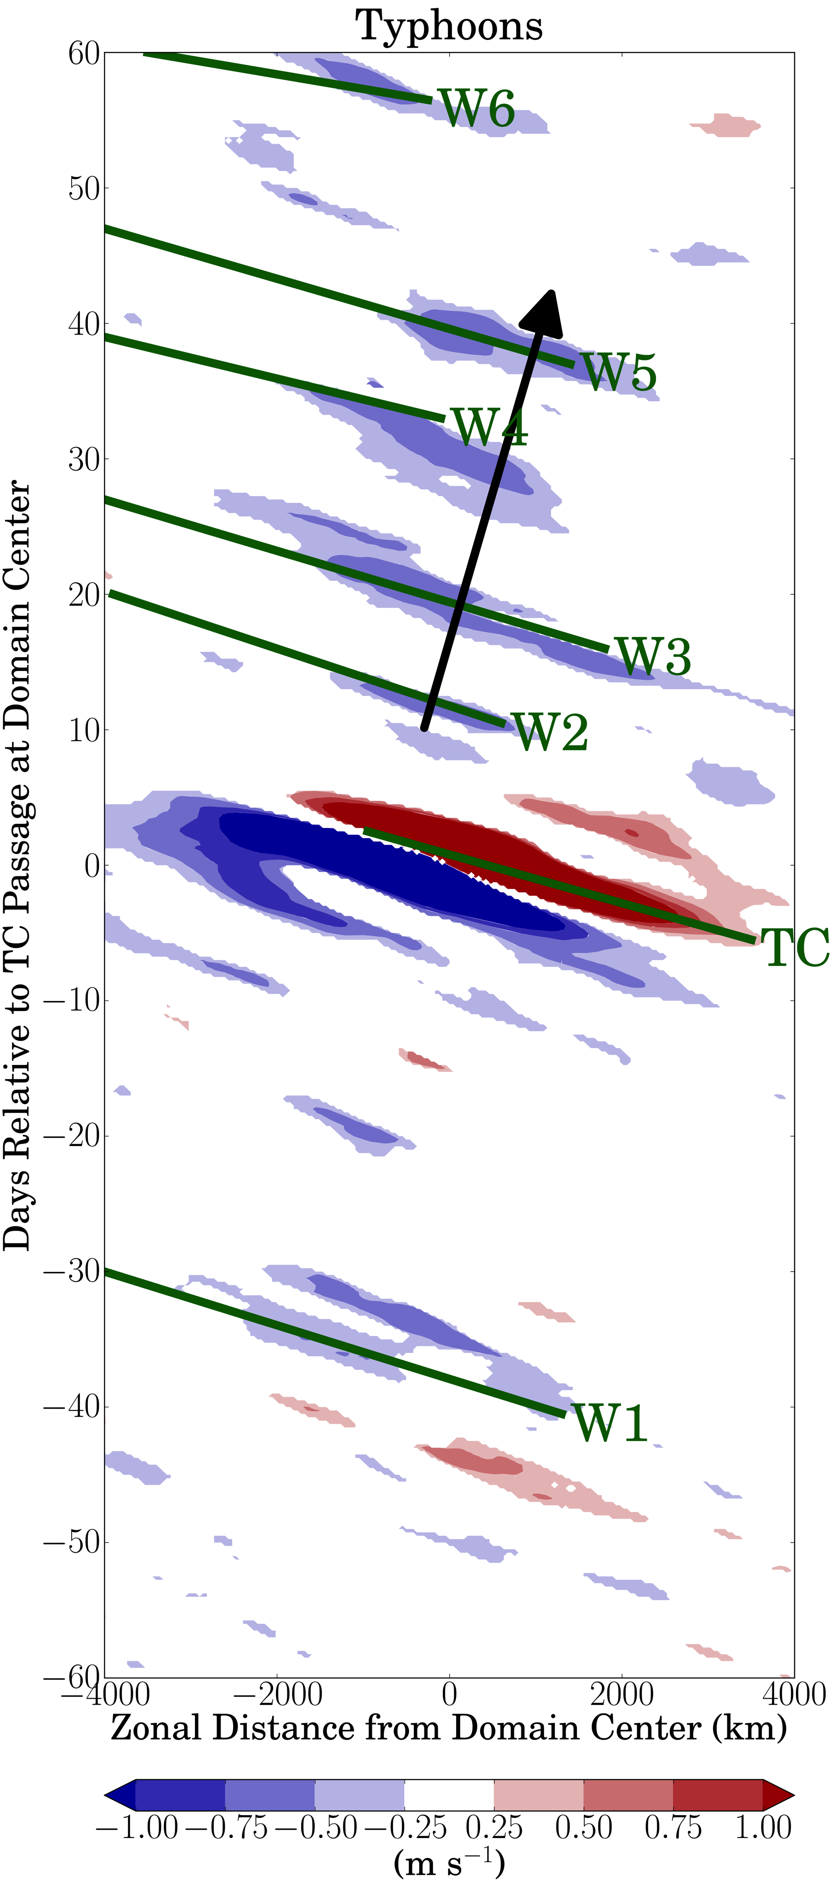
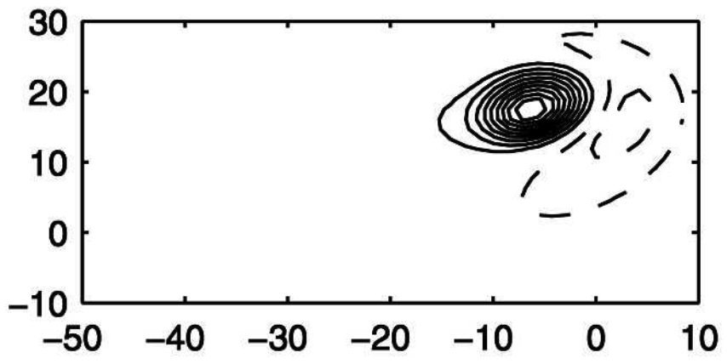
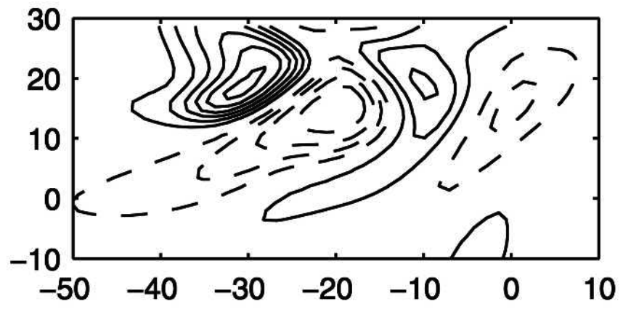
A Composite Analysis of the Environmental Memory of Tropical Cyclone Events
Ben Schenkel¹ (benschenkel@gmail.com) and Robert E. Hart²
1: Princeton University, 2: Florida State University
AMS Tropical Poster: 186
1. Introduction
3. Results: Time-Longitude Structure of Environmental Memory
5. Results: Sensitivity of Environmental Memory to TC-induced Rossby Wave Dispersion
Motivation
Tropical cyclones (TCs) reduce sea surface temperatures (SSTs), on average, for over a month following TC passage (Fig. 1; Hart et al. 2007)
TCs may dry and cool atmosphere for weeks following TC passage due to reduced SSTs (Sobel and Camargo 2005) although uncertainties remain in atmospheric memory of TCs
Greater understanding of atmospheric TC memory may help refine potential role of TCs in climate
a)
Overview
Analysis of composited large-scale atmospheric and SST memory of TC passage using time-longitude plots
Overview
Subset composites into unfavorable and favorable conditions for TC-induced Rossby wave dispersion to determine their role in composited westward propagating anomalies in Figs. 1 and 3
Synopsis
Composites of TCs with unfavorable conditions for Rossby wave dispersion (N = 154 TCs) characterized by:
  Absence of negative MSE anomalies after TC passage (Fig. 6a)
  Smaller, weaker negative SST anomalies after TC passage suggest smaller TCs (Fig. 6c)
  Absence of westward propagating northerly anomalies after TC passage (Fig. 6e)
Composites of TCs with favorable conditions for Rossby wave dispersion (N = 201 TCs) characterized by:
  Enhanced negative MSE anomalies after TC passage (Fig. 6b)
  Larger, stronger negative SST anomalies after TC passage suggesting larger TCs (Fig. 6d)
  Enhanced northerly anomalies after TC passage (Fig. 6f) strengthen negative MSE anomalies through northerly advection of lower MSE into tropics (not shown)
Synopsis
Absence of large-scale atmospheric and SST anomalies prior to TC passage (Fig. 4a–c)
Large-scale negative MSE anomalies for up to two months following TC passage (Fig. 4a) with embedded westward propagating enhancements of negative MSE anomalies (W2–W6 in Fig. 4a)
Large-scale negative SST anomalies induced by TC (Fig. 4b) force negative MSE anomalies through reduced surface fluxes (not shown)
Westward propagating northerly anomalies (W2–W6 in Fig. 4a) with eastward group velocity following TC passage (black arrow in Fig. 4c) coincident with enhanced negative MSE anomalies (Fig. 4a)
b)
Objectives
Quantify atmospheric environmental memory of TC passage
Identify salient processes and phenomena responsible for generation of atmospheric environmental memory
a)
Vertically Integrated MSE Anomalies
c)
SST Anomalies
e)
850-hPa Meridional Wind Anomalies
b)
d)
f)
Vertically Integrated MSE Anomalies
SST Anomalies
850-hPa Meridional Wind Anomalies
a)
b)
c)
Fig. 1: Plan view of SST anomalies (K) from NASA OI SSTs (a) during and (b) one month after Hurricane Sandy’s dissipation. Black line denotes Hurricane Sandy’s track and the green circle denotes negative SST anomalies induced by Hurricane Sandy.
2. Data and Methods
Data
WPAC typhoons (max 10-m wind ≥ 64 kt) at or equatorward of 20°N during 1979–2010 (N = 355 TCs) in JTWC Best-Track (Chu et al. 2002) are examined
TC and its environment represented using 6-h 0.5° × 0.5° NCEP
Climate Forecast System Reanalysis (Saha et al. 2010)
Typhoon Bilis (2000)
Methods
Storm-relative composites of vertically integrated surface to 100-hPa moist static energy (MSE) anomalies, SST anomalies, and 850-hPa meridional wind anomalies are presented with example [TC Bilis (2000)] provided in Figs. 2–3
Anomalies computed relative to temporally evolving 6-h climatology
10,000-sample bootstrap approach with replacement used for statistical significance testing at 95% confidence interval using two-tailed test to determine whether anomalies are different from zero
Fig. 6: Time-longitude plot of composited vertically-integrated surface to 100-hPa MSE anomalies (10⁶ J m⁻²) for TCs with (a) unfavorable conditions and (b) favorable conditions for Rossby wave dispersion, SST anomalies (K) for TCs with (c) unfavorable conditions and (d) favorable conditions for Rossby wave dispersion, and 850-hPa meridional wind anomalies (m s⁻¹) for TCs with (e) unfavorable conditions and (f) favorable conditions for Rossby wave dispersion meridionally-averaged from 250 km south and north of TC passage. TC and W1–W7 labels denote TC and westward propagating MSE anomalies. Anomalies are only shown if they are statistically significantly different from zero at the 95% confidence interval. Black arrow depicts group velocity direction for westward propagating anomalies in panel 6f.
Fig. 4: Time-longitude plot of composited (a) vertically-integrated surface to 100-hPa MSE anomalies (10⁶ J m⁻²), (b) SST anomalies (K), and (c) 850-hPa meridional wind anomalies (m s⁻¹) meridionally-averaged from 250 km south and north of TC passage. TC and W1–W6 labels denote TC and westward propagating MSE and meridional wind anomalies. Anomalies are shown if they are statistically significantly different from zero at the 95% confidence interval. Black arrow depicts group velocity direction for westward propagating anomalies.
7. Summary and Discussion
8. Acknowledgments
Subset of TCs, likely large TCs, induce negative MSE anomalies and trigger Rossby waves following TC passage (Fig. 7a)
Large TCs induce negative MSE anomalies due to:
  Excitation of broad region of negative SST anomalies reducing surface fluxes into atmosphere
  Northerly advection of lower MSE into tropics due to Rossby waves dispersed by TCs
Subset of TCs, likely small TCs, do not induce significant MSE anomalies and do not trigger Rossby waves following TC passage (Fig. 7b)
Results suggest initial atmospheric state during TC passage determines strength of environmental TC memory by influencing both Rossby wave dispersion from TC and TC size
This research is sponsored by an NASA Graduate Fellowship, NSF Grant ATM-0842618, and NSF AGS Postdoctoral Fellowship. The author thanks three anonymous reviewers, Daniel Voss of KU, Brian Tang of SUNY/Albany, Ming Cai of FSU, Bill Dewar of FSU, Paul Roundy of SUNY/Albany, Michael Bosilovich of NASA/GSFC, Lance Bosart of SUNY/Albany, Naoko Sakaeda of NOAA/ESRL, and Ryan Truchelut of TigerWx for fruitful discussions.
-------------------------------------------------------------
Hart, R., R. Maue, and M. Watson, 2007: Estimating local memory of tropical cyclones through MPI anomaly evolution. MWR, 135, 3990–4005.
Krouse, K., Sobel, A., and L. M. Polvani, 2008: On the wavelength of the Rossby waves radiated by tropical cyclones. JAS, 65, 644–654.
Krouse, K. D., and A. H. Sobel, 2010: An observational study of multiple TC events in the western North Pacific. Tellus, 62A, 256–265.
Schenkel, B.A., and Hart, R.E., 2015: An Examination of the Thermodynamic Impacts of Western North Pacific TCs on Their Tropical Tropospheric Environment. J. Climate, 28, 7529–7560
Sobel, A., and S. Camargo, 2005: Influence of western North Pacific tropical cyclones on their large-scale environment. JAS, 62, 3396–3407.
4. Source of Westward Propagating Anomalies in Composites: TC-Induced Rossby waves
Example Domain for TC Bilis on 0600 UTC 21 August 2000
Synopsis
TC-induced Rossby wave dispersion triggered to east and south of TC by cyclonic circulation of TC
Rossby wave dispersion occurs for TCs moving westward at Rossby wave phase speed (Fig. 5) in environments with: 1) easterly vertical wind shear or 2) cyclonic horizontal wind shear
a)
Day 2
A
Distance from Domain Center (° Latitude)
b)
Day 11
A
C
A
Revised Methodology
Subset original composites into unfavorable (N = 154 TCs) and favorable (N = 201 TCs) conditions for TC-induced Rossby wave dispersion (Krouse and Sobel 2010) to determine if Rossby waves force westward propagating anomalies (W2–W6 in Figs. 1,3)
Fig. 3: Time-longitude plot of vertically integrated surface to 100-hPa MSE anomalies (10⁷ J m⁻²) for TC Bilis (2000) in Fig. 2. B, P, and W1–W5 labels denote TC Bilis, TC Prapiroon, and westward propagating negative MSE anomalies, respectively.
Distance from Domain Center (° Longitude)
Fig. 7: Schematic depicting salient factors for (a) significant and (b) non-significant environmental response that generally occurs for larger and smaller TCs, respectively. The darker blue shading denotes stronger negative MSE anomalies. The difference in the size of the TC symbol denotes differences in TC size between the two subsets. MJO+ denotes the convectively suppressed MJO.
Fig. 2: Example grid constructed for TC Bilis (2000) on 0600 UTC 21 August 2000. The black line denotes the track of TC Bilis, while the gray star denotes the example time of interest for which the example domain is centered upon in time and space. The green box denotes the 500 km meridional distance over which meridional averages are calculated for Fig. 3.
Fig. 5: Plan view of relative vorticity (10⁻⁵ s⁻¹) from shallow-water β-plane simulation of TC-like vortex propagating westward at Rossby wave phase speed during (a) day 2 and (b) day 11 (Krouse et al. 2008).

