Slide 1

A Composite Analysis of Cross-Equatorial Total Energy Transport by Tropical Cyclones
Benjamin A. Schenkel (bschenkel@albany.edu),
Lance F. Bosart, and Daniel Keyser
University at Albany, SUNY
17th Cyclone Workshop
10/30/15
Research Sponsored by NSF Atmospheric and Geospace Sciences Postdoctoral Research Fellowship

Slide 2
How do TCs Transport Total Energy Meridionally?
  Motivation
  Background
  Results
  Summary
Late NH Summer Zonal Mean Meridional Circulation
p
30°S
15°S
0
15°N
30°N
Cross-Equatorial Energy Transport by TCs Benjamin A. Schenkel University at Albany, SUNY 2/20

Slide 3
How do TCs Transport Total Energy Meridionally?
  Motivation
  Background
  Results
  Summary
Late NH Summer Zonal Mean Meridional Circulation with Tropical Cyclone (TC)
TC
p
30°S
15°S
0
15°N
30°N
Three potential mechanisms whereby TCs can transport total energy meridionally:
  Movement of TC from tropics into midlatitudes (e.g., Cordeira 2011)
Cross-Equatorial Energy Transport by TCs Benjamin A. Schenkel University at Albany, SUNY 2/20

Slide 4
How do TCs Transport Total Energy Meridionally?
  Motivation
  Background
  Results
  Summary
Late NH Summer Zonal Mean Meridional Circulation with Tropical Cyclone (TC)
TC
p
30°S
15°S
0
15°N
30°N
Three potential mechanisms whereby TCs can transport total energy meridionally:
  Movement of TC from tropics into midlatitudes (e.g., Cordeira 2011)
Cross-Equatorial Energy Transport by TCs Benjamin A. Schenkel University at Albany, SUNY 2/20

Slide 5
How do TCs Transport Total Energy Meridionally?
  Motivation
  Background
  Results
  Summary
Late NH Summer Zonal Mean Meridional Circulation with Tropical Cyclone (TC)
TC
p
30°S
15°S
0
15°N
30°N
Three potential mechanisms whereby TCs can transport total energy meridionally:
  Movement of TC from tropics into midlatitudes (e.g., Cordeira 2011)
  Lower-tropospheric meridional transport of latent energy and sensible heat by TC inflow
Cross-Equatorial Energy Transport by TCs Benjamin A. Schenkel University at Albany, SUNY 2/20

Slide 6
How do TCs Transport Total Energy Meridionally?
  Motivation
  Background
  Results
  Summary
Late NH Summer Zonal Mean Meridional Circulation with Tropical Cyclone (TC)
TC
p
30°S
15°S
0
15°N
30°N
Three potential mechanisms whereby TCs can transport total energy meridionally:
  Movement of TC from tropics into midlatitudes (e.g., Cordeira 2011)
  Lower-tropospheric meridional transport of latent energy and sensible heat by TC inflow
  Upper-tropospheric meridional transport of potential energy and sensible heat by TC outflow
Cross-Equatorial Energy Transport by TCs Benjamin A. Schenkel University at Albany, SUNY 2/20

Slide 7
How do TCs Transport Total Energy Meridionally?
  Motivation
  Background
  Results
  Summary
Late NH Summer Zonal Mean Meridional Circulation with Tropical Cyclone (TC)
TC
Goal: To examine whether significant cross-equatorial total energy transport occurs due to western North Pacific TCs
p
30°S
15°S
0
15°N
30°N
Three potential mechanisms whereby TCs can transport total energy meridionally:
  Movement of TC from tropics into midlatitudes (e.g., Cordeira 2011)
  Lower-tropospheric meridional transport of latent energy and sensible heat by TC inflow
  Upper-tropospheric meridional transport of potential energy and sensible heat by TC outflow
Cross-Equatorial Energy Transport by TCs Benjamin A. Schenkel University at Albany, SUNY 2/20

Slide 8
Outline
  Motivation
  Background
  Results
  Summary
  Background
Background
  Review of lower-tropospheric TC structure
  Review of upper-tropospheric TC structure
Results
  Spatial structure of cross-equatorial total energy transport by TCs and their environment
  Zonal integrals of cross-equatorial total energy transport by TCs and their environment
Summary and conclusions
Cross-Equatorial Energy Transport by TCs Benjamin A. Schenkel University at Albany, SUNY 3/20
Notes:
Insert case study into talk

Slide 9
Outline
  Motivation
  Background
  Results
  Summary
  Background
Background
  Review of lower-tropospheric TC structure
  Review of upper-tropospheric TC structure
Results
  Spatial structure of cross-equatorial total energy transport by TCs and their environment
  Zonal integrals of cross-equatorial total energy transport by TCs and their environment
Summary and conclusions
Cross-Equatorial Energy Transport by TCs Benjamin A. Schenkel University at Albany, SUNY 3/20
Notes:
Insert case study into talk

Slide 10
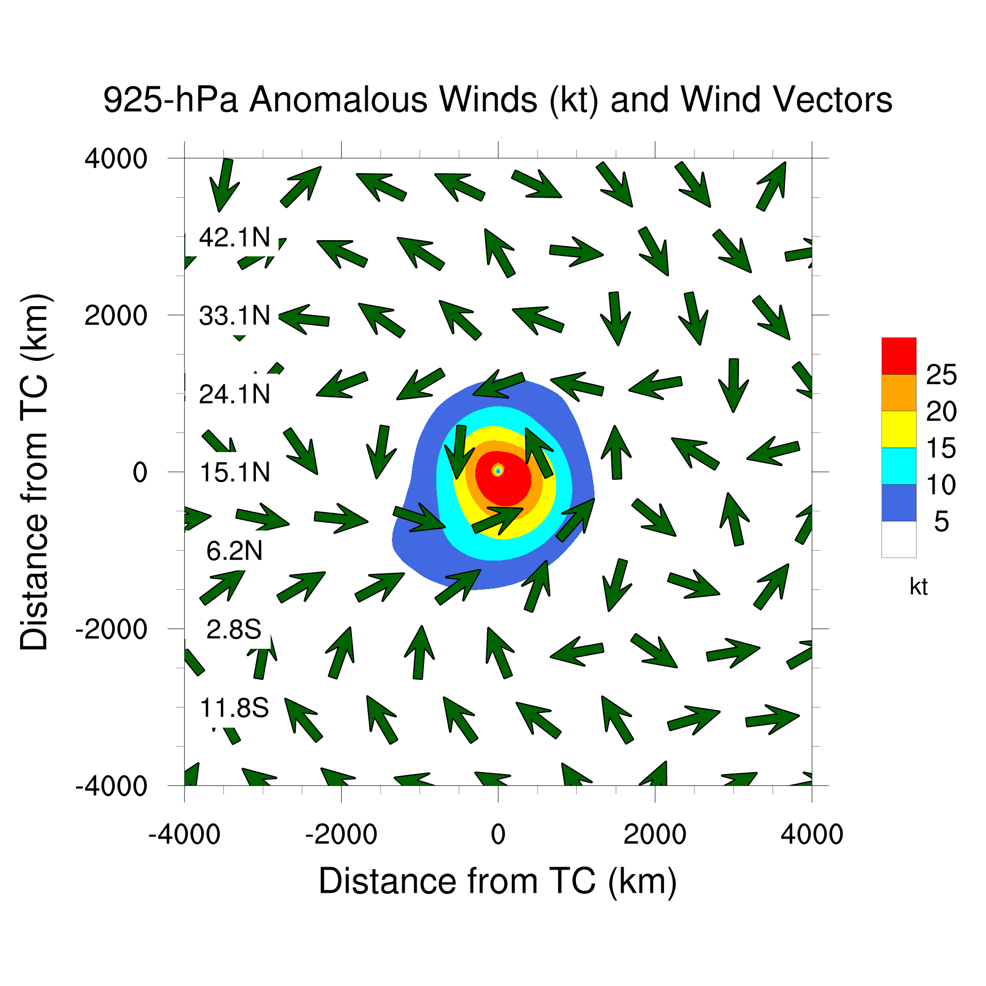
Review of TC Structure: Lower Troposphere
  Motivation
  Background
  Results
  Summary
  Background
Composite anomalies for JTWC Best-Track western North Pacific TCs equatorward of 20°N from 1979–2010 (N = 696 TCs) created from NCEP CFSR
Lower-tropospheric TC circulation is cyclonic and largely symmetric
TC circulation extends ~1500 km from TC center
Cross-Equatorial Energy Transport by TCs Benjamin A. Schenkel University at Albany, SUNY 4/20
Notes:
Insert case study into talk

Slide 11
Review of TC Structure: Lower Troposphere
  Motivation
  Background
  Results
  Summary
  Background
Weak northward total energy transport due to lower-tropospheric TC inflow across equator
Cross-Equatorial Energy Transport by TCs Benjamin A. Schenkel University at Albany, SUNY 4/20
Notes:
Insert case study into talk

Slide 12
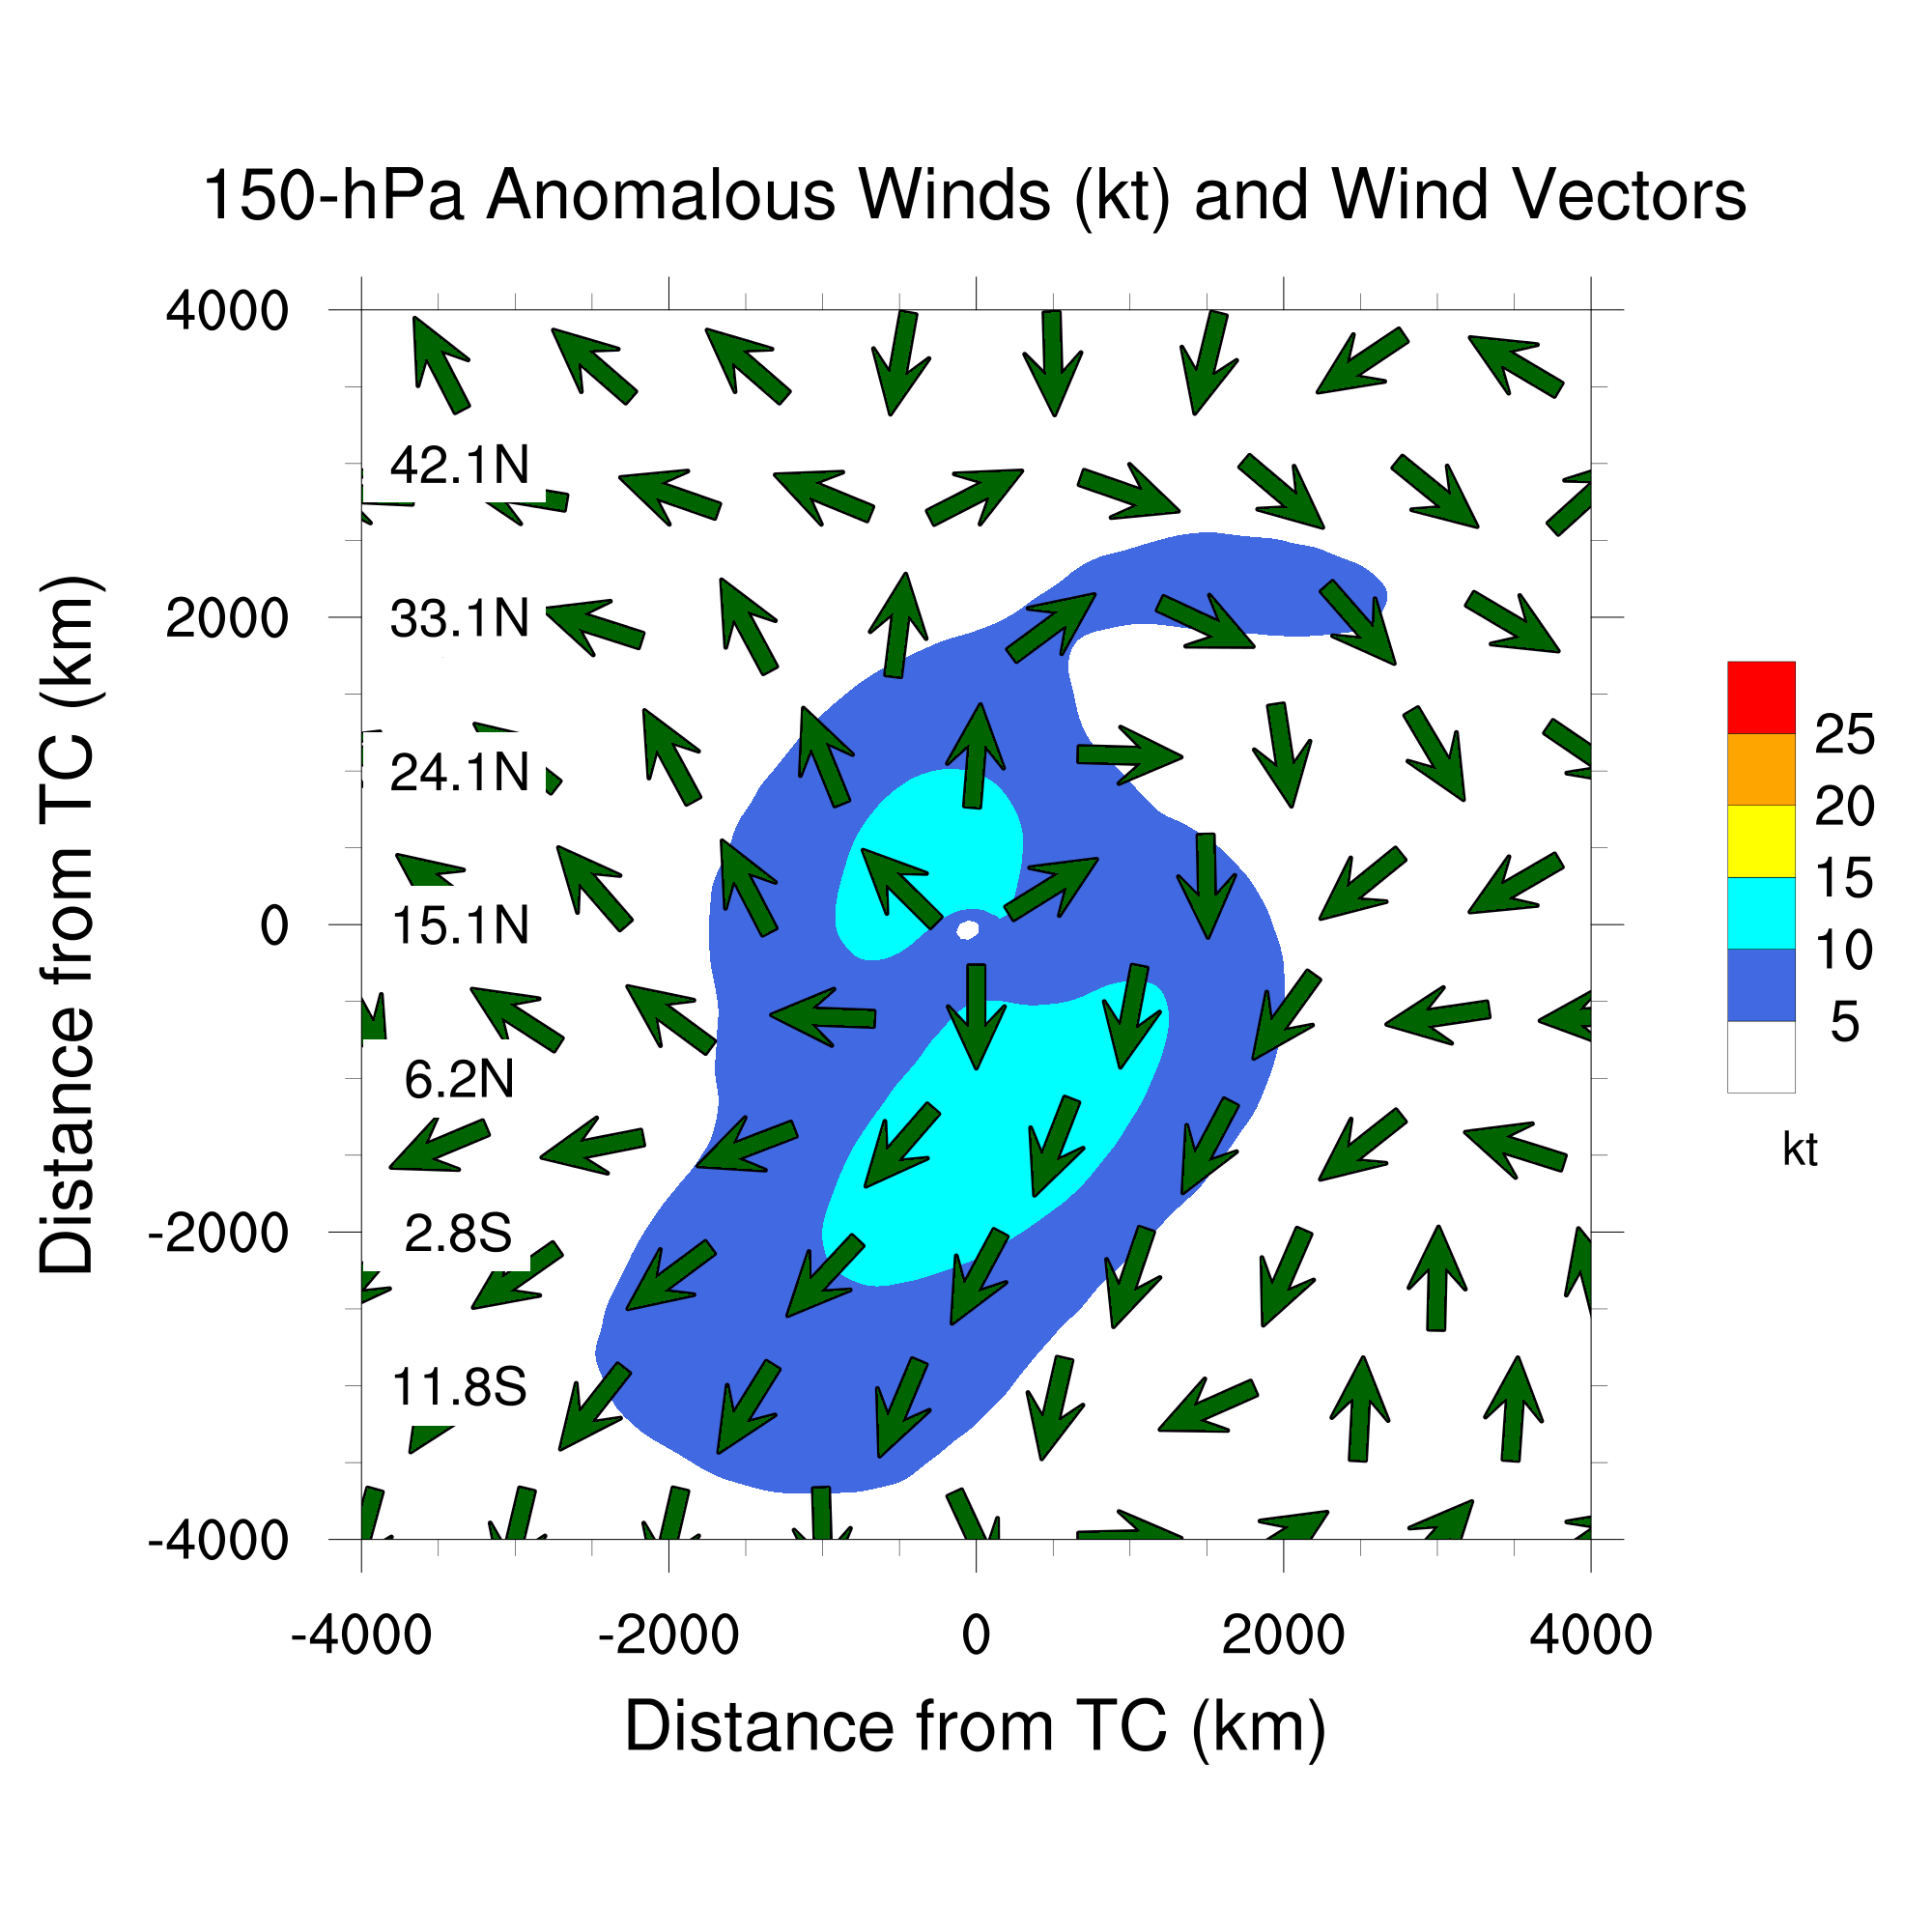
Review of TC Structure: Upper Troposphere
  Motivation
  Background
  Results
  Summary
  Background
Upper-tropospheric TC circulation is anticyclonic and asymmetric
TC circulation concentrated within two TC outflow jets
Equatorward outflow jet extends ~3000 km to south of TC
Strong southward total energy transport due to equatorward TC outflow jet across equator
Cross-Equatorial Energy Transport by TCs Benjamin A. Schenkel University at Albany, SUNY 5/20
Notes:
Insert case study into talk

Slide 13
Motivating Questions
  Motivation
  Background
  Results
  Summary
  Background
Are western North Pacific TCs responsible for significant cross-equatorial transport of total energy?
How do western North Pacific TCs transport total energy across the equator?
Does the large-scale environment compensate for cross-equatorial transport of total energy by western North Pacific TCs?
Do western North Pacific TCs constitute a significant fraction of aggregate cross-equatorial total energy transport during NH summer and fall?
In the interest of brevity, this presentation will focus on addressing questions #1–3.
Cross-Equatorial Energy Transport by TCs Benjamin A. Schenkel University at Albany, SUNY 6/20

Slide 14
Outline
  Motivation
  Background
  Results
  Summary
  Background
Background
  Review of lower-tropospheric TC structure
  Review of upper-tropospheric TC structure
Results
  Spatial structure of cross-equatorial total energy transport by TCs and their environment
  Zonal integrals of cross-equatorial total energy transport by TCs and their environment
Summary and conclusions
Cross-Equatorial Energy Transport by TCs Benjamin A. Schenkel University at Albany, SUNY 7/20
Notes:
Insert case study into talk

Slide 15
  Motivation
  Background
  Results
  Summary
Methodology: Quantifying Cross-Equatorial Total Energy Transport by TCs
Three-dimensional composites centered on TC longitude are used to evaluate mean cross-equatorial total energy transport by TCs
    Composites are constructed using NCEP CFSR (Saha et al. 2010) for Best-Track TCs (maximum 10-m wind speed ≥ 34 kt; Chu et al. 2002) over the western North Pacific at or equatorward of 20°N during 1979–2010 (N = 696 TCs)
    Composites of anomalies are used to isolate role of TCs in meridional total energy transport
Cross-Equatorial Energy Transport by TCs Benjamin A. Schenkel University at Albany, SUNY 8/20

Slide 16
  Motivation
  Background
  Results
  Summary
Methodology: Quantifying Cross-Equatorial Total Energy Transport by TCs
Composite meridional total energy transport (Trenberth et al. 1997) used to assess role of TCs in cross-equatorial total energy transport:
Term 1: Vertically integrated meridional total energy transport
Term 2: Vertically integrated meridional kinetic energy transport
Term 3: Vertically integrated meridional latent energy transport
Term 4: Vertically integrated meridional sensible heat transport
Term 5: Vertically integrated meridional potential energy transport
(1)
(2)
(3)
(4)
(5)
Cross-Equatorial Energy Transport by TCs Benjamin A. Schenkel University at Albany, SUNY 9/20

Slide 17
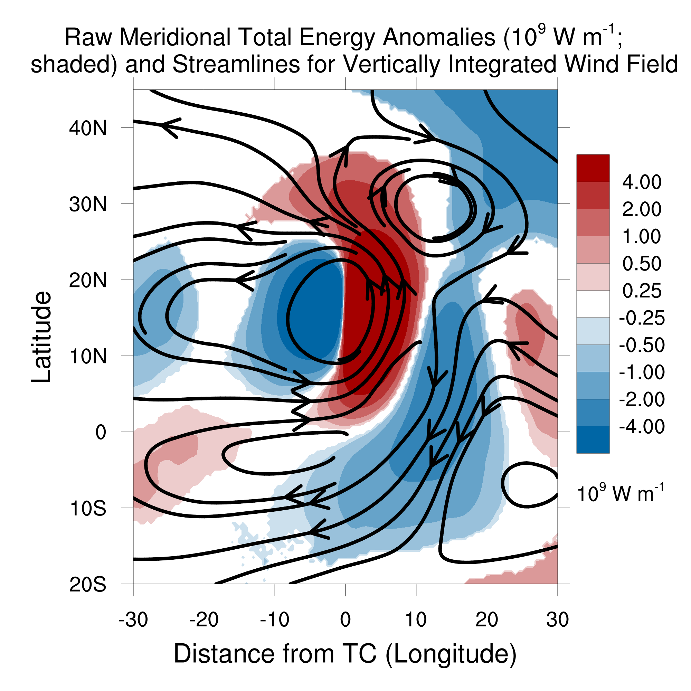
  Motivation
  Background
  Results
  Summary
Vertically Integrated Meridional Total Energy Transport by TCs
Meridional Total Energy Transport Anomalies (10⁹ W m⁻¹;
shaded) and Streamlines for Vertically Integrated Wind Field
Meridional total energy transport anomalies due to TCs result from:
Northward
transport
Southward
transport
Cross-Equatorial Energy Transport by TCs Benjamin A. Schenkel University at Albany, SUNY 10/20

Slide 18
  Motivation
  Background
  Results
  Summary
Vertically Integrated Meridional Total Energy Transport by TCs
Meridional Total Energy Transport Anomalies (10⁹ W m⁻¹;
shaded) and Streamlines for Vertically Integrated Wind Field
Meridional total energy transport anomalies due to TCs result from:
Cyclonic circulation of TC
Northward
transport
Southward
transport
Cross-Equatorial Energy Transport by TCs Benjamin A. Schenkel University at Albany, SUNY 10/20

Slide 19
  Motivation
  Background
  Results
  Summary
Vertically Integrated Meridional Total Energy Transport by TCs
Meridional Total Energy Transport Anomalies (10⁹ W m⁻¹;
shaded) and Streamlines for Vertically Integrated Wind Field
Meridional total energy transport anomalies due to TCs result from:
Cyclonic circulation of TC
Upper-tropospheric equatorward outflow jet on southeastern flank of anticyclonic TC circulation
Northward
transport
Southward
transport
Cross-Equatorial Energy Transport by TCs Benjamin A. Schenkel University at Albany, SUNY 10/20

Slide 20
  Motivation
  Background
  Results
  Summary
Vertically Integrated Meridional Total Energy Transport by TCs
Meridional Total Energy Transport Anomalies (10⁹ W m⁻¹;
shaded) and Streamlines for Vertically Integrated Wind Field
Meridional total energy transport anomalies due to TCs result from:
Cyclonic circulation of TC
Upper-tropospheric equatorward outflow jet on southeastern flank of anticyclonic TC circulation
Equatorward outflow jet of TC is dominant source of anomalous cross-equatorial total energy transport
Northward
transport
Southward
transport
Next, meridional total energy transport anomalies in environment outside of TC are examined using domain extending across all longitudes
Cross-Equatorial Energy Transport by TCs Benjamin A. Schenkel University at Albany, SUNY 10/20
Notes:
Tidy up last bullet point on this slide

Slide 21
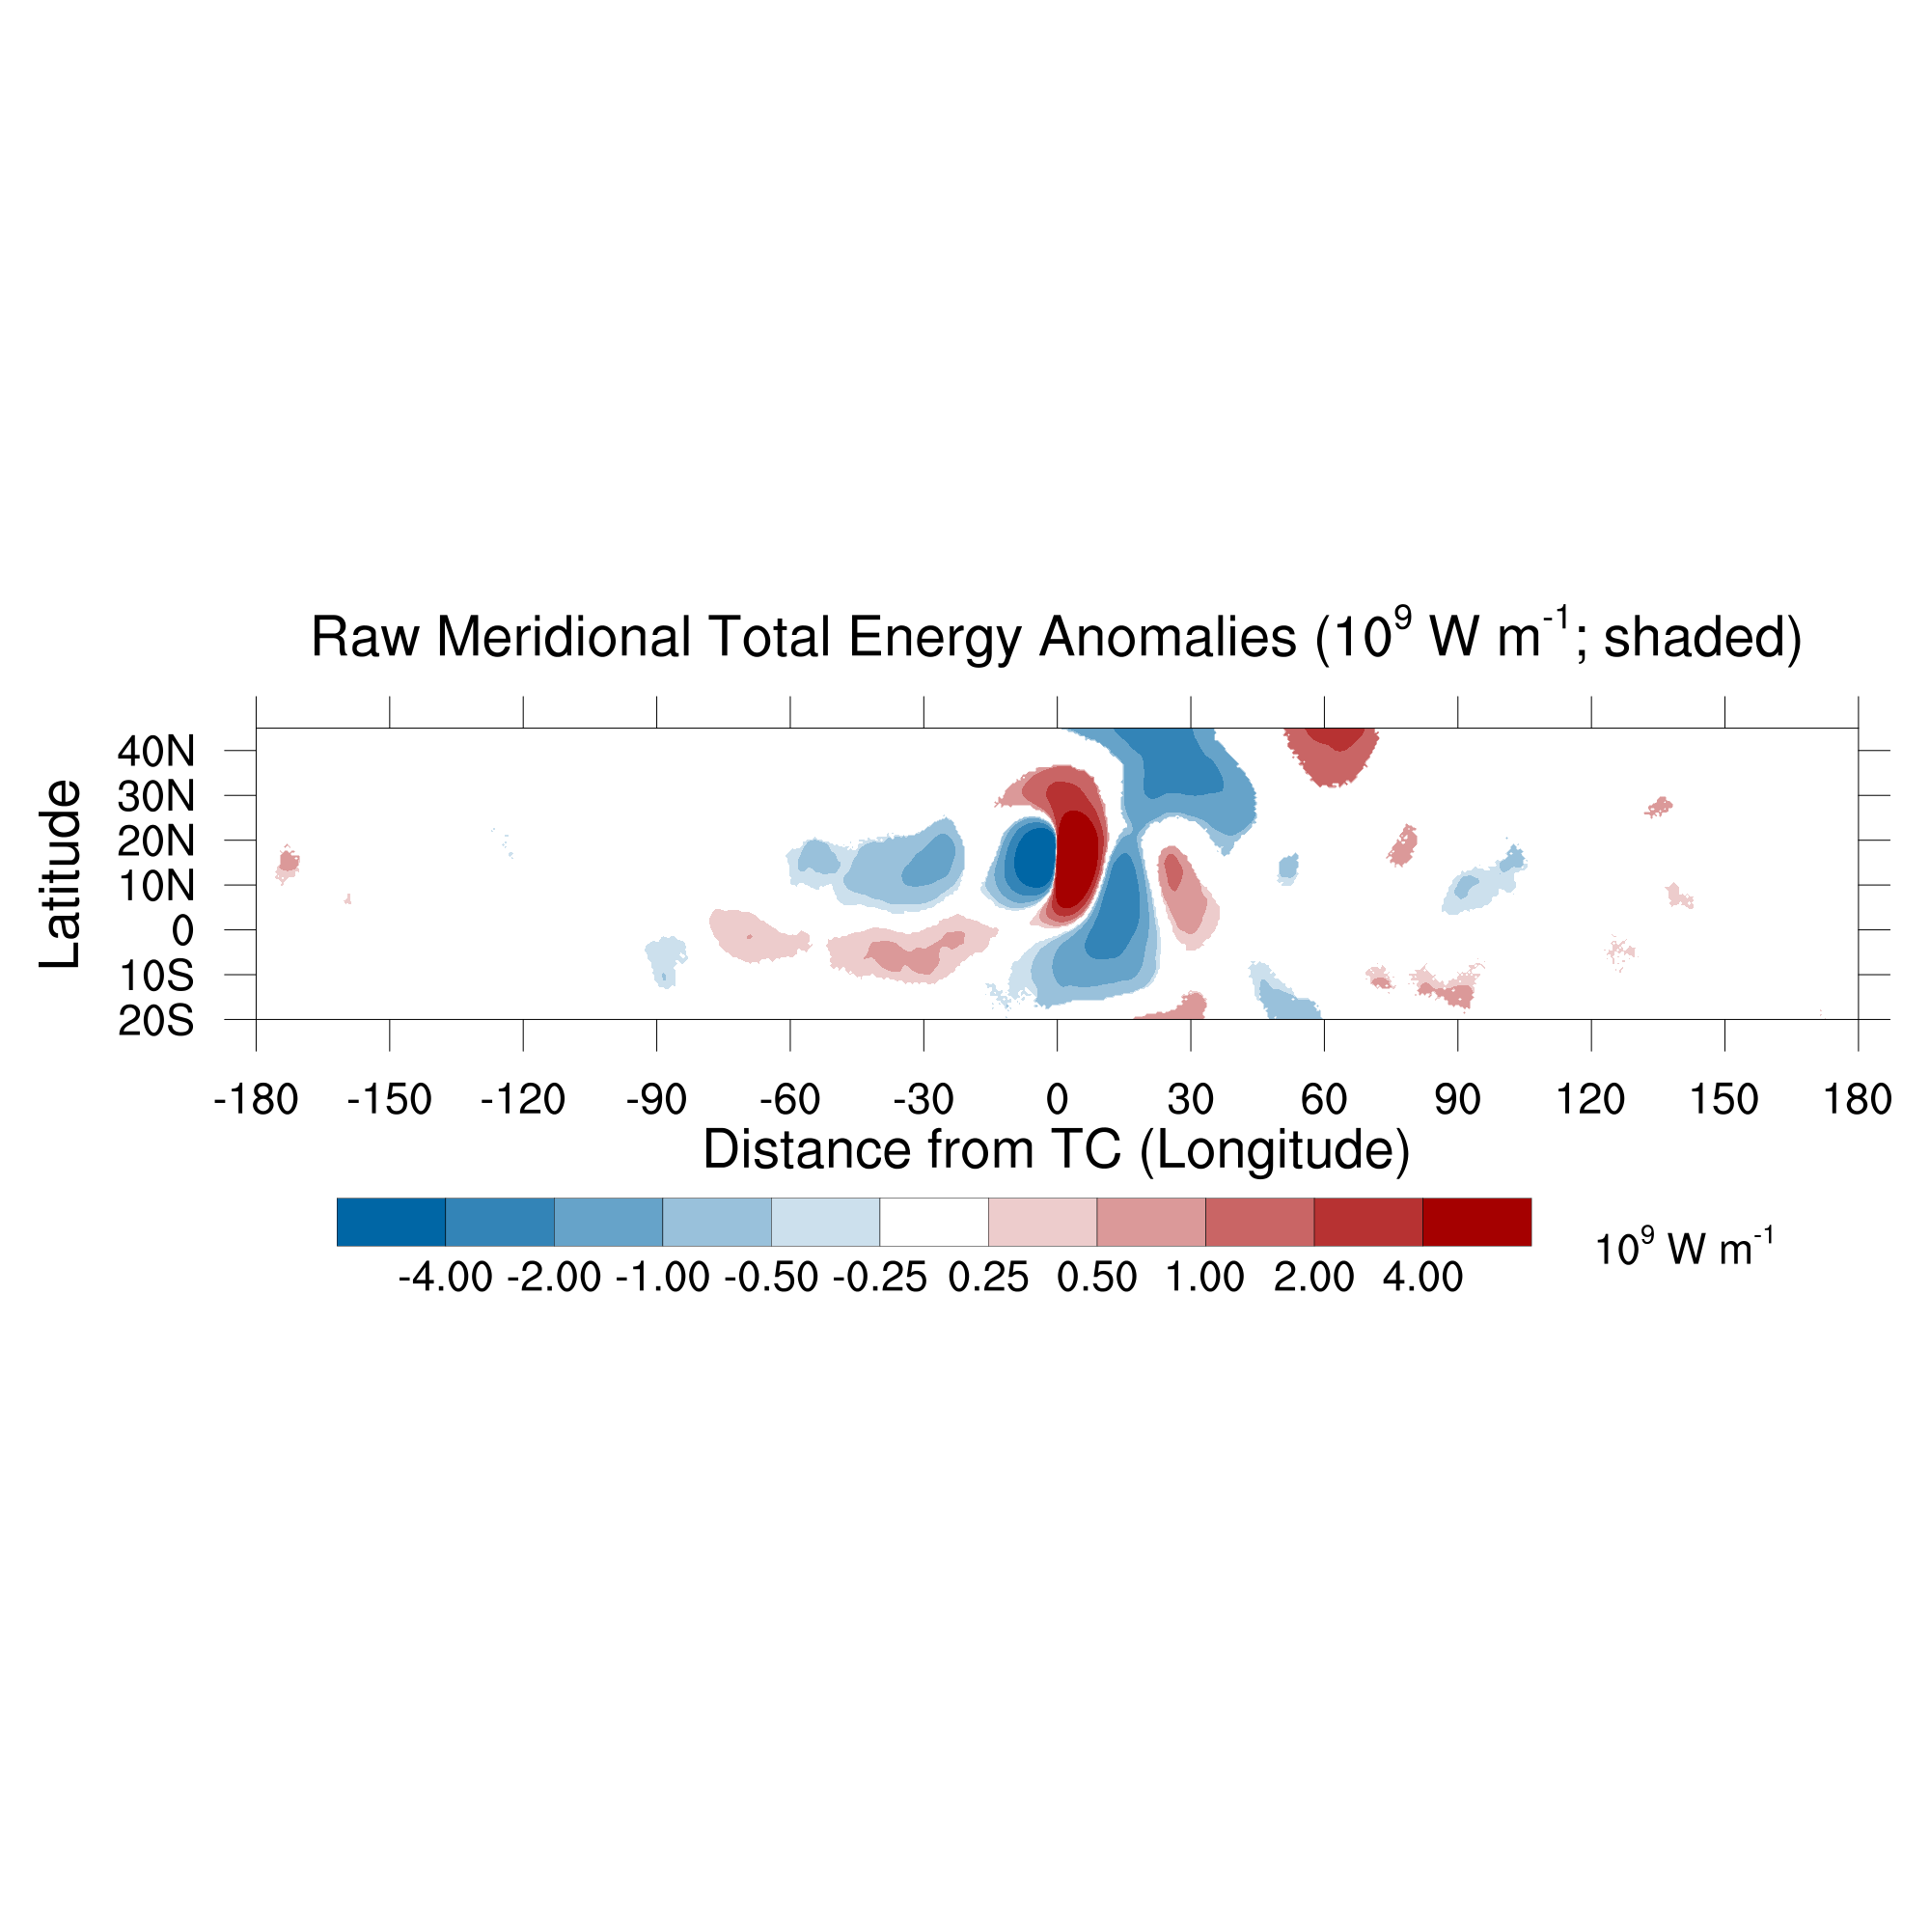
Global Structure of Meridional Total Energy Transport Anomalies
  Motivation
  Background
  Results
  Summary
Meridional Total Energy Transport Anomalies (10⁹ W m⁻¹; shaded)
Southward transport
Northward transport
Equatorward outflow jet of TC is dominant source of anomalous cross-equatorial total energy transport
Broad region of weak northward total energy transport anomalies to southwest of TC countering southward transport by TC
Cross-Equatorial Energy Transport by TCs Benjamin A. Schenkel University at Albany, SUNY 11/20
Notes:
Form of energy

Slide 22
Global Structure of Meridional Total Energy Transport Anomalies
  Motivation
  Background
  Results
  Summary
Meridional Total Energy Transport Anomalies (10⁹ W m⁻¹; shaded)
To quantify meridional total energy transport anomalies across equator by TC and its environment, composites are zonally integrated over three regions:
  TC and its immediate environment (Near TC)
  Environment outside of TC (Outside TC)
  All longitudes including TC and its outer environment (Total)
Southward transport
Northward transport
Absence of significant meridional transports outside of TC within composites suggesting TC is dominant feature
Cross-Equatorial Energy Transport by TCs Benjamin A. Schenkel University at Albany, SUNY 11/20

Slide 23
Global Structure of Meridional Total Energy Transport Anomalies
  Motivation
  Background
  Results
  Summary
Meridional Total Energy Transport Anomalies (10⁹ W m⁻¹; shaded)
To quantify meridional total energy transport anomalies across equator by TC and its environment, composites are zonally integrated over three regions:
  TC and its immediate environment (Near TC)
  Environment outside of TC (Outside TC)
  All longitudes including TC and its outer environment (Total)
Absence of significant meridional transports outside of TC within composites suggesting TC is dominant feature
Cross-Equatorial Energy Transport by TCs Benjamin A. Schenkel University at Albany, SUNY 11/20

Slide 24
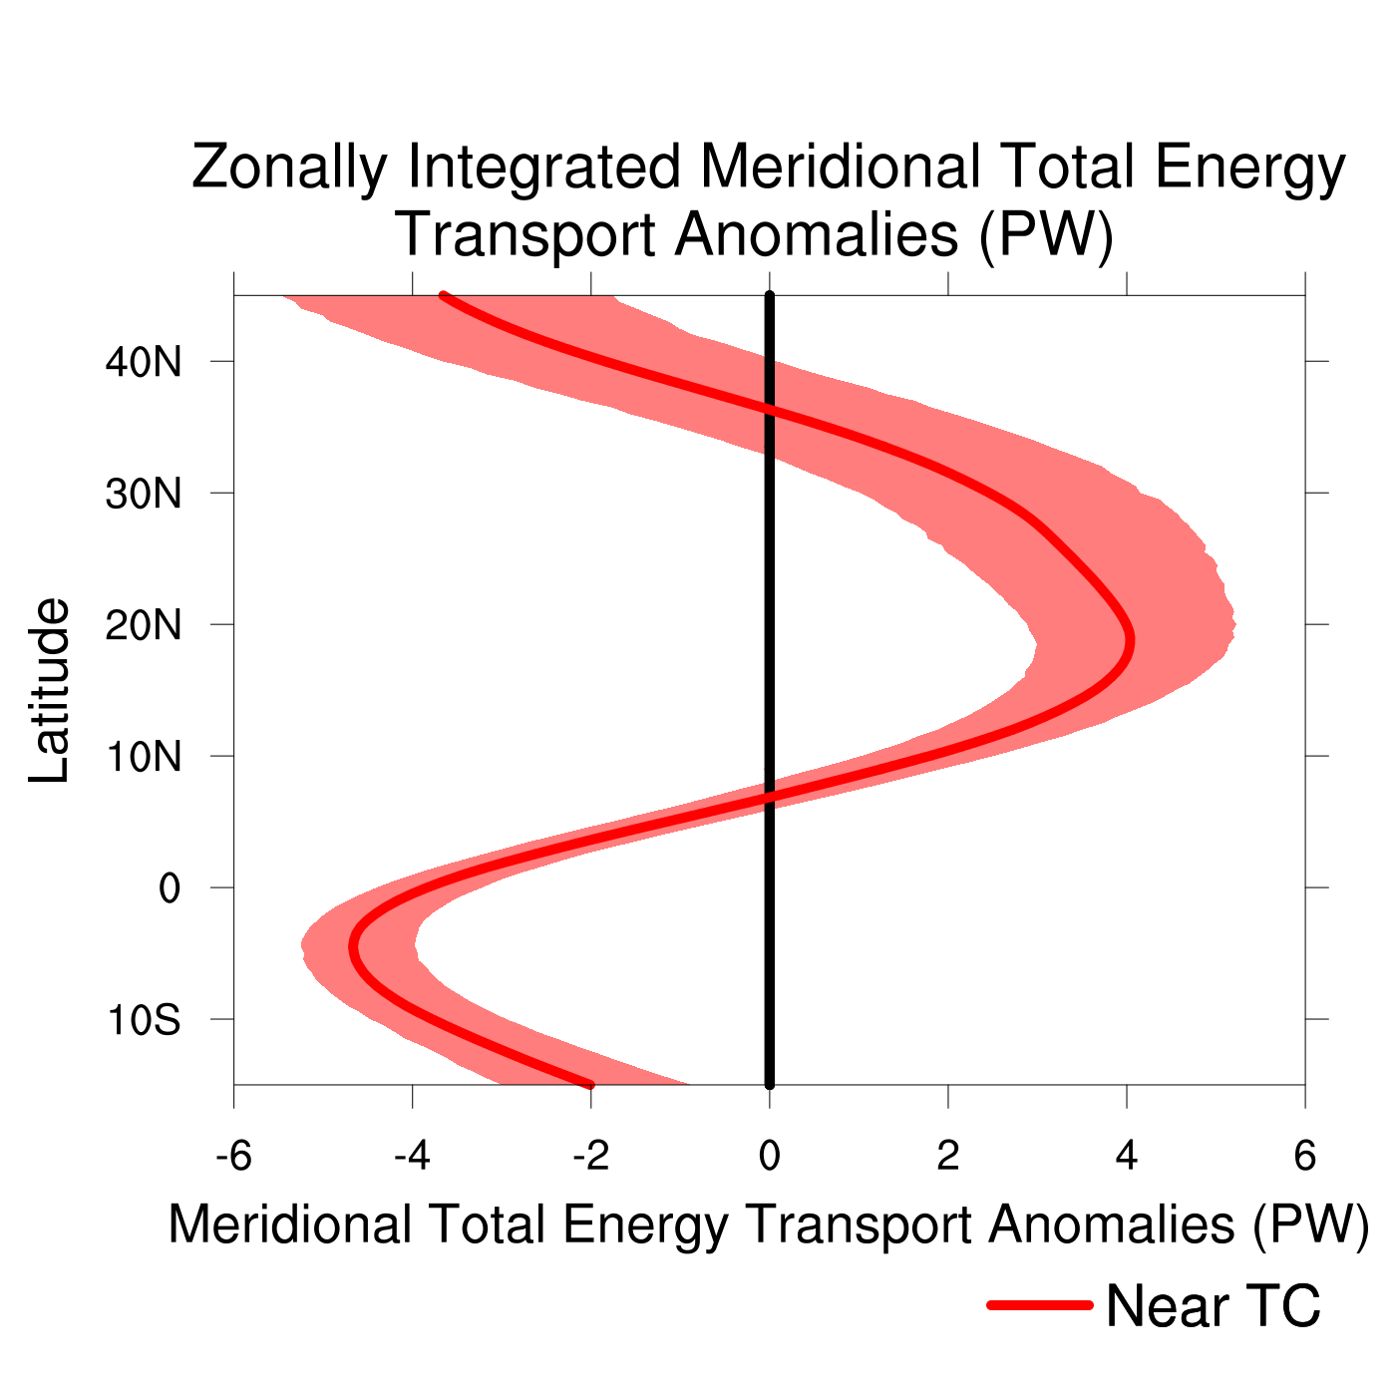
Quantifying Meridional Total Energy Transport by TCs in a Global Context
  Motivation
  Background
  Results
  Summary
Significant anomalous southward total energy transport at equator due to equatorward outflow jet of TC
large-scale response of environment to TC passage similar to TC Yuri
Cross-Equatorial Energy Transport by TCs Benjamin A. Schenkel University at Albany, SUNY 12/20
Notes:
Inflow? And conclusion too wordy

Slide 25
Global Structure of Meridional Total Energy Transport Anomalies
  Motivation
  Background
  Results
  Summary
Meridional Total Energy Transport Anomalies (10⁹ W m⁻¹; shaded)
To quantify meridional total energy transport anomalies across equator by TC and its environment, composites are zonally integrated over three regions:
  TC and its immediate environment (Near TC)
  Environment outside of TC (Outside TC)
  All longitudes including TC and its outer environment (Total)
Absence of significant meridional transports outside of TC within composites suggesting TC is dominant feature
Cross-Equatorial Energy Transport by TCs Benjamin A. Schenkel University at Albany, SUNY 13/20

Slide 26
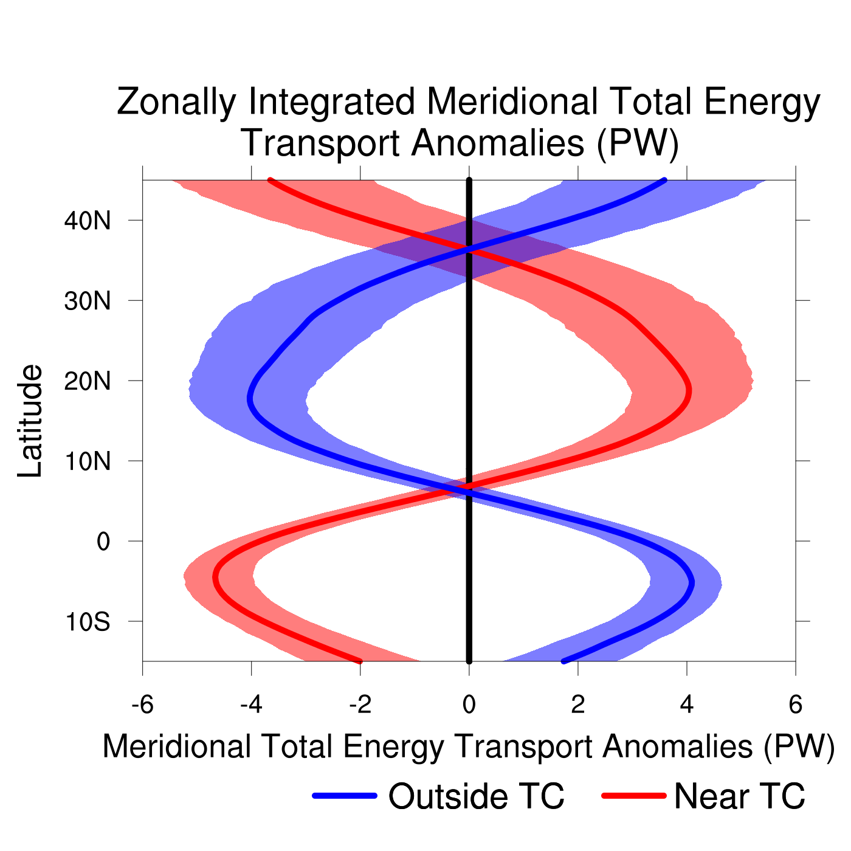
Quantifying Meridional Total Energy Transport by TCs in a Global Context
  Motivation
  Background
  Results
  Summary
Meridional total energy transport anomalies outside of TC nearly balance meridional total energy transport anomalies by TC
large-scale response of environment to TC passage similar to TC Yuri
Cross-Equatorial Energy Transport by TCs Benjamin A. Schenkel University at Albany, SUNY 14/20

Slide 27
Global Structure of Meridional Total Energy Transport Anomalies
  Motivation
  Background
  Results
  Summary
Meridional Total Energy Transport Anomalies (10⁹ W m⁻¹; shaded)
To quantify meridional total energy transport anomalies across equator by TC and its environment, composites are zonally integrated over three regions:
  TC and its immediate environment (Near TC)
  Environment outside of TC (Outside TC)
  All longitudes including TC and its outer environment (Total)
Absence of significant meridional transports outside of TC within composites suggesting TC is dominant feature
Cross-Equatorial Energy Transport by TCs Benjamin A. Schenkel University at Albany, SUNY 15/20

Slide 28
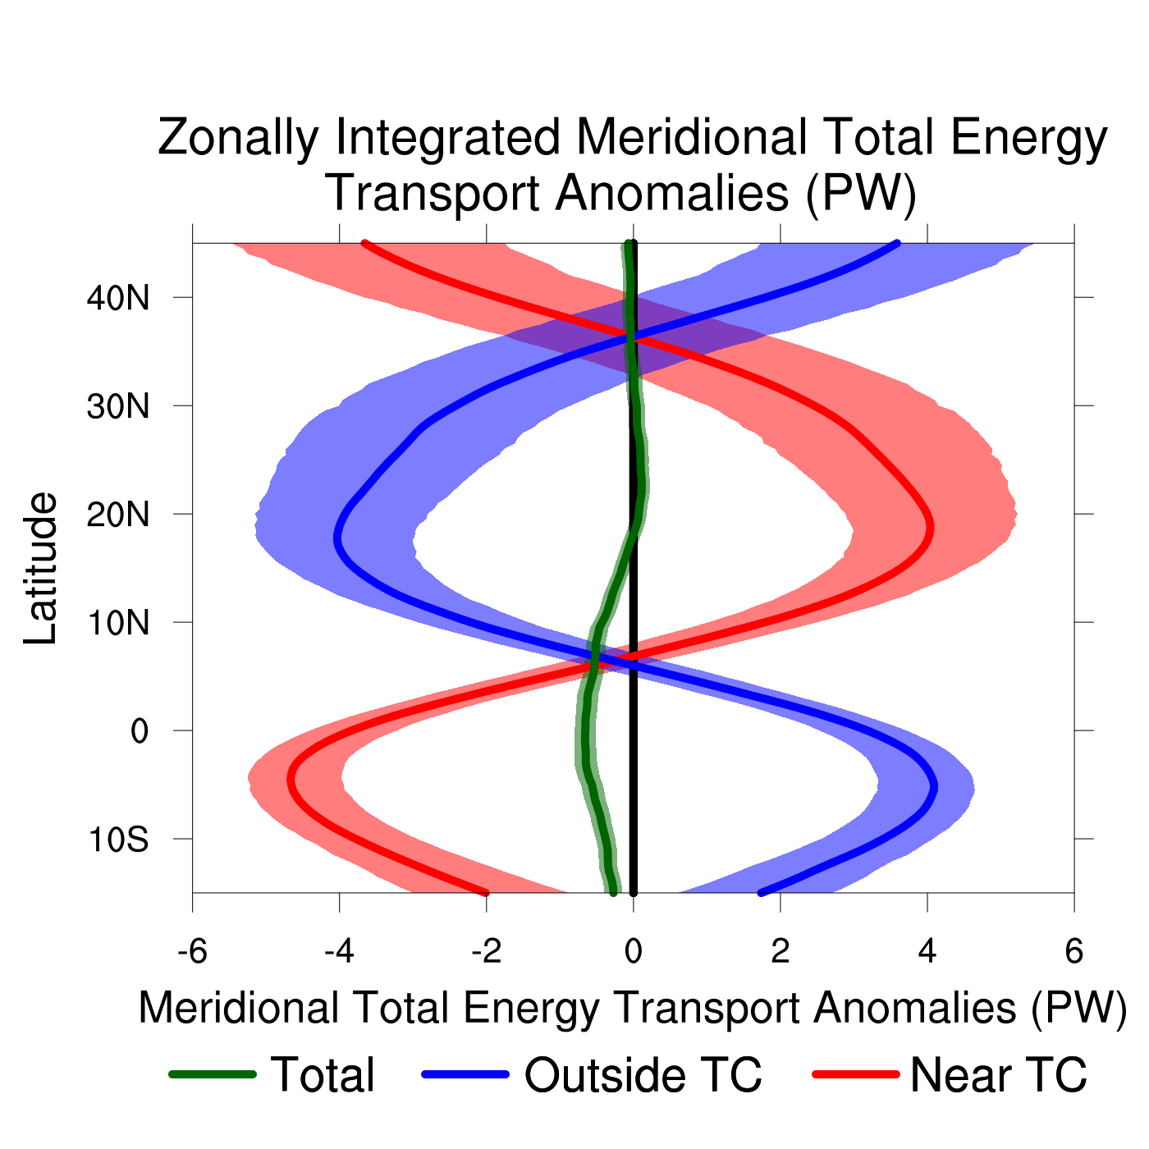
Quantifying Meridional Total Energy Transport by TCs in a Global Context
  Motivation
  Background
  Results
  Summary
Zonal integration over all longitudes yields significant southward transport anomalies of −0.5 PW near equator, suggesting transport by TCs is dominant
−0.5 PW southward energy transport anomalies by TC is large relative to −1 to −2 PW climatological southward energy transport near equator during NH summer and fall
large-scale response of environment to TC passage similar to TC Yuri
How does the zonal mean meridional circulation change in response to TC occurrence?
Cross-Equatorial Energy Transport by TCs Benjamin A. Schenkel University at Albany, SUNY 16/20

Slide 29
Global Structure of Meridional Total Energy Transport Anomalies
  Motivation
  Background
  Results
  Summary
Meridional Total Energy Transport Anomalies (10⁹ W m⁻¹; shaded)
Quantify TC impacts on zonal mean meridional circulation by computing total and anomalous zonal mean meridional streamfunction averaged over all longitudes (green box)
Cross-Equatorial Energy Transport by TCs Benjamin A. Schenkel University at Albany, SUNY 17/20

Slide 30
Enhanced Zonal Mean Meridional Circulation
  Motivation
  Background
  Results
  Summary
Total (black contours; 10⁶ kg s⁻¹) and Anomalous (shaded; 10⁶ kg s⁻¹) Zonal Mean Meridional Streamfunction
Broader, enhanced zonal mean meridional circulation in deep tropics during TC occurrence
Zonal mean meridional circulation anomalies due to TC and its upper-tropospheric equatorward outflow jet
10⁶ kg s⁻¹
Counterclockwise
Clockwise
Cross-Equatorial Energy Transport by TCs Benjamin A. Schenkel University at Albany, SUNY 18/20
Notes:
Check the units. Check definition of v, and omega relative to streamfunction. If streamfunction is defined in terms of dpsi/dp, then pressure should be plotted as linear scale in figure. Check the sign of the streamfunction.

Slide 31
Outline
  Motivation
  Background
  Results
  Summary
  Background
Background
  Review of lower-tropospheric TC structure
  Review of upper-tropospheric TC structure
Results
  Spatial structure of cross-equatorial total energy transport by TCs and their environment
  Zonal integrals of cross-equatorial total energy transport by TCs and their environment
Summary and conclusions
Cross-Equatorial Energy Transport by TCs Benjamin A. Schenkel University at Albany, SUNY 19/20
Notes:
Insert case study into talk

Slide 32
Summary: TC Impacts on Meridional Total Energy Transport
  Motivation
  Background
  Results
  Summary
Late NH Summer Zonal Mean Meridional Circulation with a TC
TC
p
30°S
15°S
0
15°N
30°N
Cross-Equatorial Energy Transport by TCs Benjamin A. Schenkel University at Albany, SUNY 20/20

Slide 33
Summary: TC Impacts on Meridional Total Energy Transport
  Motivation
  Background
  Results
  Summary
Late NH Summer Zonal Mean Meridional Circulation with a TC
TC
p
30°S
15°S
0
15°N
30°N
Southward upper-tropospheric total energy transport by TC outflow is dominant source of cross-equatorial transport by the TC
Cross-Equatorial Energy Transport by TCs Benjamin A. Schenkel University at Albany, SUNY 20/20

Slide 34
Summary: TC Impacts on Meridional Total Energy Transport
  Motivation
  Background
  Results
  Summary
Late NH Summer Zonal Mean Meridional Circulation with a TC
TC
Southward energy transport by TC
p
Northward energy transport by
environment outside of TC
30°S
15°S
0
15°N
30°N
Southward vertically integrated total energy transport across equator due to TC
Northward vertically integrated total energy transport across equator due to environment outside of TC
Cross-Equatorial Energy Transport by TCs Benjamin A. Schenkel University at Albany, SUNY 20/20

Slide 35
Summary: TC Impacts on Meridional Total Energy Transport
  Motivation
  Background
  Results
  Summary
Late NH Summer Zonal Mean Meridional Circulation with a TC
TC
Southward energy transport by TC
p
Northward energy transport by
environment outside of TC
30°S
15°S
0
15°N
30°N
Broader, enhanced southward vertically integrated total energy transport by zonal mean meridional circulation across equator due to TC
Cross-Equatorial Energy Transport by TCs Benjamin A. Schenkel University at Albany, SUNY 20/20

