Slide 1
An Assessment of the Impact of Tropical Cyclones on Their Large Scale Environment
Benjamin A. Schenkel (bschenkel@fsu.edu) and Robert E. Hart
4th WCRP International Conference on Reanalyses
Department of Earth, Ocean, and Atmospheric Science
The Florida State University
Research Sponsored by NASA Earth and Space Science Fellowship
and NSF Grant #ATM-0842618

Slide 2
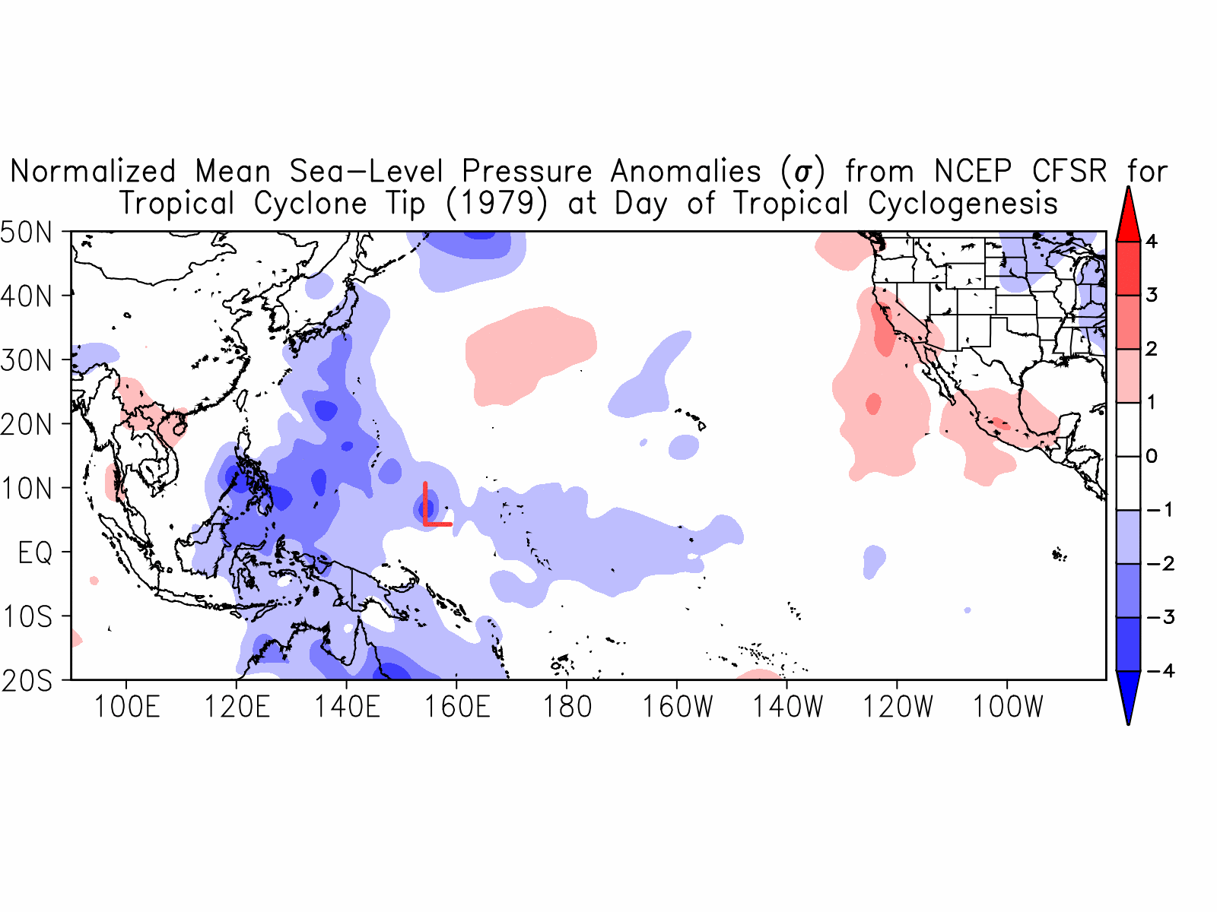
Motivation
Introduction
Methodology
Large Scale Impacts of TCs
Assessing the Large Scale Impact of TCs Benjamin A. Schenkel The Florida State University 2/14
Notes:
Less time on slide, explain figures

Slide 3
Motivation
Introduction
Methodology
Large Scale Impacts of TCs
Assessing the Large Scale Impact of TCs Benjamin A. Schenkel The Florida State University 2/14

Slide 4
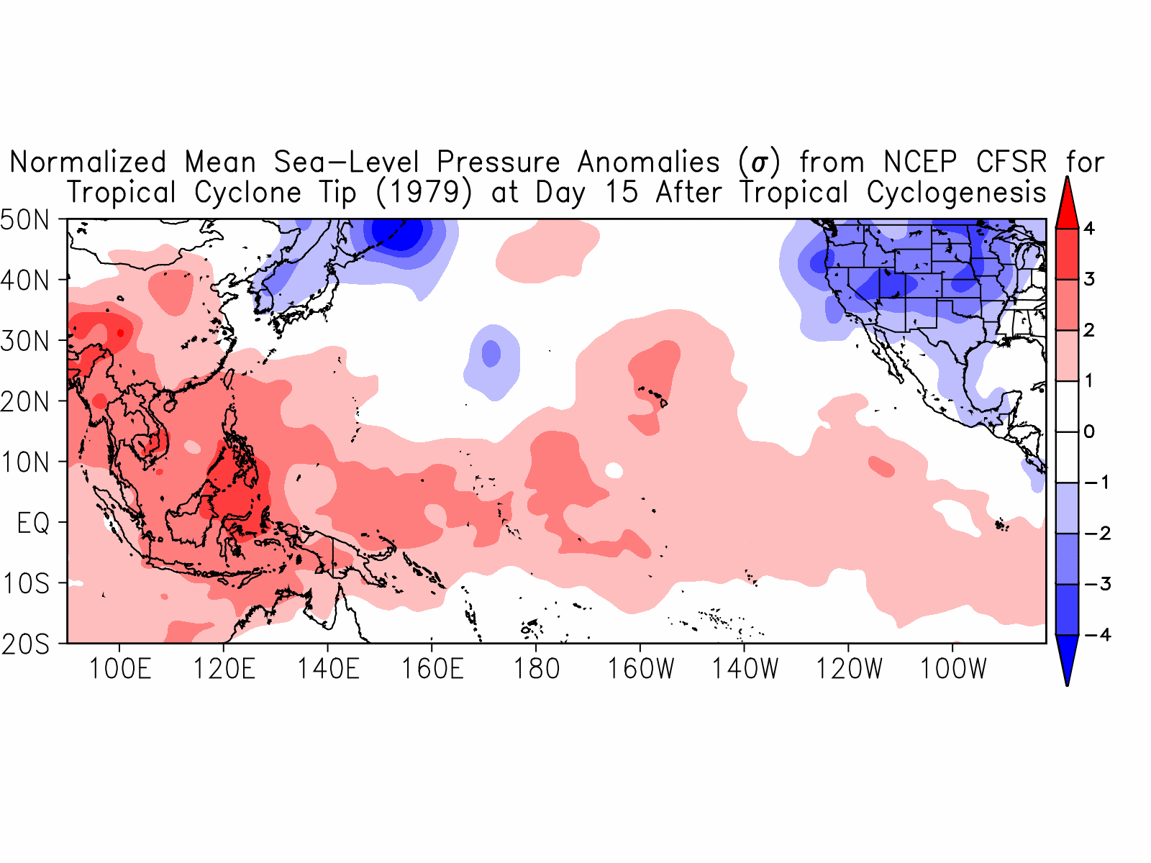
Motivation
Introduction
Methodology
Large Scale Impacts of TCs
How do tropical cyclones (TCs) impact the large scale circulation?
???
Assessing the Large Scale Impact of TCs Benjamin A. Schenkel The Florida State University 3/14

Slide 5
Introduction
Methodology
Large Scale Impacts of TCs
Previous Work on Reanalysis TC Fidelity
In interest of full disclosure, evaluation of reanalysis TC position and intensity has shown:
Significant discrepancies between reanalysis and Best-Track TC position
Underestimation of reanalysis TC intensity beyond what can be solely attributed to the coarse resolution of reanalyses
Substantial differences in the timing of TC intensity changes between the Best-Track and reanalysis TCs
Several examples of nonphysical reanalysis TC structure
Schenkel, B.A. and R.E. Hart, 2012: An Examination of Tropical Cyclone Position, Intensity, and Intensity Life Cycle within Atmospheric Reanalysis Datasets. J. Climate, MERRA Special Collection, in press.
Acknowledgments: Michael Bosilovich (GSFC/NASA), Bob Kistler (EMC/NOAA), Daryl Kleist (EMC/NOAA), Dick Dee (ECMWF)
Assessing the Large Scale Impact of TCs Benjamin A. Schenkel The Florida State University 4/14

Slide 6
Atmospheric Response to TC Passage
Introduction
Methodology
Large Scale Impacts of TCs
Polar Jet
Polar Jet
L
H
TEJ
Excitation of Rossby wave train
Tropopause
Significant heat and moisture transports
Low
Energy
45°N
Cooler and Drier
SST Cold Wake
TC
Large scale response of environment to TC passage similar to TC Yuri
Significant reduction in meridional energy gradient
High
Energy
Sfc.
0
Does the tropical environmental response extend beyond the SST cold wake?
Assessing the Large Scale Impact of TCs Benjamin A. Schenkel The Florida State University 5/14

Slide 7
Introduction
Methodology
Large Scale Impacts of TCs
Methodology: Quantifying the Large Scale Response to TC Passage
Objective: To analyze the response of the tropical atmospheric environment to TC passage
Evaluation of mean environmental response will occur using four-dimensional storm-relative composites of normalized anomalies
Composites are constructed using the NCEP Climate Forecast System Reanalysis (Saha et al. 2011) for category 3 to 5 Best-Track TCs in the Western North Pacific from 1982-2009 (N=257 TCs)
CFSR chosen for this study given it has strongest reanalysis TC intensities and smallest differences between reanalysis and Best-Track TC positions
Reanalyses are crucial for this analysis since they provide the only means of evaluating the mean large scale environmental response for historical TC cases
Assessing the Large Scale Impact of TCs Benjamin A. Schenkel The Florida State University 6/14

Slide 8
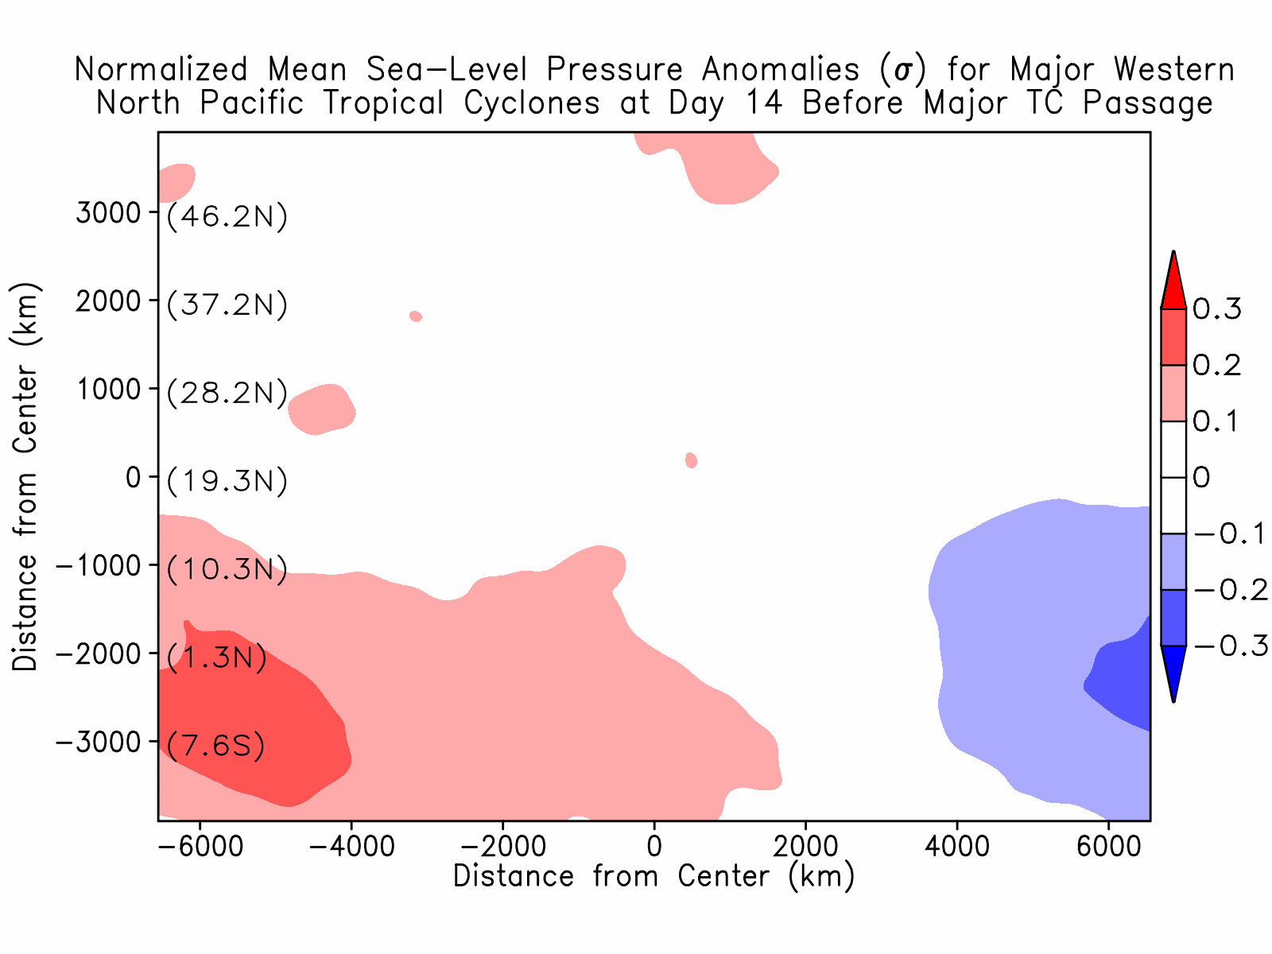
Large Scale Pressure Anomalies in the Tropics Following TC Passage
Introduction
Methodology
Large Scale Impacts of TCs
8000 km by 2000 km response to TC passage
Large scale response of environment to TC passage similar to TC Yuri
Assessing the Large Scale Impact of TCs Benjamin A. Schenkel The Florida State University 7/14

Slide 9
Large Scale Pressure Anomalies in the Tropics Following TC Passage
Introduction
Methodology
Large Scale Impacts of TCs
8000 km by 2000 km response to TC passage
Large scale response of environment to TC passage similar to TC Yuri
Assessing the Large Scale Impact of TCs Benjamin A. Schenkel The Florida State University 7/14

Slide 10
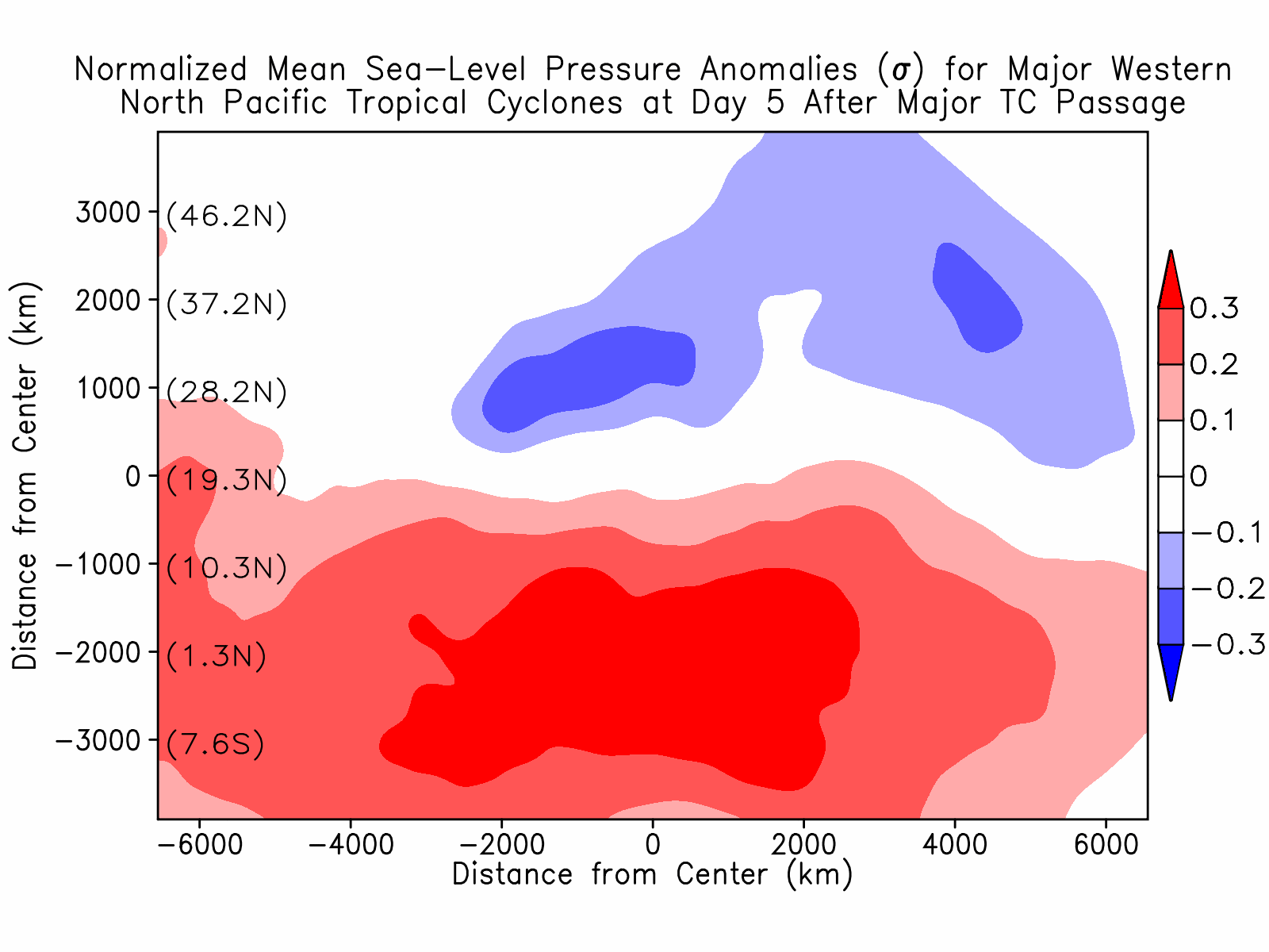
Large Scale Pressure Anomalies in the Tropics Following TC Passage
Introduction
Methodology
Large Scale Impacts of TCs
Large scale response similar to TC Tip with significant anomalies through day 11
Anomalies are significant (≥0.2σ) over an area extending over one-quarter of the circumference of the globe
22% reduction in meridional pressure gradient
Assessing the Large Scale Impact of TCs Benjamin A. Schenkel The Florida State University 8/14

Slide 11
Large Scale Pressure Anomalies in the Tropics Following TC Passage
Introduction
Methodology
Large Scale Impacts of TCs
Large scale response similar to TC Tip with significant anomalies through day 11
Anomalies are significant (≥0.2σ) over an area extending over one-quarter of the circumference of the globe
22% reduction in meridional pressure gradient
Vertical cross-sections will be presented next through the domain center
Assessing the Large Scale Impact of TCs Benjamin A. Schenkel The Florida State University 8/14

Slide 12
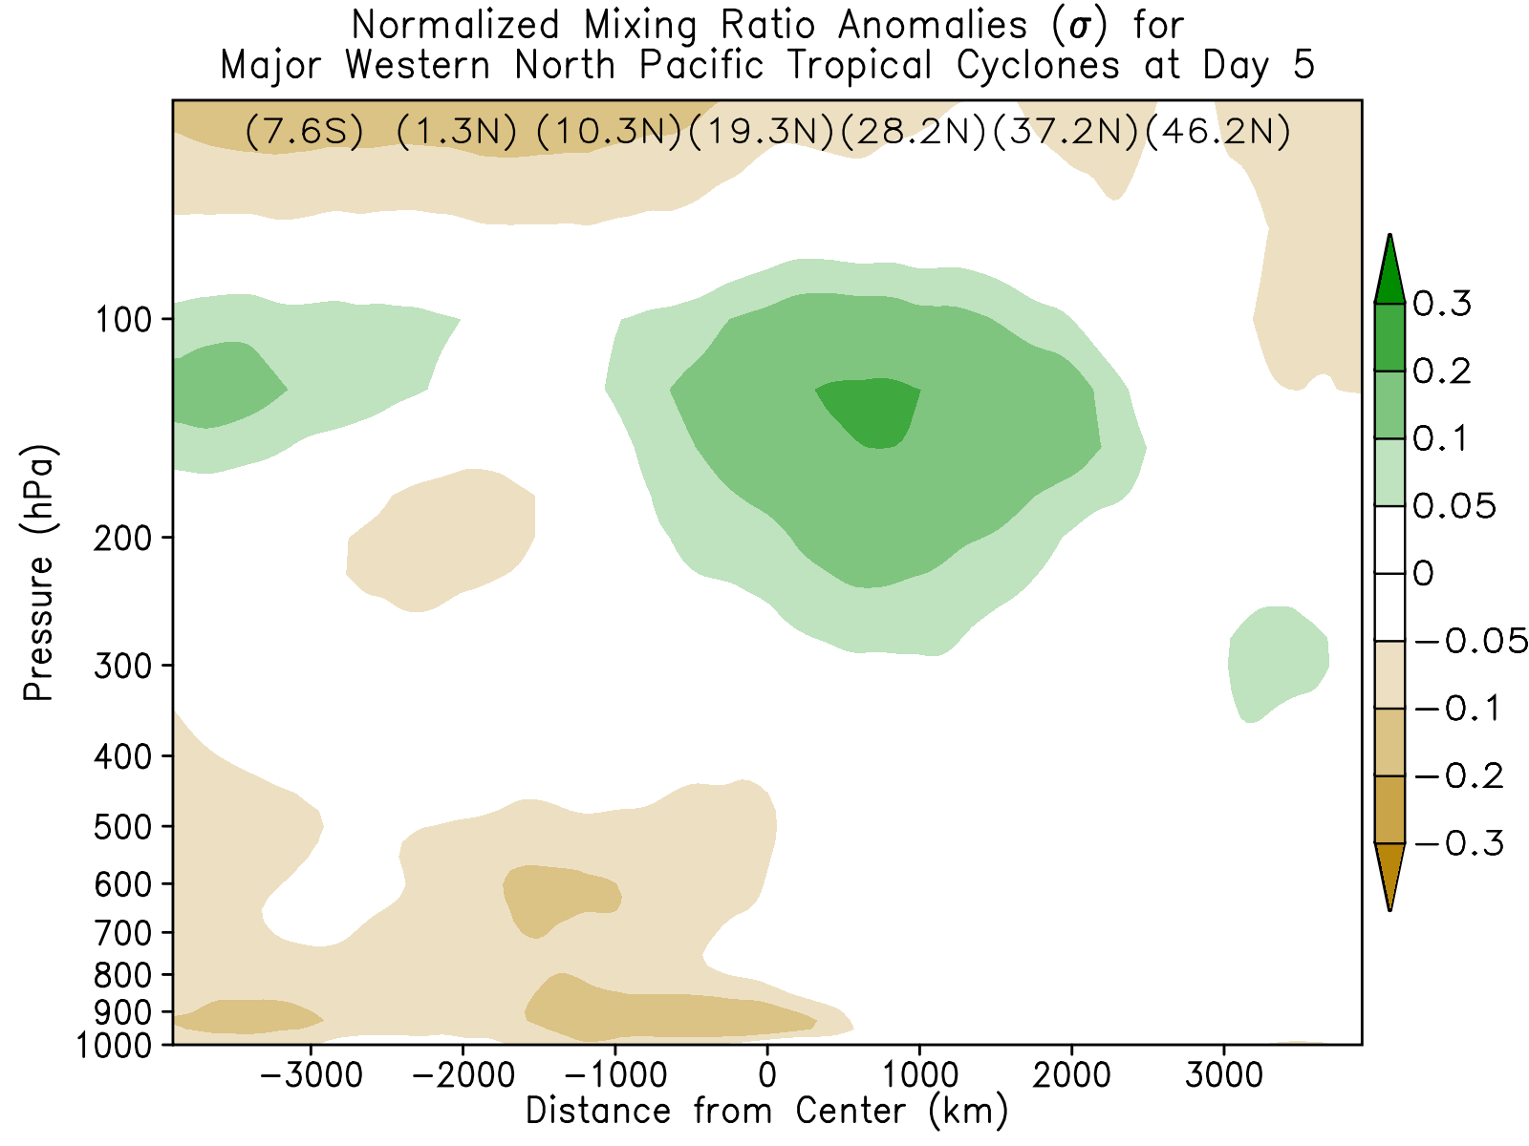
Vertical Structure of Moisture Anomalies
Introduction
Methodology
Large Scale Impacts of TCs
Moistening of upper levels due to TC
Drying of the boundary layer near the SST cold wake
Drying of the lower troposphere well away from the TC cold wake
Large scale response of environment to TC passage similar to TC Yuri
South
North
Assessing the Large Scale Impact of TCs Benjamin A. Schenkel The Florida State University 9/14

Slide 13
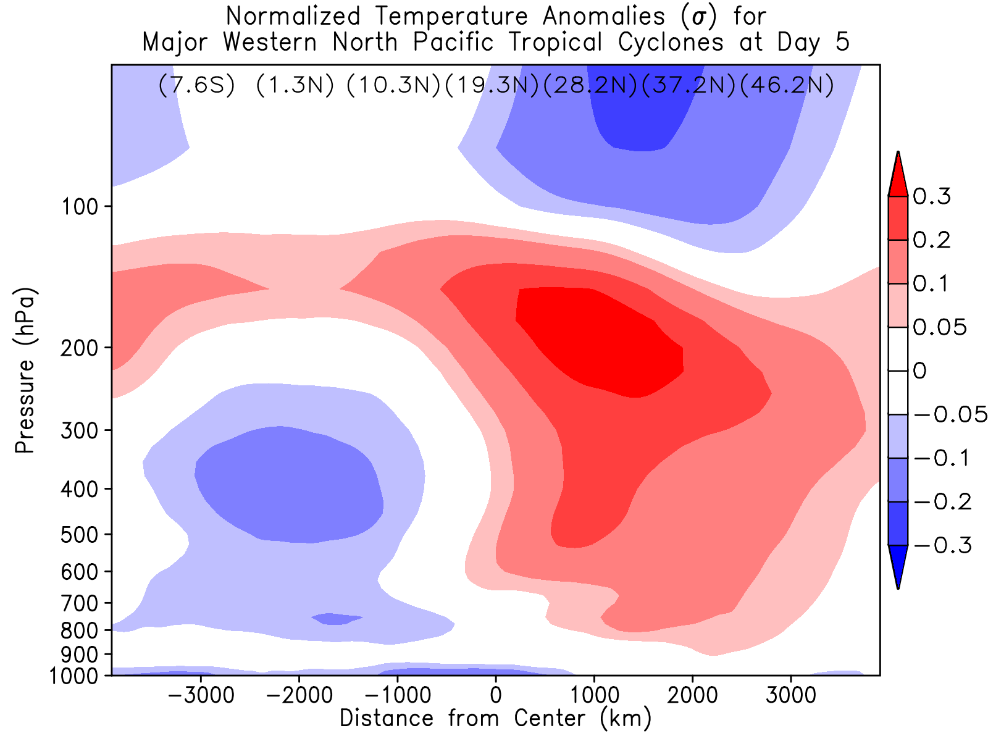
Vertical Structure of Temperature Anomalies
Introduction
Methodology
Large Scale Impacts of TCs
Warming of troposphere due to TC
Cooling of the boundary layer near the SST cold wake
Cooling of the troposphere away from the area through which the TC passed
Large scale response of environment to TC passage similar to TC Yuri
South
North
Assessing the Large Scale Impact of TCs Benjamin A. Schenkel The Florida State University 10/14

Slide 14
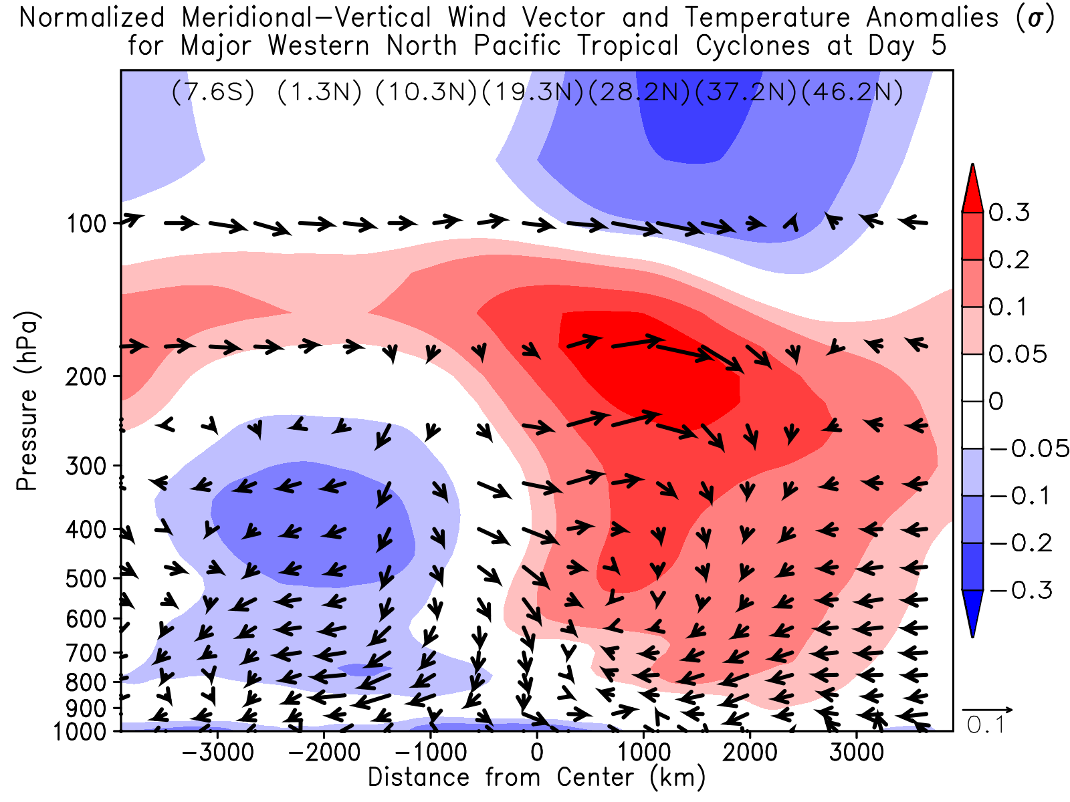
Physical Processes Responsible for Cooling and Drying of Equator
Introduction
Methodology
Large Scale Impacts of TCs
Weakening of Hadley cell following TC passage
Convergence
Subsidence
Large scale response of environment to TC passage similar to TC Yuri
South
Divergence
North
Assessing the Large Scale Impact of TCs Benjamin A. Schenkel The Florida State University 11/14
Notes:
tropopause calculation

Slide 15
Physical Processes Responsible for Cooling and Drying of Equator
Introduction
Methodology
Large Scale Impacts of TCs
Weakening of Hadley cell following TC passage
Cooling and drying in lower troposphere due to reduction in low level convergence of heat and moisture into ITCZ
Anomalous diabatic cooling from reduction in deep convection
Large scale response of environment to TC passage similar to TC Yuri
South
North
Assessing the Large Scale Impact of TCs Benjamin A. Schenkel The Florida State University 11/14

Slide 16
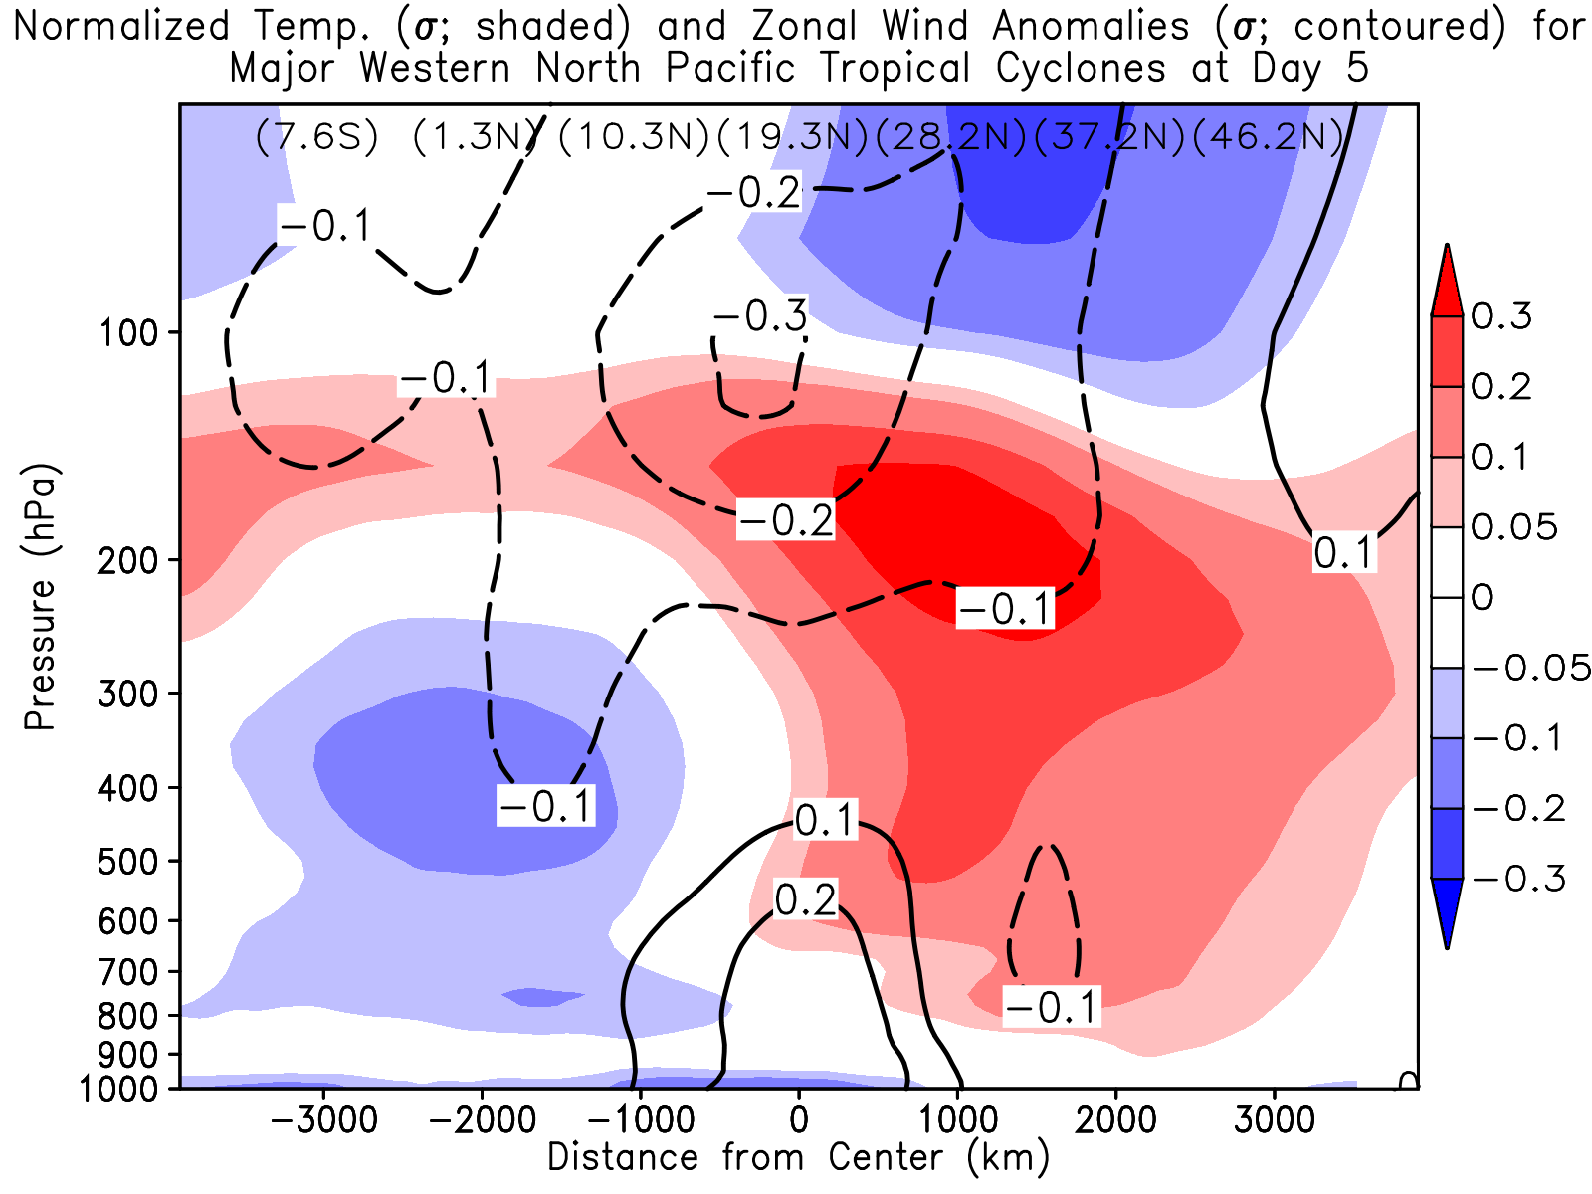
Vertical Structure of Zonal Wind Anomalies
Introduction
Methodology
Large Scale Impacts of TCs
Flux convergence of heat and moisture polewards by TC may yield the following changes:
Acceleration of TEJ
Weakening of trade winds
Large scale response of environment to TC passage similar to TC Yuri
South
North
Assessing the Large Scale Impact of TCs Benjamin A. Schenkel The Florida State University 12/14

Slide 17
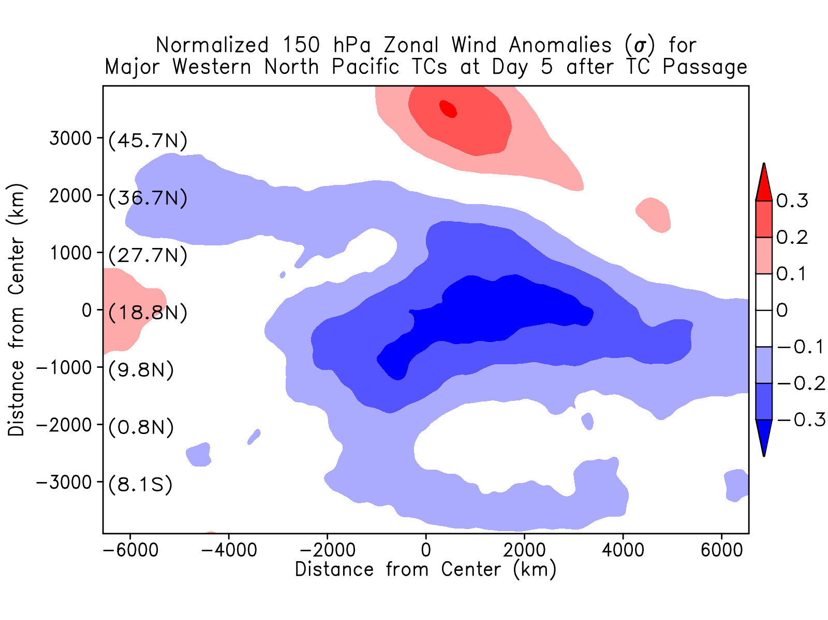
Modulation of Upper Level Jet Stream Circulations by TCs
Introduction
Methodology
Large Scale Impacts of TCs
Large scale response of environment to TC passage similar to TC Yuri
Assessing the Large Scale Impact of TCs Benjamin A. Schenkel The Florida State University 13/14

Slide 18
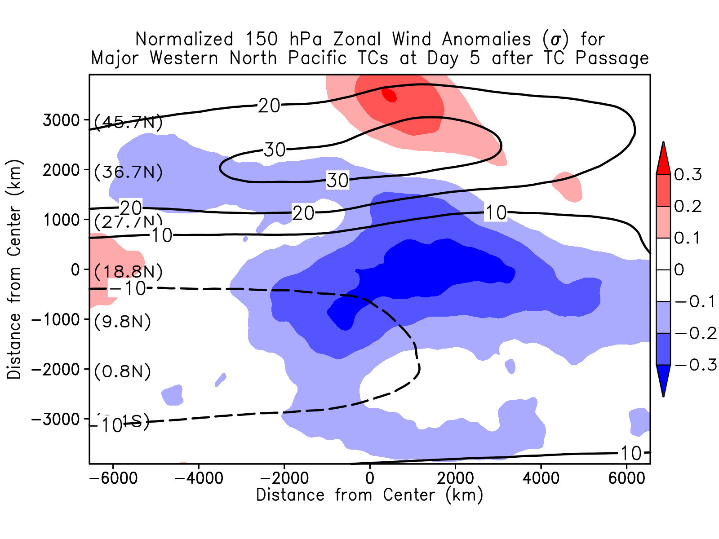
Modulation of Upper Level Jet Stream Circulations by TCs
Introduction
Methodology
Large Scale Impacts of TCs
Strengthening and broadening of TEJ following TC passage
Northward shift of Polar Jet
Polar Jet
TEJ
Large scale response of environment to TC passage similar to TC Yuri
Assessing the Large Scale Impact of TCs Benjamin A. Schenkel The Florida State University 13/14

Slide 19
Concluding Thoughts
Introduction
Methodology
Large Scale Impacts of TCs
Cold and dry anomalies in lower troposphere due to anomalous low level flux divergence of heat and moisture
Cooling and drying of lower troposphere along the TC track due to SST cold wake of TC
Cold anomalies in middle and upper troposphere due to anomalous diabatic cooling from suppression of deep convection
Polar Jet
Warm/Moist Anomaly
What is the aggregate impact of TC activity over an entire season?
TEJ
Cold Anomaly
Tropopause
H
45°N
Warm and moist anomalies at mid-latitudes due to flux convergence of heat and moisture by TC
Reduction in meridional pressure gradient
Strengthening and broadening of TEJ
Northward movement of Polar Jet
Cooler and Drier
TC
Future work will quantify the sensitivity of these results among reanalyses…
Cold/Dry Anomaly
L
Sfc.
0
Assessing the Large Scale Impact of TCs Benjamin A. Schenkel The Florida State University 14/14

Slide 20
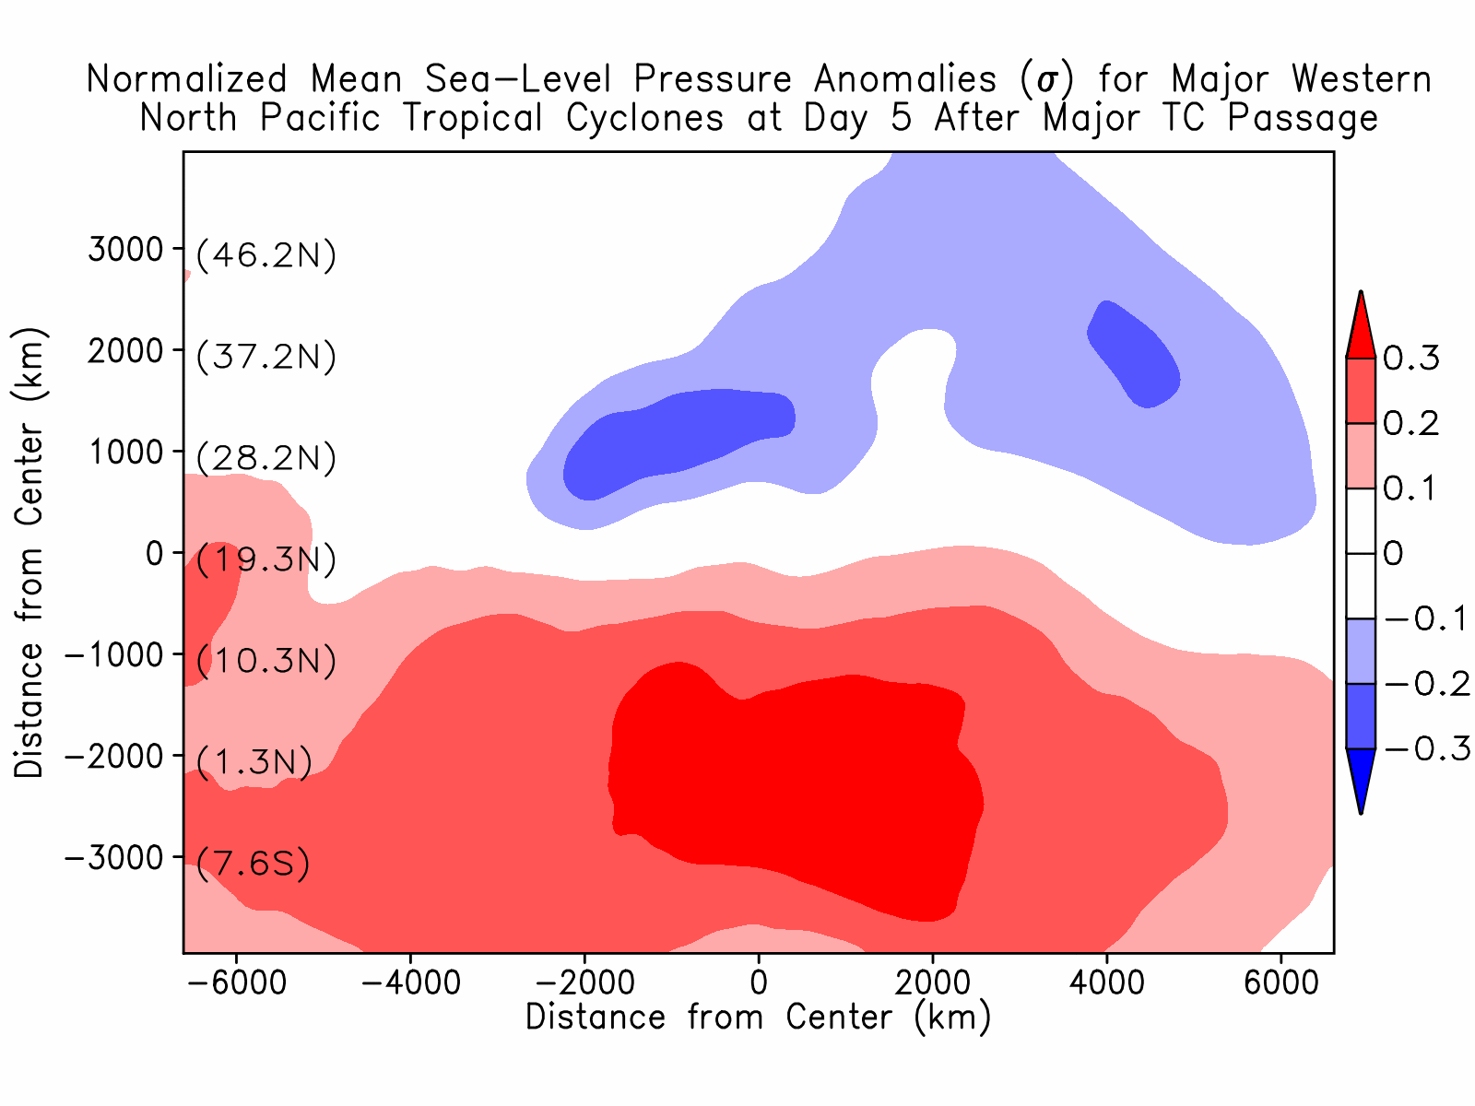
Variability of Large Scale Pressure Anomalies Among Reanalyses
Introduction
Methodology
Large Scale Impacts of TCs
ERA-Interim
Assessing the TC Climate Footprint Benjamin A. Schenkel and Robert E. Hart The Florida State University 7/14

Slide 21
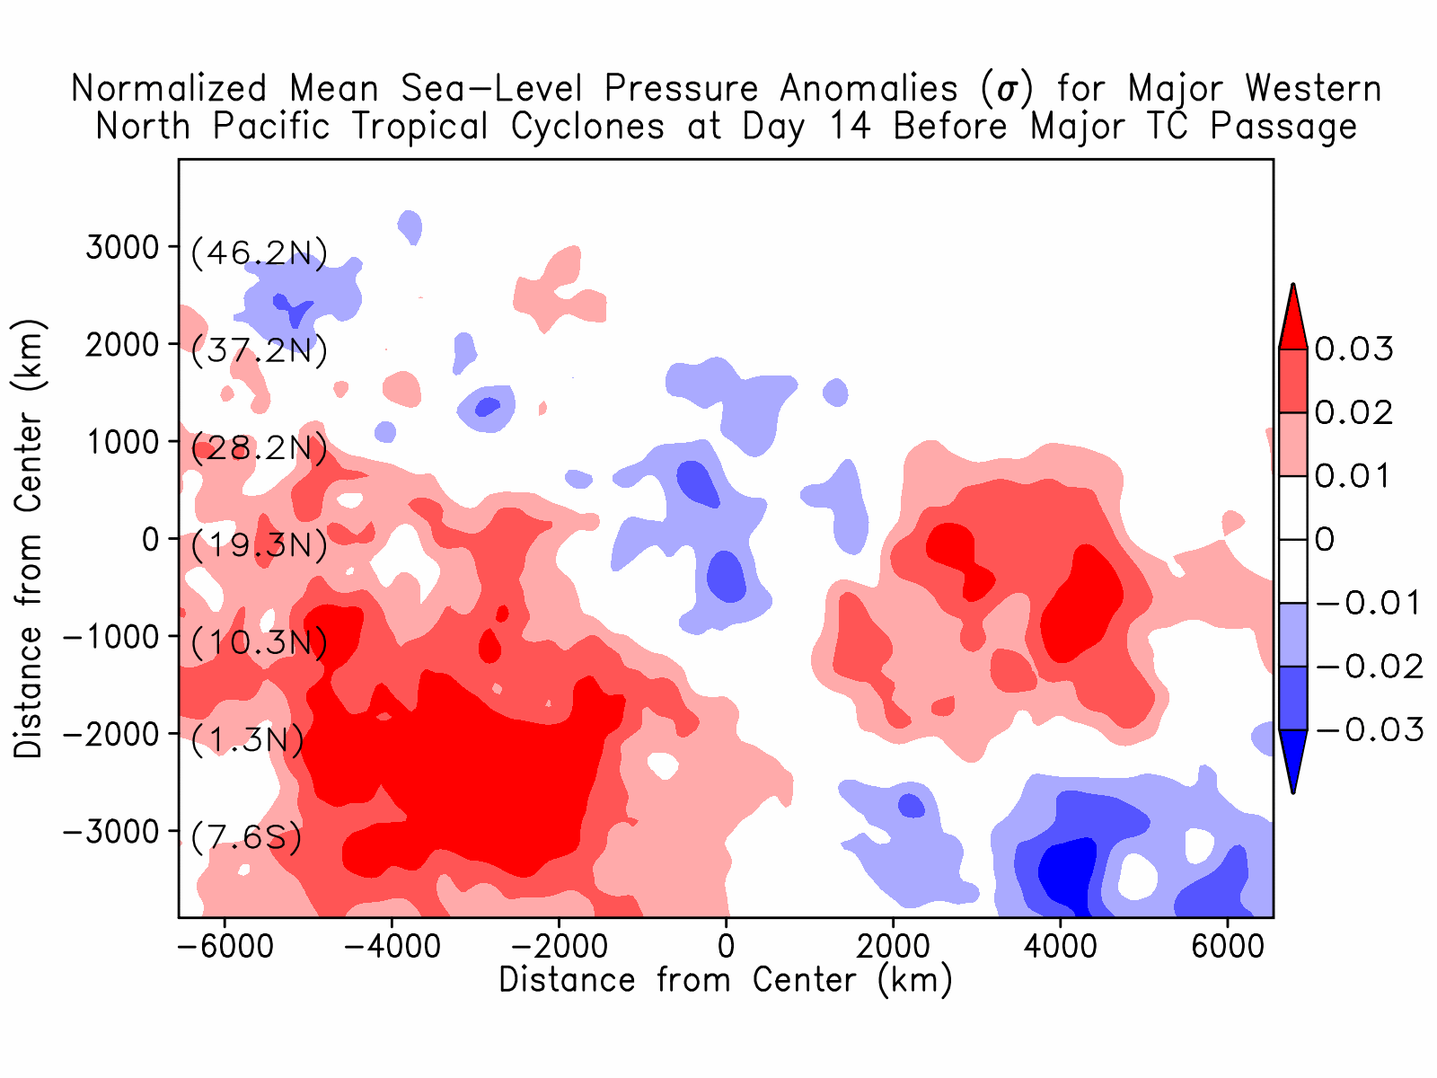
Variability of Large Scale Pressure Anomalies Among Reanalyses
Introduction
Methodology
Large Scale Impacts of TCs
Red: Anomalies in CFSR more strongly positive
Blue: Anomalies in ERA-Interim more strongly positive
CFSR shows stronger positive anomalies in western portion of domain with differences of 10-15%
Northward shift of positive anomalies in CFSR relative to ERA-Interim
CFSR minus ERA-Interim
Response in large scale pressure anomalies appears consistent among reanalyses…
Assessing the TC Climate Footprint Benjamin A. Schenkel and Robert E. Hart The Florida State University 7/14

