Slide 1
The Role of Tropical Cyclones in Cross-Equatorial Total Energy Transport
Benjamin A. Schenkel (bschenkel@albany.edu)¹,
Daniel Keyser, Lance F. Bosart, and Robert E. Hart²
¹University at Albany, SUNY
²The Florida State University
31st AMS Conference on Hurricanes and Tropical Meteorology
Research Sponsored by NSF Atmospheric and Geospace Sciences Postdoctoral Research Fellowship

Slide 2
How do TCs Transport Total Energy Meridionally?
Motivation
Background
Results
Summary
Late NH Summer Zonal Mean Meridional Circulation
p
30°S
15°S
0
15°N
30°N
Cross-Equatorial Energy Transport by TCs Benjamin A. Schenkel University at Albany, SUNY 2/14

Slide 3
How do TCs Transport Total Energy Meridionally?
Motivation
Background
Results
Summary
Late NH Summer Zonal Mean Meridional Circulation with TC
TC
p
30°S
15°S
0
15°N
30°N
There are three mechanisms whereby TCs can transport total energy meridionally:
Movement of TC from tropics into midlatitudes (e.g., Cordeira 2011)
Cross-Equatorial Energy Transport by TCs Benjamin A. Schenkel University at Albany, SUNY 2/14

Slide 4
How do TCs Transport Total Energy Meridionally?
Motivation
Background
Results
Summary
Late NH Summer Zonal Mean Meridional Circulation with TC
TC
p
30°S
15°S
0
15°N
30°N
There are three mechanisms whereby TCs can transport total energy meridionally:
Movement of TC from tropics into midlatitudes (e.g., Cordeira 2011)
Cross-Equatorial Energy Transport by TCs Benjamin A. Schenkel University at Albany, SUNY 2/14

Slide 5
How do TCs Transport Total Energy Meridionally?
Motivation
Background
Results
Summary
Late NH Summer Zonal Mean Meridional Circulation with TC
TC
p
30°S
15°S
0
15°N
30°N
There are three mechanisms whereby TCs can transport total energy meridionally:
Movement of TC from tropics into midlatitudes (e.g., Cordeira 2011)
Lower-tropospheric meridional transport of latent energy and sensible heat by TC inflow
Cross-Equatorial Energy Transport by TCs Benjamin A. Schenkel University at Albany, SUNY 2/14

Slide 6
How do TCs Transport Total Energy Meridionally?
Motivation
Background
Results
Summary
Late NH Summer Zonal Mean Meridional Circulation with TC
TC
p
30°S
15°S
0
15°N
30°N
There are three mechanisms whereby TCs can transport total energy meridionally:
Movement of TC from tropics into midlatitudes (e.g., Cordeira 2011)
Lower-tropospheric meridional transport of latent energy and sensible heat by TC inflow
Upper-tropospheric meridional transport of potential energy and sensible heat by TC outflow
Cross-Equatorial Energy Transport by TCs Benjamin A. Schenkel University at Albany, SUNY 2/14

Slide 7
How do TCs Transport Total Energy Meridionally?
Motivation
Background
Results
Summary
Late NH Summer Zonal Mean Meridional Circulation with TC
TC
Goal: To determine whether significant southward total energy transport across equator occurs due to upper-tropospheric outflow of TC
p
30°S
15°S
0
15°N
30°N
There are three mechanisms whereby TCs can transport total energy meridionally:
Movement of TC from tropics into midlatitudes (e.g., Cordeira 2011)
Lower-tropospheric meridional transport of latent energy and sensible heat by TC inflow
Upper-tropospheric meridional transport of potential energy and sensible heat by TC outflow
Cross-Equatorial Energy Transport by TCs Benjamin A. Schenkel University at Albany, SUNY 2/14

Slide 8
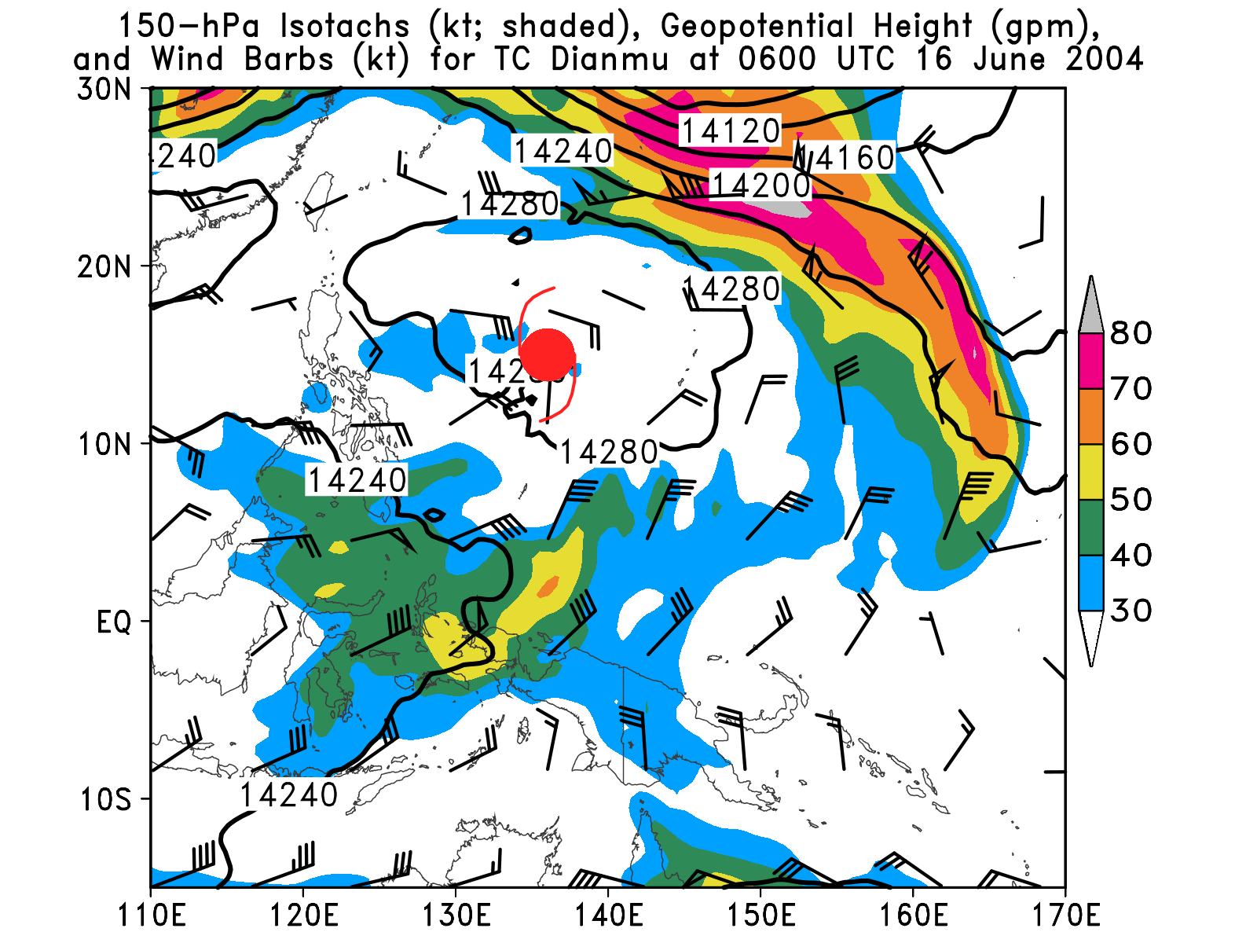
Review of Upper-Tropospheric TC Structure
Motivation
Background
Results
Summary
Background
Generation of anticyclone aloft due to latent heat release from convection
Flow is divergent and asymmetric with strongest wind speeds found in equatorward outflow jets
TC
H
kt
Cross-Equatorial Energy Transport by TCs Benjamin A. Schenkel University at Albany, SUNY 3/14
Notes:
Remove slide and switch out with case study, look at merrill figure for reference latitude

Slide 9
Review of Upper-Tropospheric TC Structure
Motivation
Background
Results
Summary
Background
Generation of anticyclone aloft due to latent heat release from convection
Flow is divergent and asymmetric with strongest wind speeds found in equatorward outflow jets
TCs can transport heat and potential energy across equator in upper-tropospheric outflow
H
kt
Cross-Equatorial Energy Transport by TCs Benjamin A. Schenkel University at Albany, SUNY 3/14
Notes:
Insert case study into talk

Slide 10
Motivation
Background
Results
Summary
Methodology: Quantifying Southward Total Energy Transport Across Equator by TCs
Evaluation of mean meridional total energy transport by TCs utilizes three-dimensional composites centered on TC longitude
Composites are constructed using NCEP Climate Forecast System Reanalysis (Saha et al. 2010) for TCs (maximum 10-m wind speed ≥ 34 kt) in western North Pacific at or equatorward of 20°N during 1979–2010 (N = 696 TCs)
Composites of raw anomalies and normalized anomalies are used to isolate role of TCs in meridional total energy transport
Cross-Equatorial Energy Transport by TCs Benjamin A. Schenkel University at Albany, SUNY 4/14

Slide 11
Motivation
Background
Results
Summary
Methodology: Quantifying Southward Total Energy Transport Across Equator by TCs
Composited meridional total energy transport (Trenberth et al. 1997) used to assess role of TCs in southward total energy transport across equator:
Term 1: Vertically integrated meridional total energy transport
Term 2: Vertically integrated meridional kinetic energy transport
Term 3: Vertically integrated meridional latent energy transport
Term 4: Vertically integrated meridional sensible heat transport
Term 5: Vertically integrated meridional potential energy transport
(1)
(2)
(3)
(4)
(5)
Cross-Equatorial Energy Transport by TCs Benjamin A. Schenkel University at Albany, SUNY 5/14

Slide 12
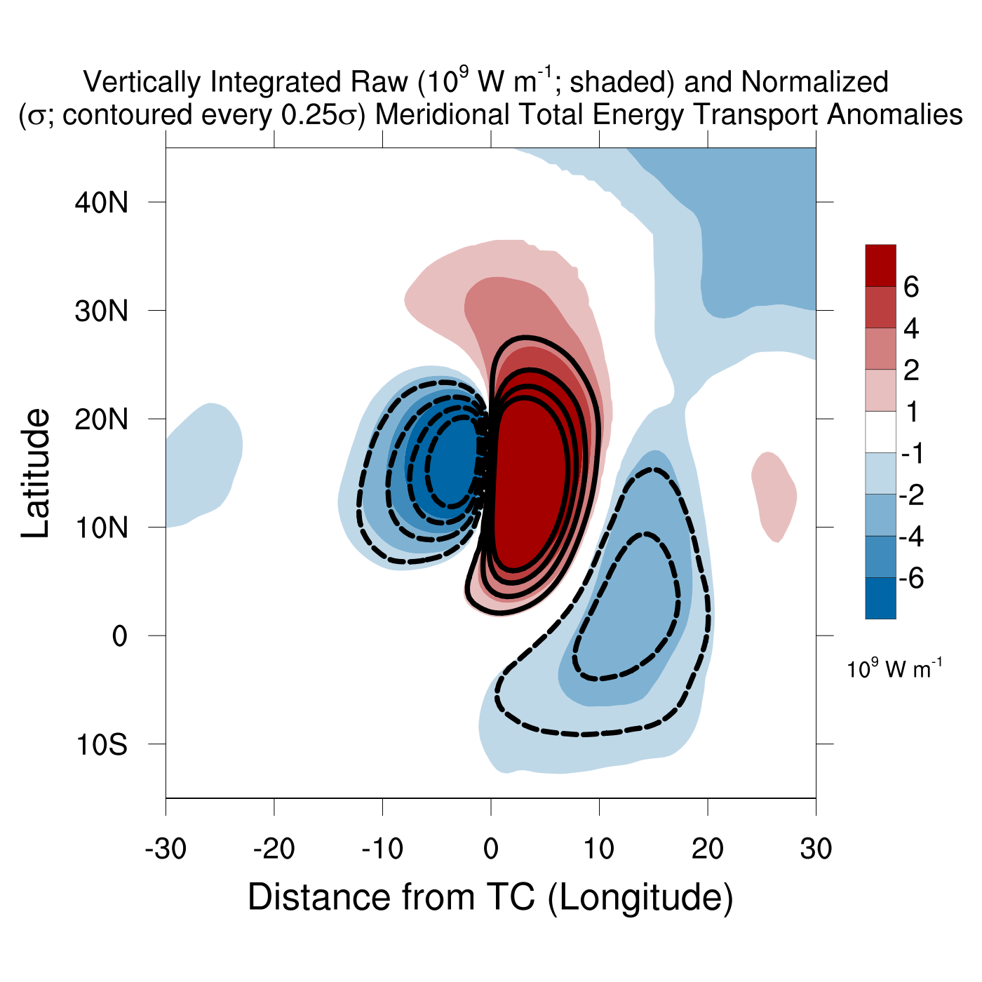
Motivation
Background
Results
Summary
Vertically Integrated Meridional Total Energy Transport by TCs
Meridional total energy transport anomalies in deep tropics due to two factors:
Blue/Dashed: Southward total energy transport
Red/Solid: Northward total energy transport
Cross-Equatorial Energy Transport by TCs Benjamin A. Schenkel University at Albany, SUNY 6/14

Slide 13
Motivation
Background
Results
Summary
Vertically Integrated Meridional Total Energy Transport by TCs
Meridional total energy transport anomalies in deep tropics due to two factors:
Cyclonic circulation of TC
Blue/Dashed: Southward total energy transport
Red/Solid: Northward total energy transport
Cross-Equatorial Energy Transport by TCs Benjamin A. Schenkel University at Albany, SUNY 6/14

Slide 14
Motivation
Background
Results
Summary
Vertically Integrated Meridional Total Energy Transport by TCs
Meridional total energy transport anomalies in deep tropics due to two factors:
Cyclonic circulation of TC
Upper-tropospheric equatorward outflow jet on southeastern flank of anticyclonic circulation of TC
Blue/Dashed: Southward total energy transport
Red/Solid: Northward total energy transport
H
Cross-Equatorial Energy Transport by TCs Benjamin A. Schenkel University at Albany, SUNY 6/14

Slide 15
Motivation
Background
Results
Summary
Vertically Integrated Meridional Total Energy Transport by TCs
Meridional total energy transport anomalies in deep tropics due to two factors:
Cyclonic circulation of TC
Upper-tropospheric equatorward outflow jet on southeastern flank of anticyclonic circulation of TC
Southward transport by outflow jet of TC extends across equator into SH
Blue/Dashed: Southward total energy transport
Red/Solid: Northward total energy transport
H
Next, meridional total energy transport anomalies in environment outside of TC are examined using domain extending zonally across globe
Cross-Equatorial Energy Transport by TCs Benjamin A. Schenkel University at Albany, SUNY 6/14
Notes:
Add streamlines

Slide 16
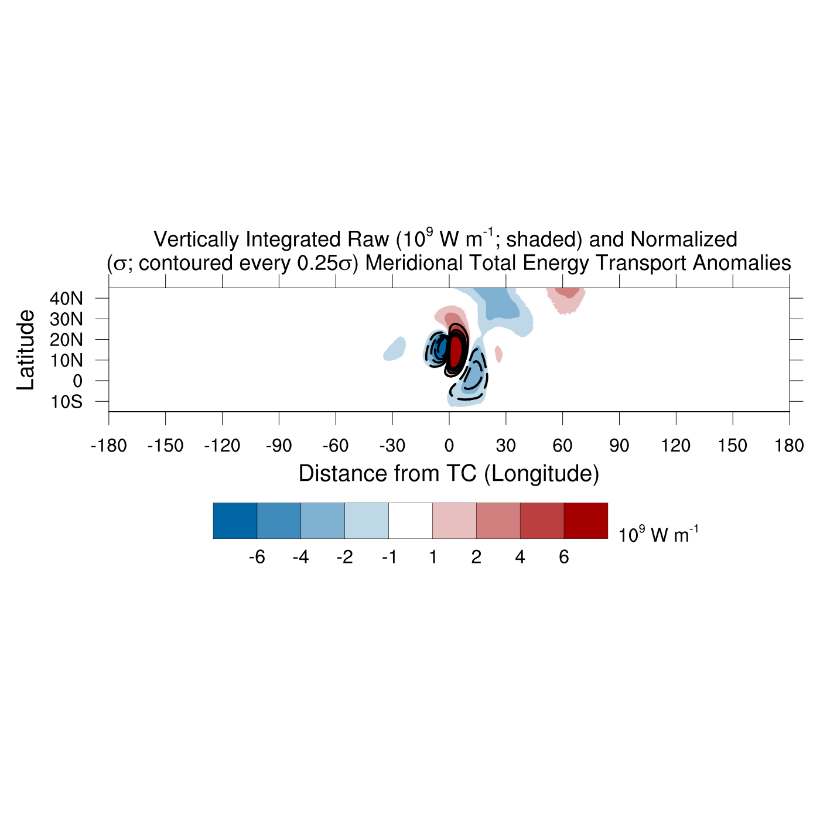
Global Structure of Meridional Total Energy Transport Anomalies
Motivation
Background
Results
Summary
Blue/Dashed: Southward total energy transport
Red/Solid: Northward total energy transport
Equatorward outflow jet of TC is primary source of anomalous meridional total energy transport at equator
Cross-Equatorial Energy Transport by TCs Benjamin A. Schenkel University at Albany, SUNY 7/14

Slide 17
Global Structure of Meridional Total Energy Transport Anomalies
Motivation
Background
Results
Summary
To quantify meridional total energy transport anomalies across equator by TC, composites are zonally integrated over three regions:
TC and its immediate environment (Near TC)
Environment outside of TC (Outside TC)
All longitudes including TC and its outer environment (Total)
Absence of significant meridional transports outside of TC within composites suggesting TC is dominant feature
Cross-Equatorial Energy Transport by TCs Benjamin A. Schenkel University at Albany, SUNY 8/14

Slide 18
Global Structure of Meridional Total Energy Transport Anomalies
Motivation
Background
Results
Summary
To quantify meridional total energy transport anomalies across equator by TC, composites are zonally integrated over three regions:
TC and its immediate environment (Near TC)
Environment outside of TC (Outside TC)
All longitudes including TC and its outer environment (Total)
Absence of significant meridional transports outside of TC within composites suggesting TC is dominant feature
Cross-Equatorial Energy Transport by TCs Benjamin A. Schenkel University at Albany, SUNY 8/14

Slide 19
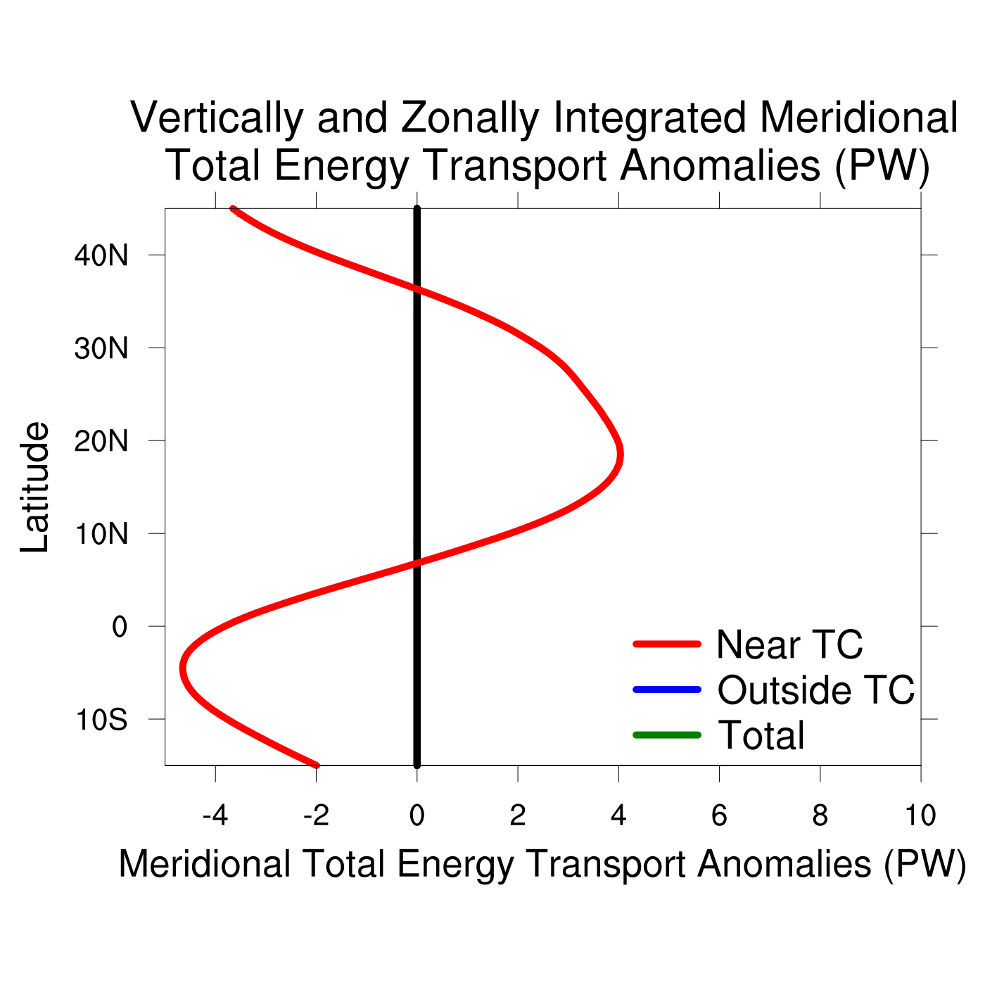
Quantifying Meridional Total Energy Transport by TCs in a Global Context
Motivation
Background
Results
Summary
Anomalous meridional total energy transport from NH tropics into NH subtropics and SH tropics
Anomalous southward meridional total energy transport at equator due to equatorward outflow jet of TC
Energy transport convergence
Energy transport divergence
Energy transport convergence
large-scale response of environment to TC passage similar to TC Yuri
Cross-Equatorial Energy Transport by TCs Benjamin A. Schenkel University at Albany, SUNY 9/14

Slide 20
Global Structure of Meridional Total Energy Transport Anomalies
Motivation
Background
Results
Summary
To quantify meridional total energy transport anomalies across equator by TC, composites are zonally integrated over three regions:
TC and its immediate environment (Near TC)
Environment outside of TC (Outside TC)
All longitudes including TC and its outer environment (Total)
Absence of significant meridional transports outside of TC within composites suggesting TC is dominant feature
Cross-Equatorial Energy Transport by TCs Benjamin A. Schenkel University at Albany, SUNY 10/14

Slide 21
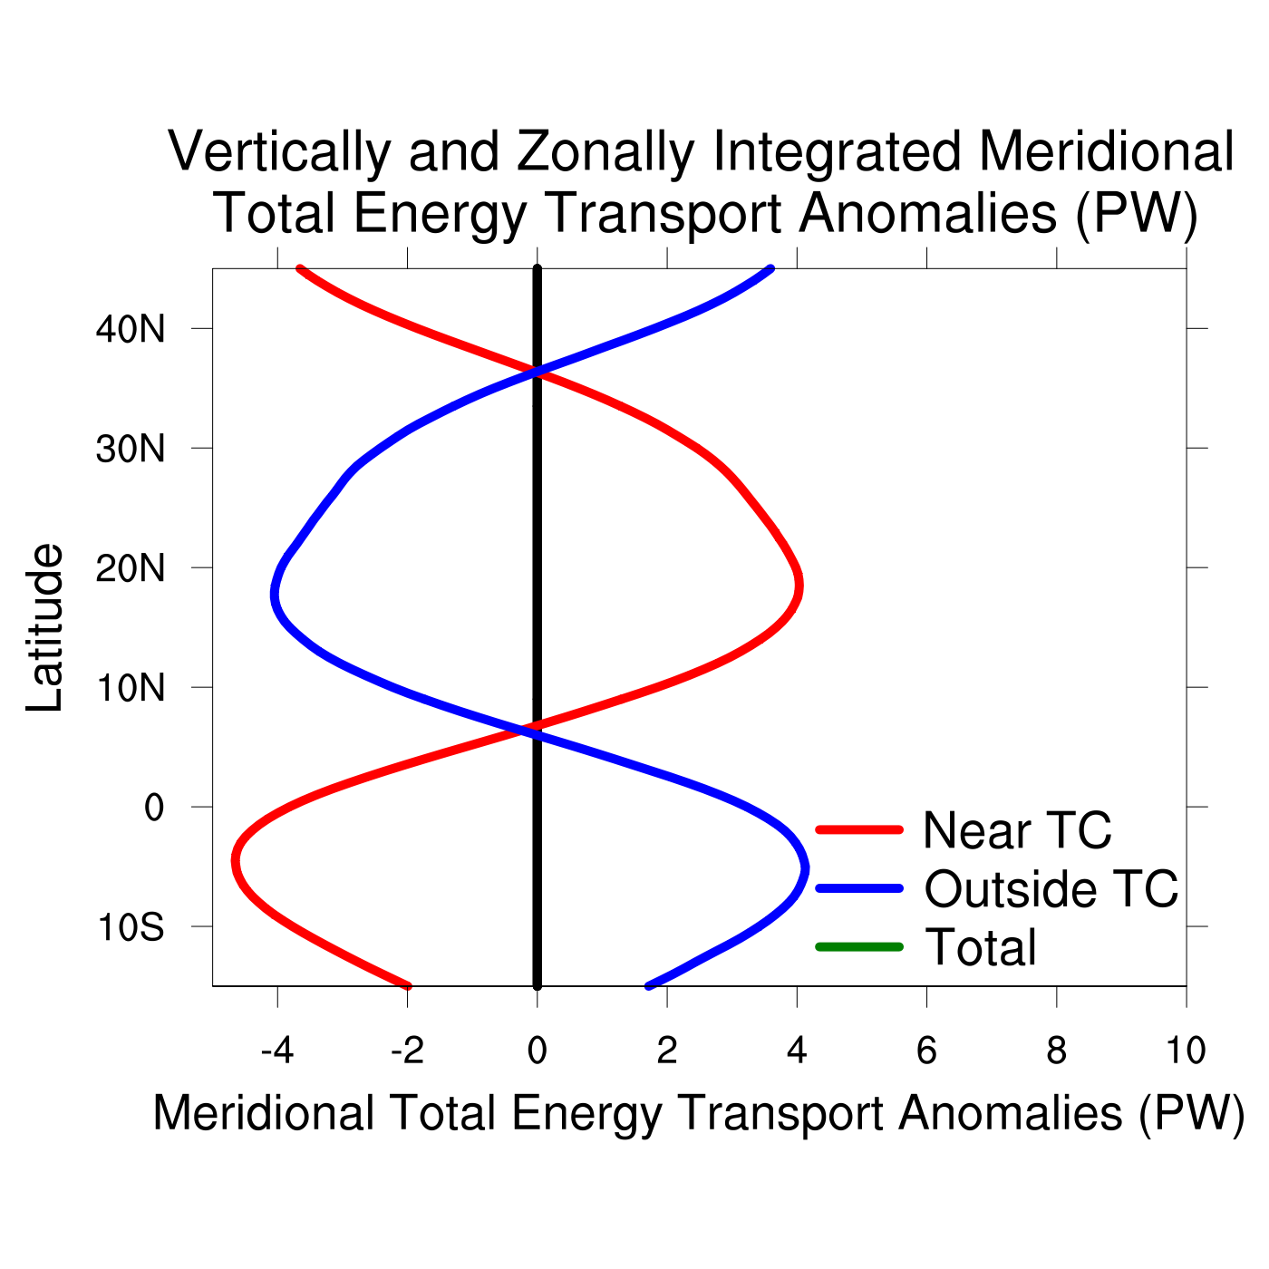
Quantifying Meridional Total Energy Transport by TCs in a Global Context
Motivation
Background
Results
Summary
Meridional total energy transport anomalies outside TC nearly balance meridional total energy transport anomalies by TC
large-scale response of environment to TC passage similar to TC Yuri
Cross-Equatorial Energy Transport by TCs Benjamin A. Schenkel University at Albany, SUNY 11/14

Slide 22
Global Structure of Meridional Total Energy Transport Anomalies
Motivation
Background
Results
Summary
To quantify meridional total energy transport anomalies across equator by TC, composites are zonally integrated over three regions:
TC and its immediate environment (Near TC)
Environment outside of TC (Outside TC)
All longitudes including TC and its outer environment (Total)
Absence of significant meridional transports outside of TC within composites suggesting TC is dominant feature
Cross-Equatorial Energy Transport by TCs Benjamin A. Schenkel University at Albany, SUNY 12/14

Slide 23
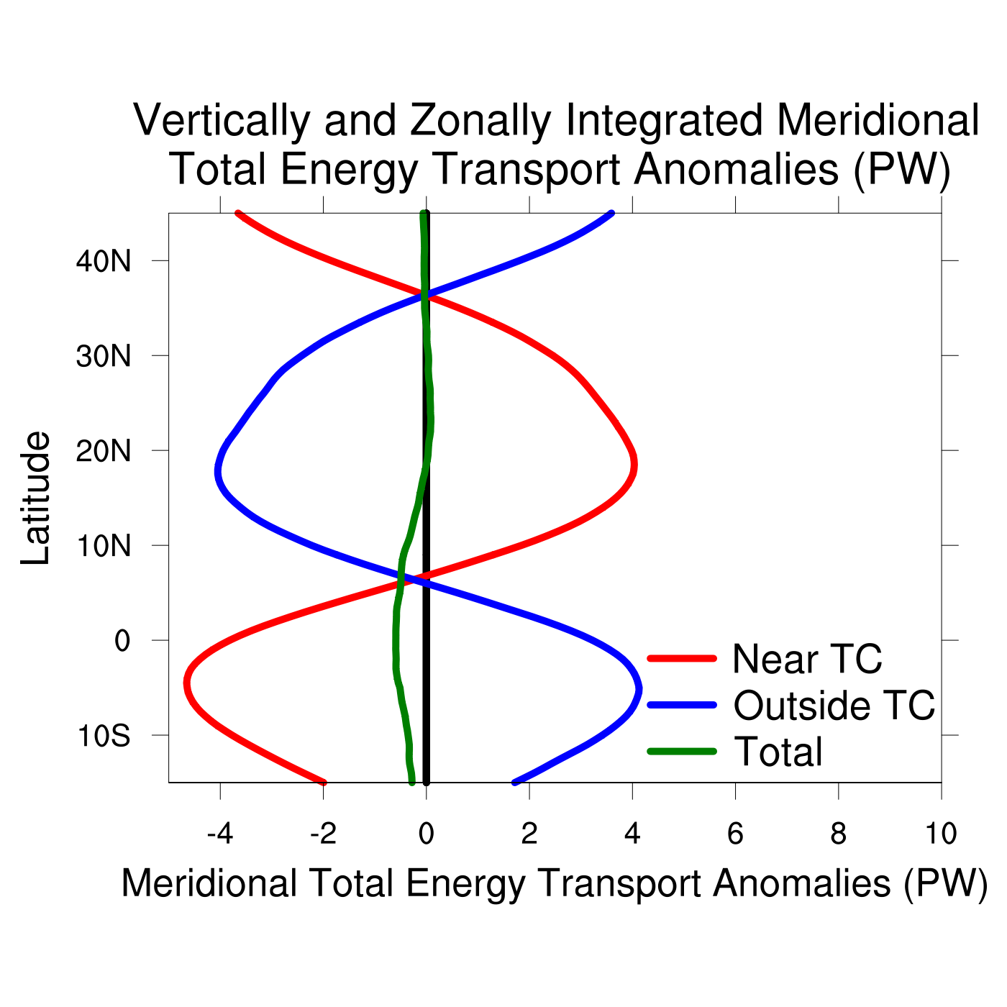
Quantifying Meridional Total Energy Transport by TCs in a Global Context
Motivation
Background
Results
Summary
Zonal integration over all longitudes yields −0.5 PW southward energy transport near equator suggesting transport by TCs is dominant
−0.5 PW southward energy transport anomalies by TC are large relative to −1.0 to −2.0 PW climatological southward energy transport near equator during NH summer and fall
large-scale response of environment to TC passage similar to TC Yuri
Cross-Equatorial Energy Transport by TCs Benjamin A. Schenkel University at Albany, SUNY 13/14

Slide 24
Summary: TC Impacts on Meridional Total Energy Transport
Motivation
Background
Results
Summary
Late NH Summer Zonal Mean Meridional Circulation with a TC
TC
p
30°S
15°S
0
15°N
30°N
Cross-Equatorial Energy Transport by TCs Benjamin A. Schenkel University at Albany, SUNY 14/14

Slide 25
Summary: TC Impacts on Meridional Total Energy Transport
Motivation
Background
Results
Summary
Late NH Summer Zonal Mean Meridional Circulation with a TC
TC
p
30°S
15°S
0
15°N
30°N
Northward lower-tropospheric total energy transport by TC inflow
Cross-Equatorial Energy Transport by TCs Benjamin A. Schenkel University at Albany, SUNY 14/14

Slide 26
Summary: TC Impacts on Meridional Total Energy Transport
Motivation
Background
Results
Summary
Late NH Summer Zonal Mean Meridional Circulation with a TC
TC
p
30°S
15°S
0
15°N
30°N
Northward lower-tropospheric total energy transport by TC inflow
Southward upper-tropospheric total energy transport by TC outflow
Cross-Equatorial Energy Transport by TCs Benjamin A. Schenkel University at Albany, SUNY 14/14

Slide 27
Summary: TC Impacts on Meridional Total Energy Transport
Motivation
Background
Results
Summary
Late NH Summer Zonal Mean Meridional Circulation with a TC
TC
Net energy transport by TC
p
Net energy transport by
environment outside of TC
30°S
15°S
0
15°N
30°N
Net southward vertically integrated total energy transport across equator by TC
Net northward vertically integrated total energy transport across equator by environment outside of TC
Cross-Equatorial Energy Transport by TCs Benjamin A. Schenkel University at Albany, SUNY 14/14

Slide 28
Summary: TC Impacts on Meridional Total Energy Transport
Motivation
Background
Results
Summary
Late NH Summer Zonal Mean Meridional Circulation with a TC
TC
Enhanced net energy transport by zonal mean meridional circulation
p
30°S
15°S
0
15°N
30°N
Enhanced net southward vertically integrated total energy transport across equator by zonal mean meridional circulation due to TC
Cross-Equatorial Energy Transport by TCs Benjamin A. Schenkel University at Albany, SUNY 14/14

