Slide 1

Interrogating the Atmospheric Environmental Impacts of Tropical Cyclones
Benjamin A. Schenkel (bschenkel@albany.edu)
University at Albany, State University of New York
CEE Seminar
6/26/2015
Research Sponsored by NSF and NASA

Slide 2
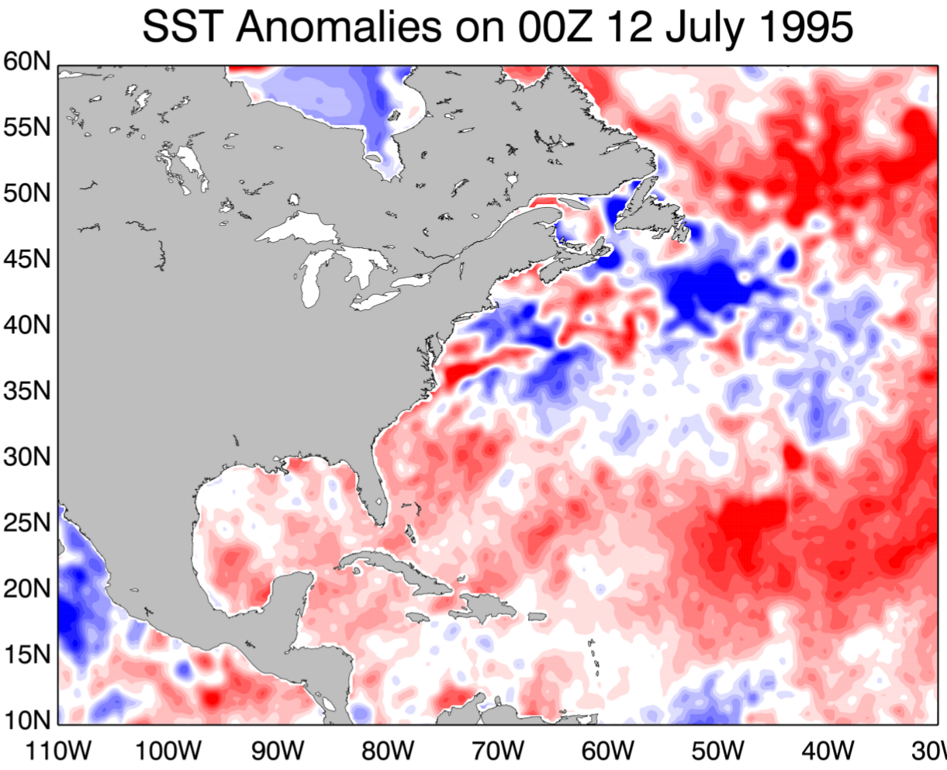
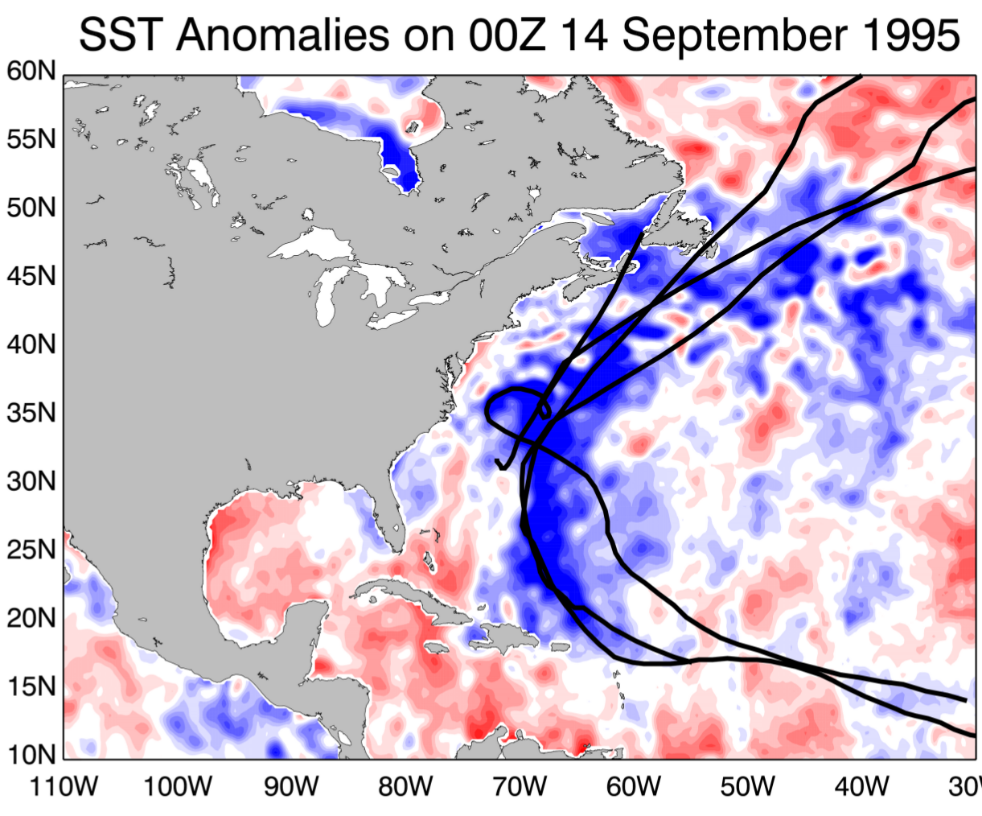
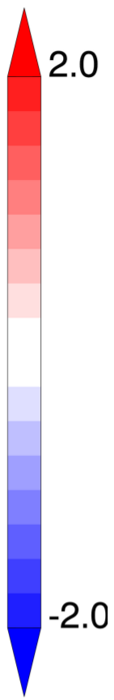
Motivation: Hurricane Sandy
How do TCs impact their environment?

Slide 3
Outline
Motivation
Background
Results
Summary
Background
Background
Primary and secondary circulation of TC
Environmental impacts of TCs
Results
Spatiotemporal structure of OLR during single TC events and multiple TC events
Spatiotemporal structure lower-tropospheric winds during single TC events and multiple TC events
Summary and discussions
Large-Scale Factors Forcing Multiple TC Events Benjamin A. Schenkel University at Albany, SUNY 18/
Notes:
Insert case study into talk

Slide 4
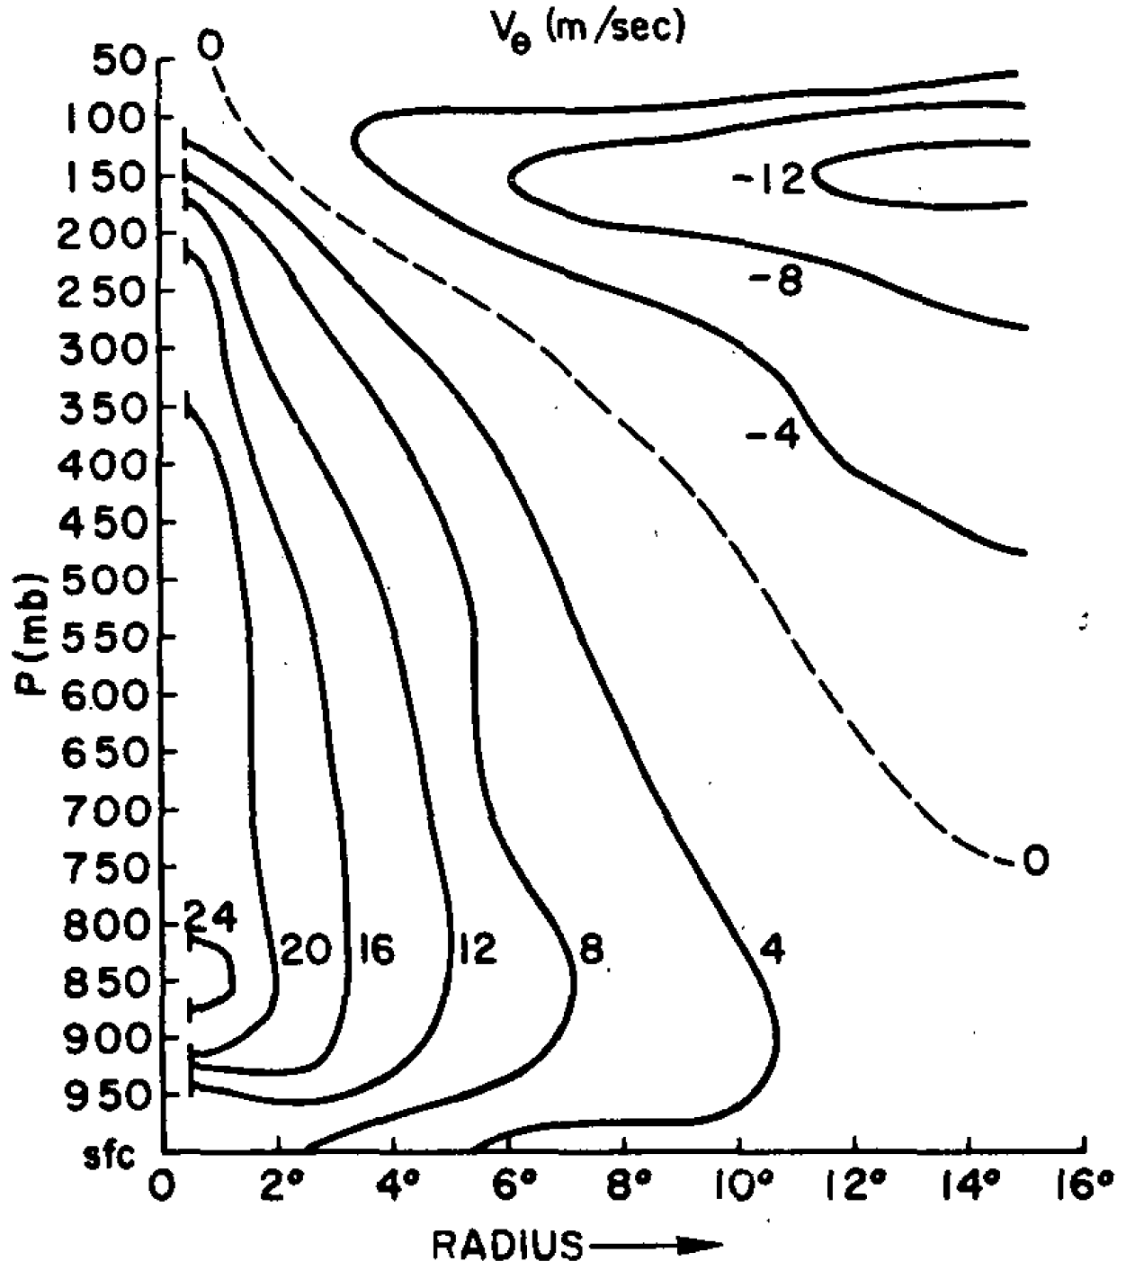
Primary Circulation of TC
Composite vertical cross section of tangential wind (m s⁻¹) for western North Pacific TCs
H
Contours: azimuthally-averaged tangential wind
Lower TC circulation is cyclonic and weakens with increasing height
Upper TC circulation becomes anticyclonic
Upper TC circulation is weaker and broader than lower TC circulation
L
Wind speed > 0: cyclonic
Wind speed < 0: anticyclonic
Frank (1977)
Cross-Equatorial Energy Transports by TCs Benjamin A. Schenkel University at Albany, SUNY 6/41

Slide 5
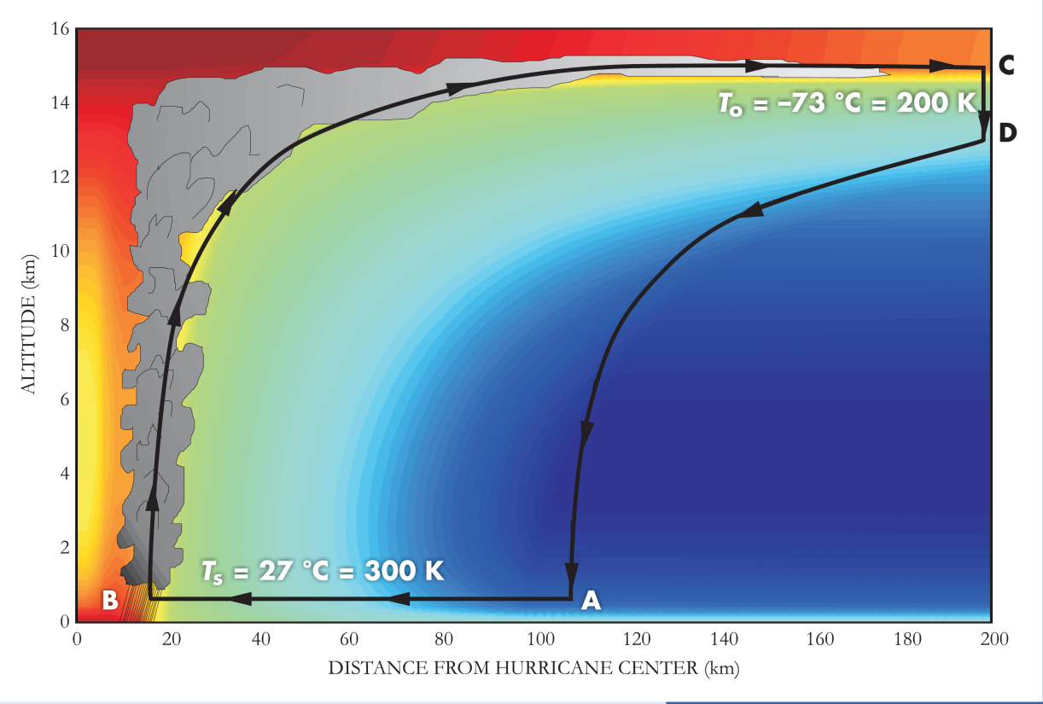
Secondary Circulation of TC
Shading: Azimuthally-averaged potential temperature
Secondary circulation in a TC consists of:
Isothermal radial inflow
Moist-adiabatic ascent and radial outflow
Descent induced by radiative cooling
Adiabatic descent outside storm core
Vertical Cross Section of TC Secondary Circulation
16
14
12
10
8
Altitude (km)
6
4
2
0
0
100
200
300
400
500
Radius from TC Center (km)
Credit: Emanuel (2006)
Warmer colors: higher potential temperature
Cooler colors: lower potential temperature
Notes:
check on hoskins

Slide 6
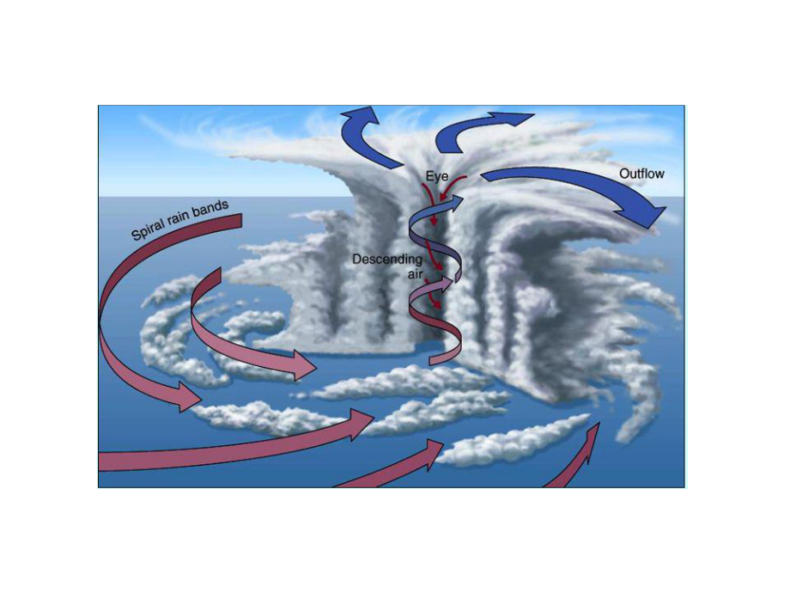
Primary and Secondary Circulation of TC
Red arrows: lower TC circulation, Blue arrows: upper TC circulation
Primary circulation is stronger than secondary circulation
Lower circulation is convergent and cyclonic
Upper circulation is divergent and anticyclonic
Vertical Cross Section of Primary and Secondary TC Circulation
Credit: University of Michigan (2015)
Notes:
check on hoskins

Slide 7
Outline
Motivation
Background
Results
Summary
Background
Background
Large-scale factors potentially responsible for multiple TC events
Influence of large-scale convective heating on TC frequency
Results
Spatiotemporal structure of OLR during single TC events and multiple TC events
Spatiotemporal structure lower-tropospheric winds during single TC events and multiple TC events
Summary and discussions
Large-Scale Factors Forcing Multiple TC Events Benjamin A. Schenkel University at Albany, SUNY 18/
Notes:
Insert case study into talk

Slide 8
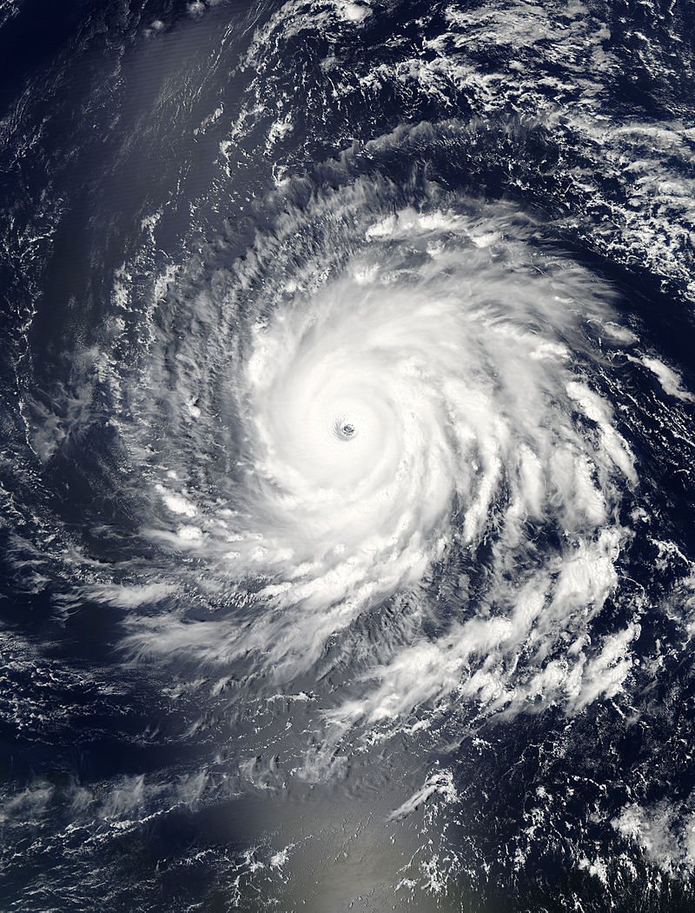
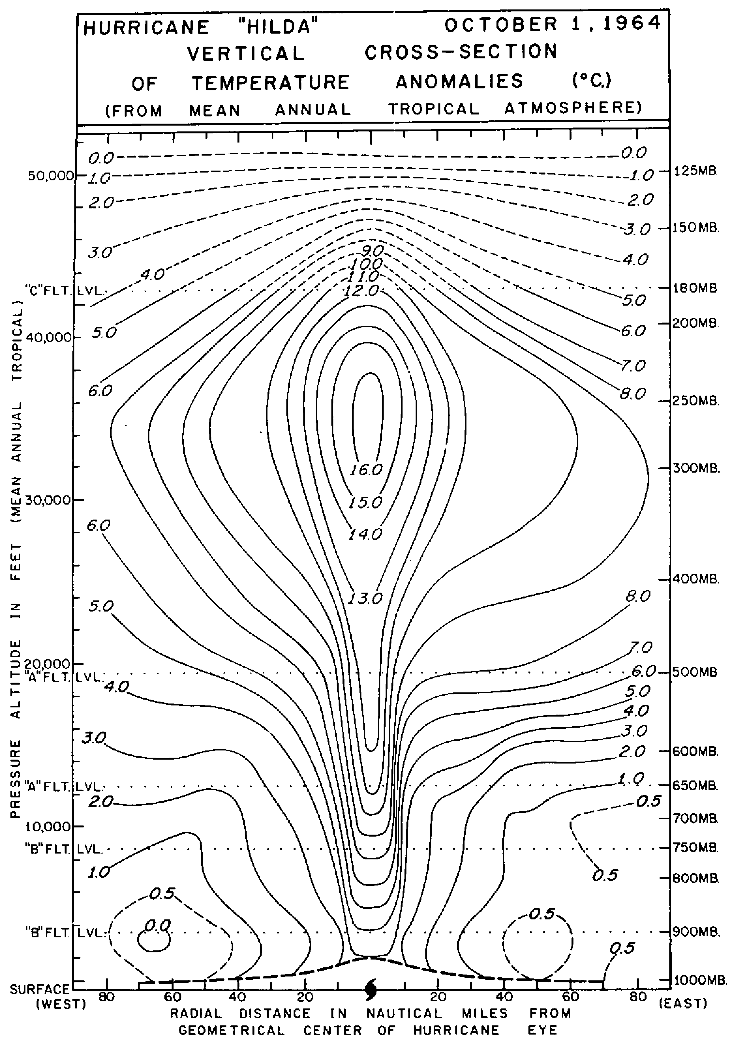
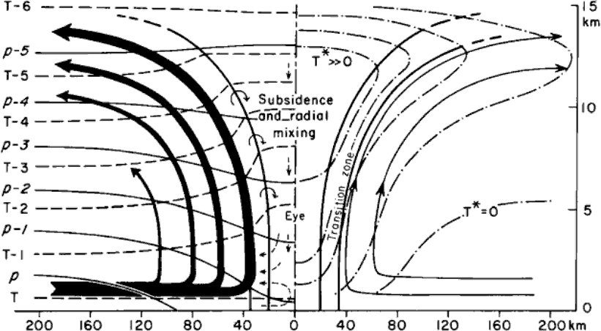
Potential Impacts of TCs upon their Environment
Motivation
Background
Results
Summary
Background
Temperature Anomalies
Secondary Circulation
Descent/Adiabatic Warming
+16°C anomaly
200
Inner Core
Subsidence/
Latent Heating
300
Credit: Palmén 1969
400
Pressure (hPa)
500
600
700
800
900
100
0
100
1000
Radius from TC Center (km)
Credit: NASA
Credit: Hawkins and Rubsam (1968)
Notes:
check on hoskins

Slide 9
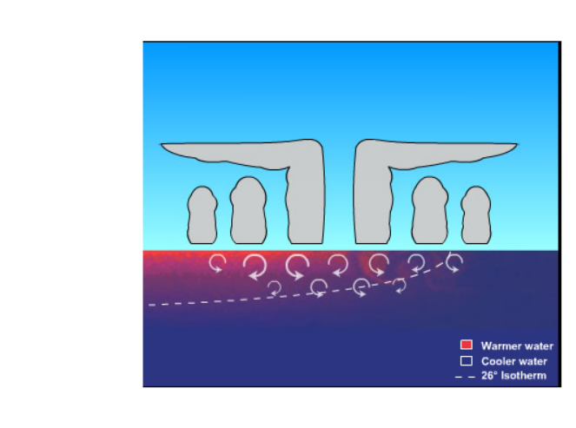
Potential Impacts of TCs upon their Environment
Motivation
Background
Results
Summary
Background
Temperature Anomalies
Vertical Cross Section of Oceanic Impacts of TC
Secondary Circulation
Descent/Adiabatic Warming
Cooling by TC-induced negative SST
anomalies
Inner Core
Subsidence/
Latent Heating
White circles: lower TC circulation
Dashed black line: thermocline
Black arrows: ocean current induced by TC
White arrows: turbulent mixing due to TC
Credit: NASA
Notes:
check on hoskins

Slide 10
Potential Impacts of TCs upon their Environment
Motivation
Background
Results
Summary
Background
Temperature Anomalies
Moisture Anomalies
How does the atmospheric environment respond to TC passage?
Secondary Circulation
Descent/Adiabatic Warming
Secondary Circulation
Descent/Drying
Cooling by TC-induced negative SST
anomalies
Drying by TC-induced negative SST
anomalies
Inner Core
Subsidence/
Latent Heating
Inner Core
Moisture
Convergence
Credit: NASA
Notes:
check on hoskins

Slide 11
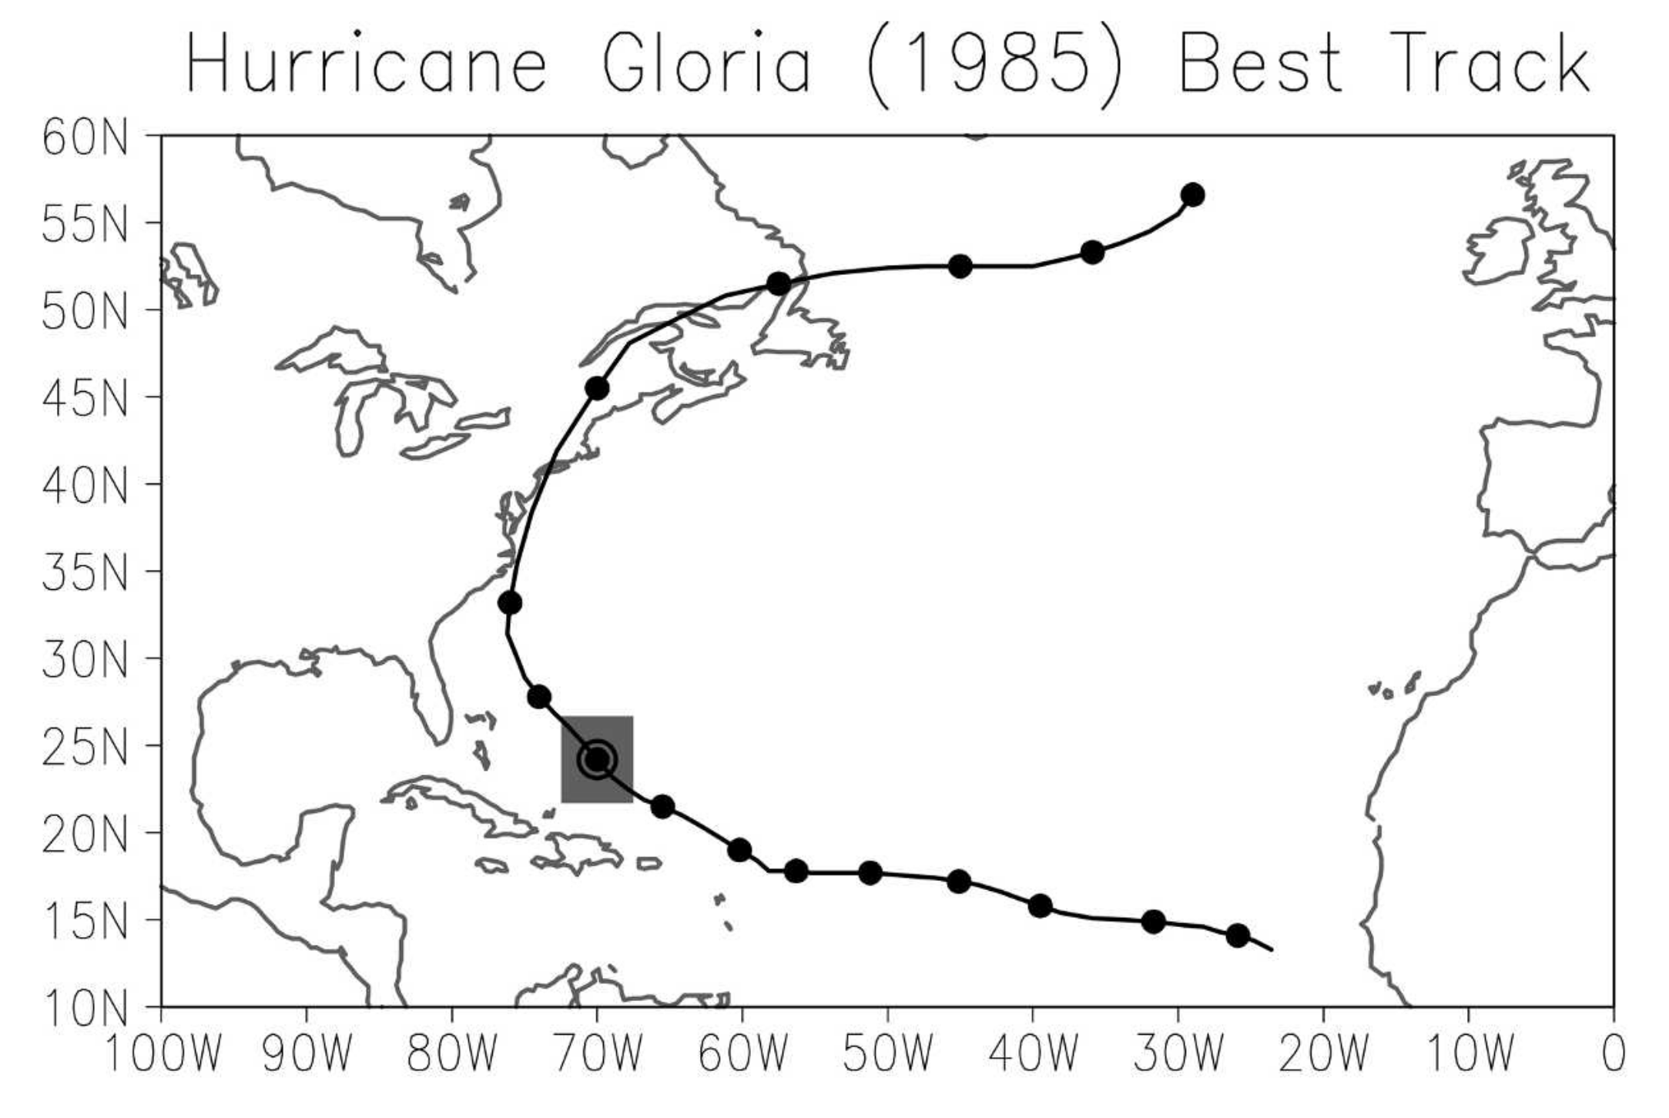
Environmental Impacts of TCs: Methodology of Hart et al. (2007)
Motivation
Background
Results
Summary
Background
Black line: Track of TC Gloria with dots at one day intervals
SST and thickness anomalies averaged within 5° × 5° box centered on TC location for each day during 20 days prior to 60 days after TC passage
Time series are averaged for all Northern Hemisphere TCs to provide composite response
Credit: Hart et al. 2007

Slide 12
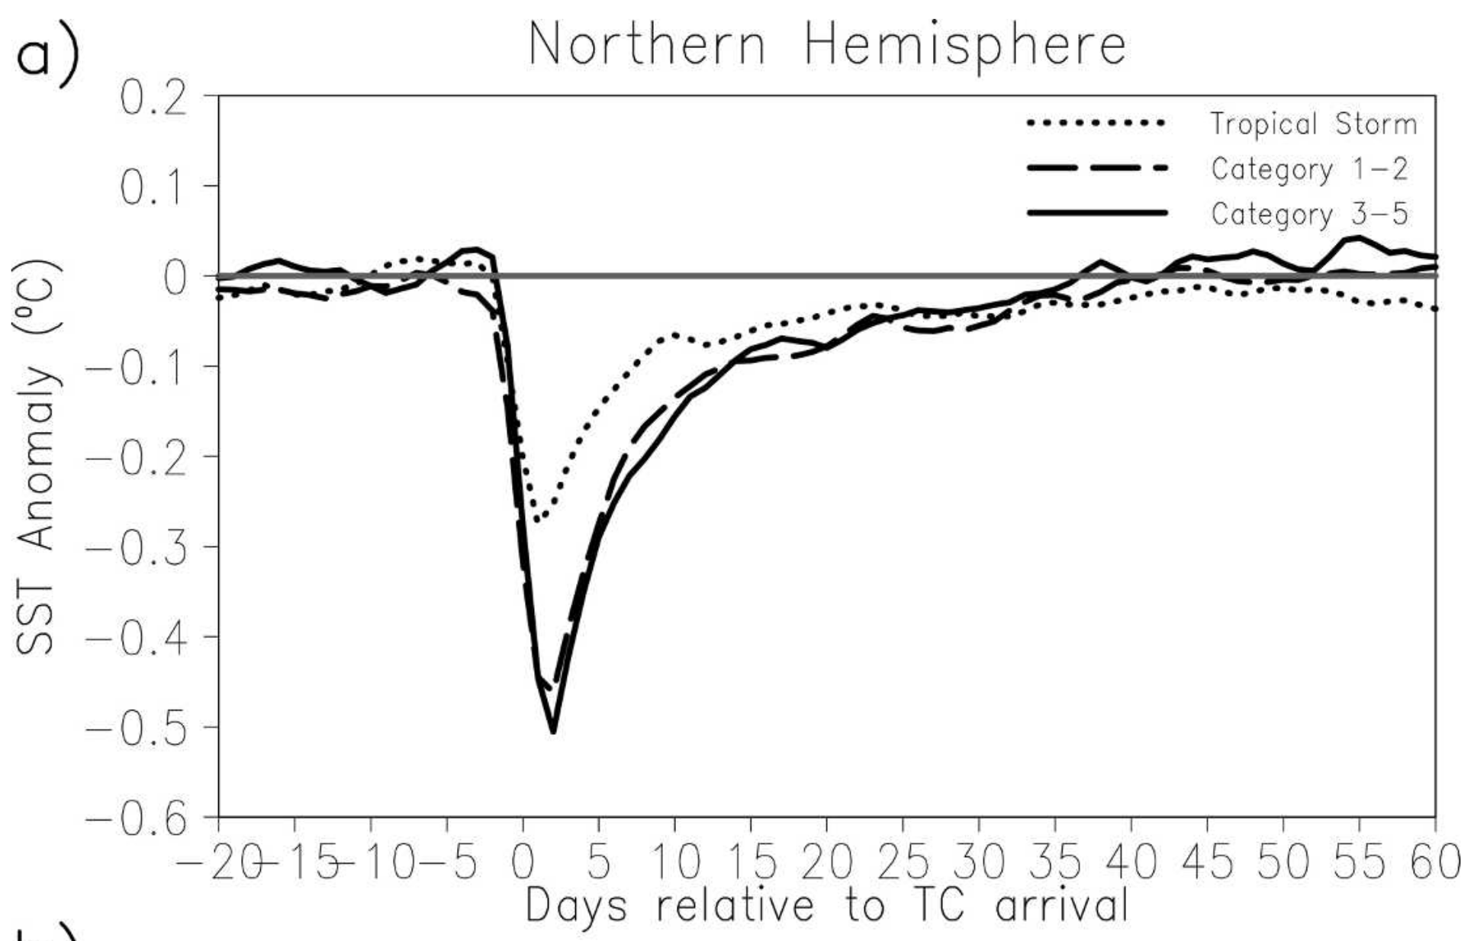
Motivation
Background
Results
Summary
Background
Impacts of TCs upon Sea Surface Temperatures
Composite time series of SST anomalies relative to TC passage
SST anomalies near climatology prior to TC passage
TC excites negative SST anomalies that scale with TC intensity
Negative SST anomalies are restored to climatology 35–40 days after TC passage
Warm
Cool
Credit: Hart et al. 2007

Slide 13
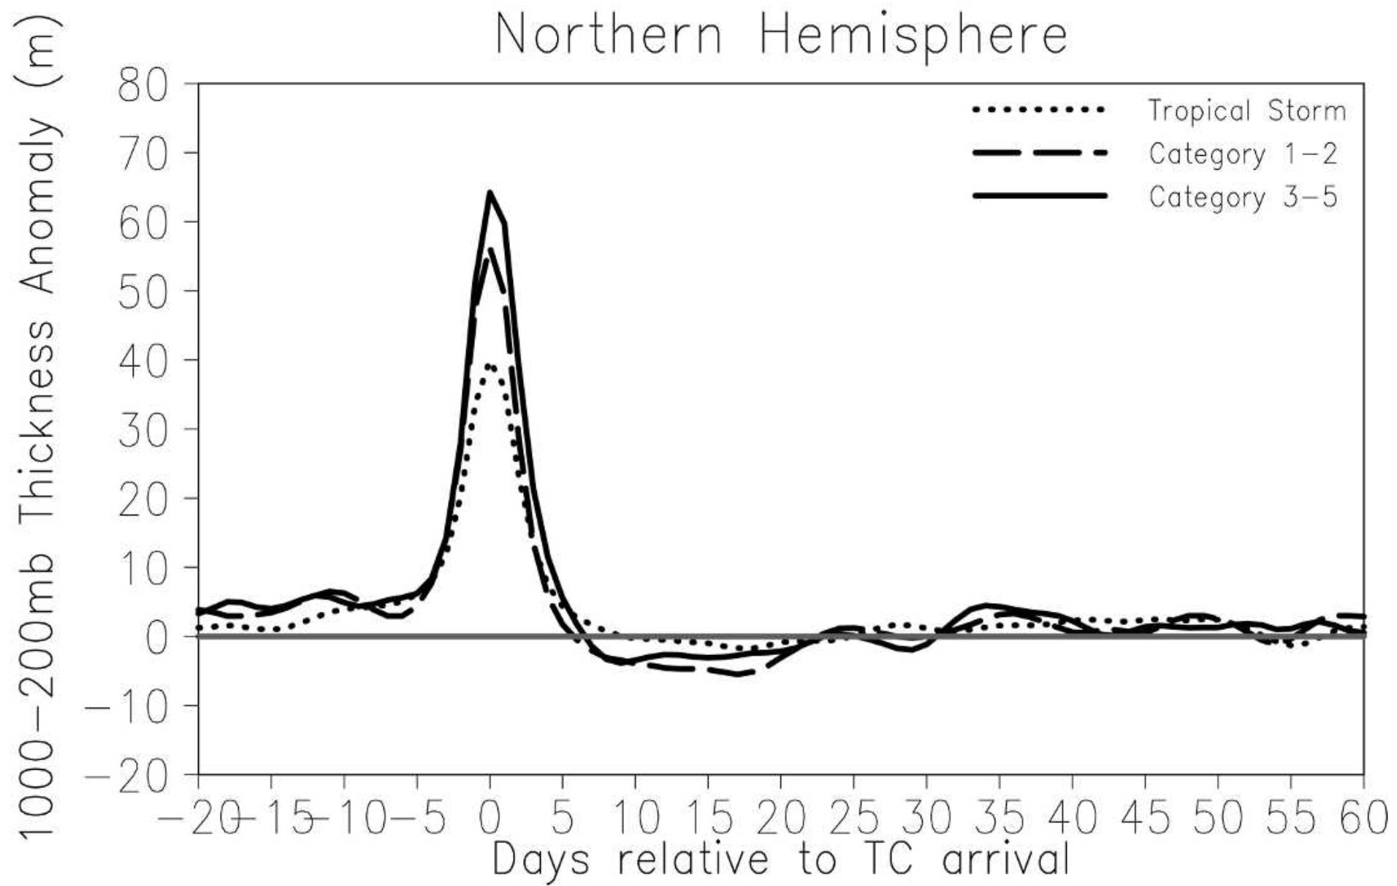
Motivation
Background
Results
Summary
Background
Atmospheric Impacts of TCs
Composite time series of 1000–200-hPa thickness anomalies relative to TC passage
Positive thickness anomalies prior to TC passage
TC associated with positive thickness anomalies that scale with intensity
Negative thickness anomalies occur 20–25 days following TC passage
Warm and/or moist
Cool and/or dry
Credit: Hart et al. 2007

Slide 14
Motivation
Background
Results
Summary
Background
Atmospheric Impacts of TCs
Composite time series of 1000–200-hPa thickness anomalies relative to TC passage
Wave-like response in thickness anomalies following TC passage
Warm and/or moist
Cool and/or dry
Credit: Hart et al. 2007

Slide 15
Questions Raised
Do environmental moisture and temperature anomalies occur prior to TC passage?
Are the cool anomalies or the dry anomalies stronger following TC passage?
What is the full spatial and temporal structure of environmental moisture and temperature anomalies following TC passage?
Can TCs dynamically impact their tropical atmospheric environment?

Slide 16
Outline
Motivation
Background
Results
Summary
Background
Background
Large-scale factors potentially responsible for multiple TC events
Influence of large-scale convective heating on TC frequency
Results
Spatiotemporal structure of OLR during single TC events and multiple TC events
Spatiotemporal structure lower-tropospheric winds during single TC events and multiple TC events
Summary and discussions
Large-Scale Factors Forcing Multiple TC Events Benjamin A. Schenkel University at Albany, SUNY 18/
Notes:
Insert case study into talk

Slide 17
Methodology
Objective: Examine four-dimensional environmental response to TC passage
Storm-relative composites of 6-h 0.5° × 0.5° NCEP Climate Forecast System Reanalysis (Saha et al. 2010) used to examine environmental response to TC passage
Reanalysis: A model simulation of a previous time that assimilates historical observations providing the most likely atmospheric state at a given time (Thorne and Vose 2010)
Western North Pacific Typhoons (maximum 10-m wind speed ≥ 64 kt) equatorward of 20°N from JTWC Best-Track (Chu et al. 2002) during 1982–2009 are chosen for analysis (N = 355 TCs)

Slide 18
Compositing Methodology
Black line: Track of Typhoon Ruth with dots at one day intervals. Gray star denotes example time of interest
Storm-relative domain centered on TC at “day 0” relative to TC passage
Time-longitude plots to follow meridionally averaged between 250 km south and north of TC location at day 0
Example Domain for Typhoon Ruth (1991)
Notes:
Axisymmetric TC structure → primary, secondary circ
Asymmetric TC structure → lower-tropospheric cyclone, subsidence environment, TC outflow
How does TC impact environment? Add shay cartoon
Questions raised
Results→ rossby wave radiation, moisture budget: pwat plot/vert motion,inert instability,memory stuff → typhoon stratified composites

Slide 19
Outline
Shading: Vertically integrated MSE anomalies from surface to 100 hPa meridionally averaged from 250 km south to 250 km north of TC latitude
Significant MSE anomalies are absent prior to TC passage
Dipole in MSE anomalies during TC passage associated with TC and subsidence from its secondary circulation
Negative MSE anomalies over broad region during two months following TC passage
Westward propagating anomalies with period of ~6–10 days
West
East
Notes:
8.07,0.15,0

Slide 20
Outline
Shading: SST anomalies meridionally averaged from 250 km south to 250 km north of TC latitude
Significant SST anomalies are absent prior to TC passage
Negative MSE anomalies over broad region during two months following TC passage
Negative SST anomalies displaced to east of negative MSE anomalies
West
East
Notes:
8.07,0.15,0

Slide 21
Outline
Shading: 850-hPa meridional wind anomalies meridionally averaged from 250 km south to 250 km north of TC latitude
Significant lower-tropospheric meridional wind anomalies generally absent prior to TC passage
Westward propagating northerly wind anomalies generally coincident with westward propagating negative MSE anomalies
Meridional wind anomalies exhibit eastward group velocity
West
East
Notes:
8.07,0.15,0

Slide 22
Outline
Environmental Response Before TC Passage: absence of significant anomalies
Environmental Response After TC Passage:
Broad region of negative vertically integrated MSE anomalies containing westward propagating anomalies
Broad region of negative SST anomalies
Westward propagating negative meridional wind anomalies
Notes:
8.07,0.15,0

Slide 23
Source of Westward Propagating Anomalies:
TC-Induced Rossby Waves?
A: Anticyclone
C: Cyclone
: TC Utor
: TC Trami
3–8 Day Filtered Surface Wind Data
U
T
TC-induced Rossby waves result from lower-tropospheric cyclonic circulation of TC impinging on planetary vorticity gradient generating series of cyclonic and anticyclonic disturbances
U
A
C
Fu et al. 2007

Slide 24
Source of Westward Propagating Anomalies:
TC-Induced Rossby Waves?
A: Anticyclone
C: Cyclone
: TC Utor
: TC Trami
3–8 Day Filtered Surface Wind Data
U
T
U
A
C
Fu et al. 2007

Slide 25
Source of Westward Propagating Anomalies:
TC-Induced Rossby Waves?
A: Anticyclone
C: Cyclone
: TC Utor
: TC Trami
3–8 Day Filtered Surface Wind Data
U
T
U
A
C
Fu et al. 2007

Slide 26
Source of Westward Propagating Anomalies:
TC-Induced Rossby Waves?
A: Anticyclone
C: Cyclone
: TC Utor
: TC Trami
3–8 Day Filtered Surface Wind Data
U
T
A
T
A
Fu et al. 2007

Slide 27
Source of Westward Propagating Anomalies:
TC-Induced Rossby Waves?
A: Anticyclone
C: Cyclone
: TC Utor
: TC Trami
3–8 Day Filtered Surface Wind Data
U
07/03/01
07/07/01
U
A
T
U
TC-induced Rossby waves have period of ~6–10 days
At least ~40% of WPAC TCs generate Rossby waves
A
C
C
07/05/01
07/09/01
U
T
A
A
C
Fu et al. 2007

Slide 28
Source of Westward Propagating Anomalies:
TC-Induced Rossby Waves?
Krouse et al. (2008, 2010) suggest that TCs can generate Rossby waves if the TC is moving westward quicker than the lower-tropospheric steering flow of Rossby waves
Using this criteria of Krouse et al. (2008, 2010), an alternate set of composites are constructed for two subsets of typhoons to identify influence of TC-induced Rossby waves:
Favorable composites for typhoon-induced Rossby waves (N=201)
Unfavorable composites for typhoon-induced Rossby waves (N=155)
These two sets of TC composites to be shown have similar TC intensities, TC locations, and TC genesis dates

Slide 29
TC-Induced Rossby Waves Forcing Westward Propagating Anomalies
Unfavorable
Favorable
Shading: Vertically integrated MSE anomalies from surface to 100 hPa meridionally averaged from 250 km south to 250 km north of TC latitude
Unfavorable composites: negative MSE anomalies absent following TC passage
Favorable composites: contain stronger negative MSE anomalies and westward propagating anomalies
Not all WPAC TCs are associated with an environmental response!
West
East
West
East
Notes:
8.07,0.15,0

Slide 30
TC-Induced Rossby Waves Forcing Westward Propagating Anomalies
Unfavorable
Favorable
Shading: SST anomalies meridionally averaged from 250 km south to 250 km north of TC latitude
Unfavorable composites: weaker, zonally confined negative SST anomalies → smaller TCs?
Favorable composites: stronger, broader negative SST anomalies → larger TCs?
West
East
West
East
Notes:
8.07,0.15,0

Slide 31
TC-Induced Rossby Waves Forcing Westward Propagating Anomalies
Unfavorable
Favorable
Shading: 850-hPa meridional wind anomalies meridionally averaged from 250 km south to 250 km north of TC latitude
Unfavorable composites: absence of westward propagating anomalies
Favorable composites: stronger westward propagating anomalies relative to original composites
Prior work has shown larger TCs more likely to trigger Rossby waves consistent with results suggested here
West
East
West
East
Notes:
8.07,0.15,0

Slide 32
Summary Thus Far….
Environmental Response Before TC Passage: absence of significant anomalies
Environmental Response After TC Passage:
Broad region of negative vertically integrated MSE anomalies containing westward propagating anomalies
Broad region of negative SST anomalies
Westward propagating negative meridional wind anomalies
Westward propagating anomalies in atmospheric fields potentially due to TC-induced Rossby waves
Smaller TCs generally do not force environmental response
Larger TCs generally force environmental response via broader negative SST anomalies and TC-induced Rossby waves
Notes:
8.07,0.15,0

Slide 33
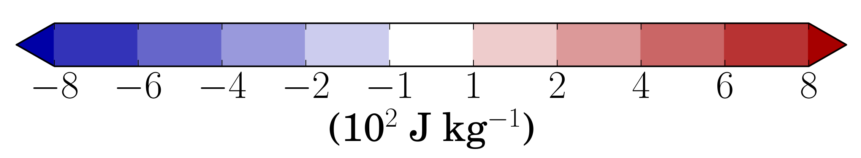
Vertical Structure of MSE Anomalies
Shading: 500 km by 500 km areal-average of MSE anomalies at location of TC passage
Negative MSE anomalies extend throughout troposphere with strongest anomalies concentrated in lower troposphere
Pulsations in negative MSE anomalies throughout troposphere timed with passage of westward propagating anomalies
Notes:
6.13, 0, 0.55

Slide 34
Vertical Structure of Latent Energy Anomalies
Shading: 500 km by 500 km areal-average of latent energy (Lq) anomalies at location of TC passage
Latent energy anomalies compose most of MSE anomalies in lower and midtroposphere
Lower-tropospheric negative latent energy anomalies consistent with structure expected from negative SST anomalies (e.g., Hashizume et al. 2002)
Notes:
6.13, 0, 0.55

Slide 35
Vertical Structure of Latent Energy Anomalies
Shading: 500 km by 500 km areal-average of latent energy (Lq) anomalies at location of TC passage
Midtropospheric latent energy anomalies due to horizontal advection by TC-induced Rossby waves
Notes:
6.13, 0, 0.55

Slide 36
Vertical Structure of Sensible Heat Anomalies
Shading: 500 km by 500 km areal-average of sensible heat (C_{p}T) anomalies at location of TC passage
Lower-tropospheric sensible heat anomalies consistent with structure expected from negative SST anomalies
Sensible heat anomalies compose most of MSE anomalies in upper troposphere
Notes:
6.13, 0, 0.55

Slide 37
Source of Upper-Tropospheric Sensible Heat Anomalies
300-hPa Sensible Heat Anomalies 12 Days after TC Passage
Negative upper-tropospheric sensible heat anomalies located over large region suggesting large-scale phenomena responsible
Notes:
6.13, 0, 0.55

Slide 38
Source of Upper-Tropospheric Sensible Heat Anomalies
300-hPa Sensible Heat Anomalies
300-hPa Sensible Heat Anomalies 12 Days after TC Passage
Negative upper-tropospheric sensible heat anomalies appear to be associated with convectively suppressed MJO
Notes:
6.13, 0, 0.55

Slide 39
Conclusions

Slide 40
Additional Questions Raised
How does the atmospheric environment respond to the impacts of TCs in the absence of Rossby waves?
Does the aggregate impact of the cooling and drying of the troposphere by WPAC TCs help constrain the seasonal cycle of MSE within the WPAC tropics?
How does the environmental atmospheric response to TC passage vary with time of year?
Can these results for WPAC TCs be extended to other basins (e.g., North Atlantic, eastern North Pacific) given differences in the large-scale environment?

