Slide 1



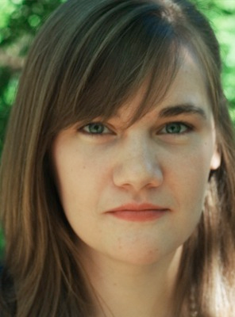

Correlations Between West Nile Virus Outbreaks and Meteorological Conditions of the Southern United States
Mentor: Dr. David Parsons
Jonathan
Wille
Jack
M^{c}Lean
Charlotte
Lunday

Slide 2
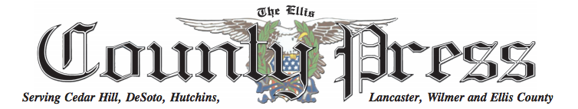




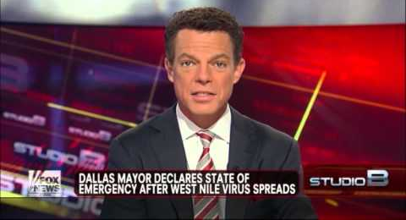

Background:
2012 WNV Outbreak largest in Texas, Oklahoma history
> Oklahoma: 187 Cases, 12 Deaths
> Texas: 1739 Cases, 76 Deaths
> Dallas County one of worst hit places with 371 cases
Weather and Climate impacts on disease is a major focus in our changing climate
Mosquito populations and behavior are significantly impacted by weather and climate (e.g., rainfall, vegetation-soil moisture, temperature including extremes, wind and humidity)
Past research on weather-climate-WNV connections is prolific, but little research has been done for the Southern Plains. Also research is often localized and relies on unstandardized mosquito numbers .
Notes:
Local bodies of government responsible for preventative actions, so local information is potentially helpful.
Previous maxes for texas and oklahoma. OK: 2007, 107 cases. TX: 2003, 702 cases
II restated the purpose a little.
Optimal humidity and temperature for mosquitoes: 80% humidity and 27.5 degrees Celsius

Slide 3
STATEMENT OF PURPOSE: Since mosquito populations are significantly impacted by weather and climate conditions, we will attempt to identify correlations between WNV disease statistics and variations in weather and seasonal indices over the Southern Great Plains
If significant correlations are found, we will propose a predictive index.

Slide 4
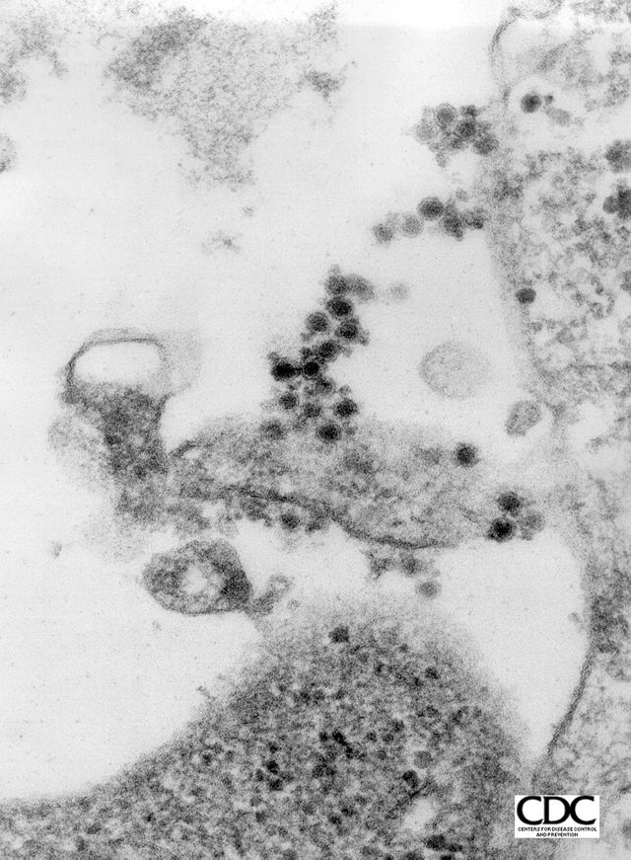
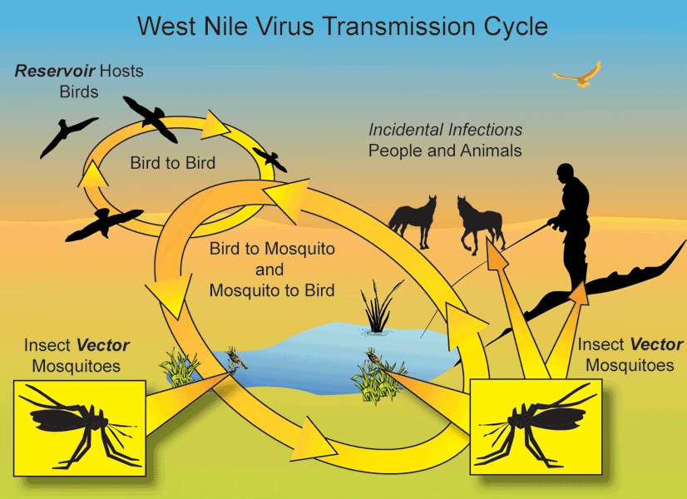
What is West Nile Virus?
Birds and mosquitoes are natural vectors of WNV, but mosquitoes pass the virus to dogs, cattle, and humans.
WNV is a flavivirus that is potentially fatal when it enters nervous system.
Notes:
West Nile Virus is a flavivirus, that is a virus that is carried by birds and mosquitoes. Female mosquitoes incidentally infect humans and livestock. Most humans who contract WNV show no symptoms. Others experience mild, flu-like symptoms. If the virus is allowed to pass into the central nervous system, it can cause encephilatis and meningitus: That is, inflammation of the brain and spinal cord, which can lead to coma, paralysis, and death.
WNV originated in Uganda and was first discovered in the U.S. in 1999, but spread into the Great Plains and Southern U.S. in 2002. The elderly population is particularly vulnerable to WNV, which has implications on the aging population of the U.S. and other developed countries.

Slide 5
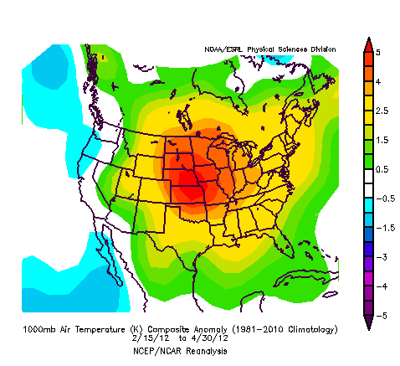
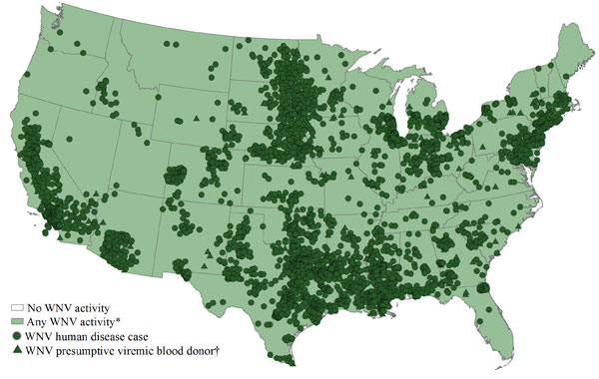
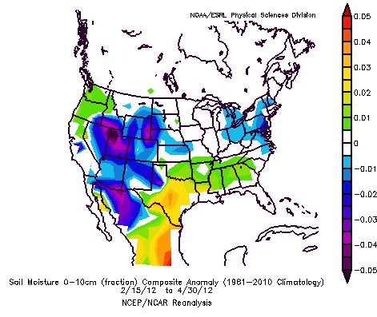
WNV in 2012
North American Regional Reanalysis (NARR) temperature (left) and soil moisture (right) for spring of 2012.
WNV cases reported to the Centers for Disease Control and Prevention (CDC) for the year 2012

Slide 6
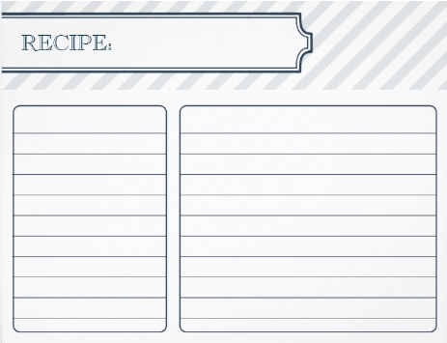
Methodology
Goal: Correlate weather and seasonal climate conditions to location of WNV outbreaks, and if possible, create a predictive index.
We need:
Cases reported to each county in Kansas, Oklahoma, and Texas
NCEP/NCAR
Soil moisture
Temperature thresholds
Wind
Rainfall
Process:
Analyze literature for theoretical correlations
Mosquito’s are sensitive to extreme heat/cold during two day gonotrophic cycle
Water movement increases larvae mortality
Regress NCEP/NCAR data using MATLAB against location and size of outbreak
Notes:
As we mentioned before, the goal of this project is to correlate weather and seasonal climate climate conditions to the location of west nile virus activity. If possible, these correlations will be used to develop a predictive index.
Are we going to use rainfall in our analysis? I thought it was just soil moisture we were interested in.

Slide 7
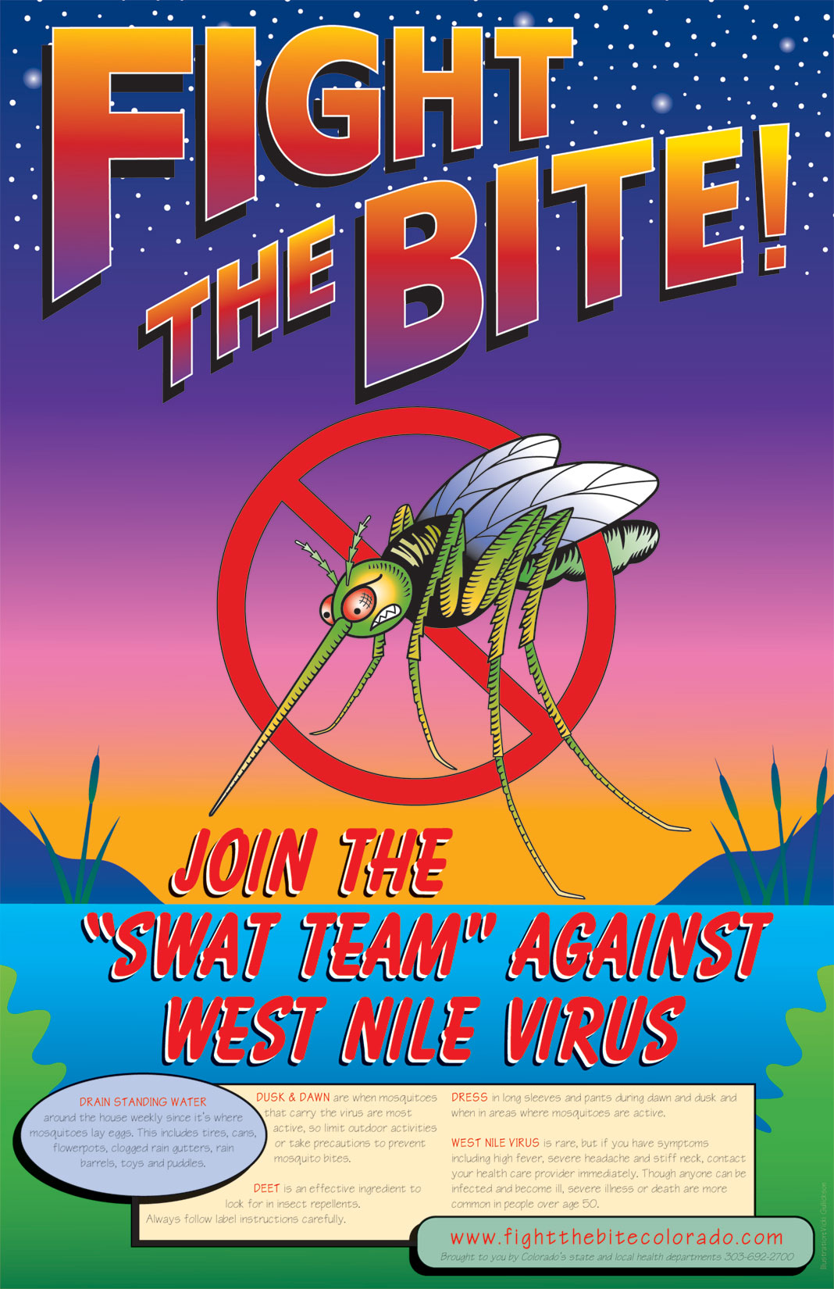
Impacts
Help towns take preventative measures
Community education drives on WNV prevention and symptom recognition
Smarter distribution of medical resources to regions with higher predicted impacts

Slide 8
References
Artsob, H. H., Gubler, D. J., Enria, D. A., Morales, M. A., Pupo, M. M., Bunning, M. L., & Dudley, J. P., 2009: West Nile Virus in the New World: Trends in the Spread and Proliferation of West Nile Virus in the Western Hemisphere. Zoonoses & Public Health, 56, 357-369. doi:10.1111/j.1863-2378.2008.01207.x
Centers for Disease Control, 2012: West Nile Virus. [http://www.cdc.gov/ncidod/dvbid/westnile/index.htm]
Chuang, T., M. B. Hildreth, D. L. Vanroekel and M. C. Wimberly, 2011: Weather and Land Cover Influences on Mosquito Populations in Sioux Falls, South Dakota. J. Med. Entomol., 48, doi. 10.1603/MEI10246.
Chuang, T., E. L. Ionides, R. G. Knepper, W. W. Stanuszek, E. D. Walker, and M. L. Wilson, 2012: Cross-Correlation Map Analyses Show Weather Variation Influences on Mosquito Abundance Patterns in Saginaw County, Michigan, 1989-2005. J. Med. Entomol., 49, doi: http://dx.doi.org/10.1603/ME11150.
Fernandez, M., 2012: Dallas Copes With Unpredictability of West Nile Virus. New York Times, 18 September, 1st ed.
Gong, H. A. T. Degaetano, and L. C. Harrington, 2011: Climate-based models for West Nile Culex Mosquito vectors in the Northeastern US. Int. J. Biometeorol., 55, doi: 10.1007/s00484-010-0354-9.
Hartley, D. M., C. M. Barker, A. L. Menach, T.Niu, H. D. Gaff, and W. K. Reisen, 2012, Effects of Temperature on Emergence and Seasonality of West Nile Virus in California. Am. J. Trop. Med. Hyg., 86, doi: 20.4260/ajtmh.2012.11-0342.
Jaslow, Ryan, 2012: West Nile virus outbreak: How to protect yourself [http://www.cbsnews.com/8301-504763_162-57495613-10391704/west-nile-virus-outbreak-how-to-protect-yourself/?tag=contentMain;contentBody]
Jones, C. E., L. P. Lounibos, P. P. Marra, and A. M. Kilpatrick, 2012: Rainfall Influences Survival of Culex pipiens (Diptera: Culicidae) in a Residential Neighborhood in the Mid-Atlantic United States. J. Med. Entomol. 49, doi: http://dx.doi.org/10.1603/ME11191.
May, F. J., Todd Davis, C. C., Tesh, R. B., & Barrett, A. T., 2011: Phylogeography of West Nile Virus: from the Cradle of Evolution in Africa to Eurasia, Australia, and the Americas. Journal Of Virology, 85, 2964-2974. doi:10.1128/JVI.01963-10
Paz S, Albersheim I., 2008: Influence of warming tendency on Culex pipiens population abundance and on the probability of West Nile Fever outbreaks (Israeli case study: 2001-2005). Ecohealth [serial online]. n.d.;5, 40-48. Available from: Science Citation Index, Ipswich, MA. Accessed December 3, 2012.
Ruiz, M. O., Chaves, L. F., Hamer, G. L., Ting, S., Brown, W. M., Walker, E. D., & ... Kitron, U. D., 2010: Local impact of temperature and precipitation on West Nile virus infection in Culex species mosquitoes in northeast Illinois, USA. Parasites & Vectors, 319-34. doi:10.1186/1756-3305-3-19
World Health Organization, World Meteorological Organization, 2012: Atlas of Health and Climate. WHO Press, 56 pp.
Yasuoka, J., Richard L., 2007: Ecology of Vector Mosquitoes in Sri Lanka - Suggestions for Future Mosquito Control in Rice Ecosystems, Southeast Asian J Trop Med Public Health, 38, 646-657.

Slide 9
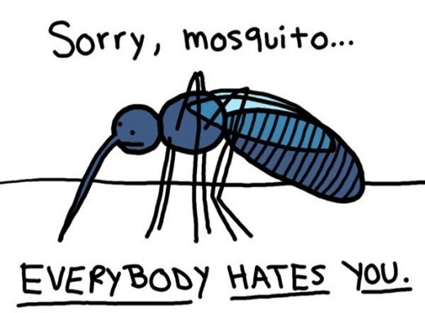
Questions?
http://weather.ou.edu/~westnile/

