Slide 1





Physical Correlations of West Nile Virus Outbreaks in the Southern United States
Mentor: Dr. David Parsons
Jonathan
Wille
Jack
M^{c}Lean
Charlotte
Lunday
Special thanks to, Jun Li, Claude Duchon, and William Crosson!

Slide 2
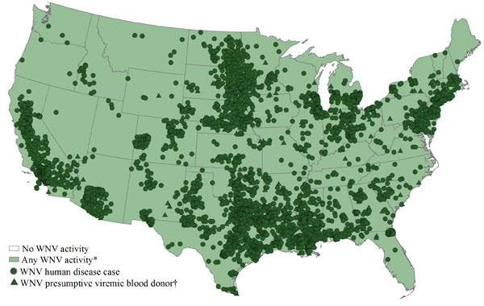
Brief Recap
WNV is a potentially fatal neuroinvasive virus
Mosquitos and birds serve as intermediate hosts
Texas 2012: 1739 cases, 76 deaths
Created unrest in Dallas
WNV cases reported to the Centers for Disease Control and Prevention (CDC) for the summer of 2012

Slide 3
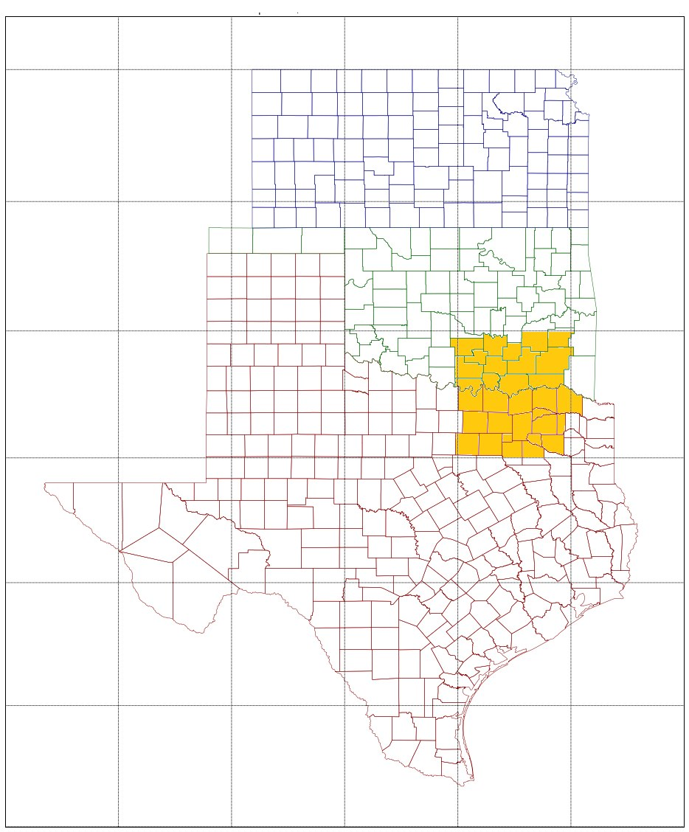
Data is in
WNV data provided by state epidemiologist in Kansas, Oklahoma, and Texas
Data spanned 2002-2012, entire duration of WNV’s presence in Southern Plains
Provides date each case is reported by hospital
Israeli case study recommends lag of 3-9 weeks. Strongest at 5 and 7 weeks (Paz 2006)
Apply a 5 and 7 week lag to our data for analysis
NCEP/NCAR data
Precipitation
0-10cm Soil Moisture
Air Temperature
Wind magnitude
2.5 degree grid spacing

Slide 4
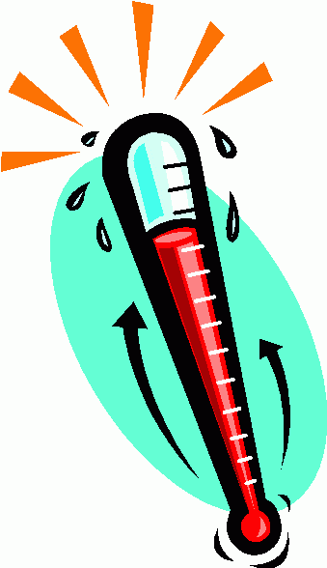
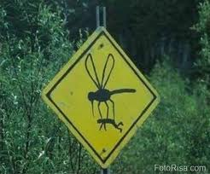
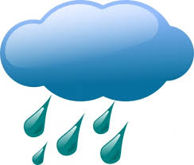
Original Mentality
+
=

Slide 5
It Turns Out….
Drought increases WNV prevalence due increased organic matter in standing water pools (Epstein and Defilippo, 2001; Epstein, 2005; Tibbetts, 2007)
Precipitation has a weak correlation in the spring and transitions to a negative correlation in the summer (Chuang, T. et al., 2012)
When temperatures don’t fall below 77° F (25° C) for seven days, the minimum temperature becomes the most important climatic factor in encouraging the early appearance of the virus (Paz 2006)
Temperatures above 39° C are lethal to some mosquitoes (Mayne, 1930) without regard to the relative humidity (Mellanby 1934). Temperatures of 40° C-42° C might be withstood for as long as 3 hours and 43° C might be withstood for 30 minutes. At 48° C females live less than one minute. (The Book)

Slide 6
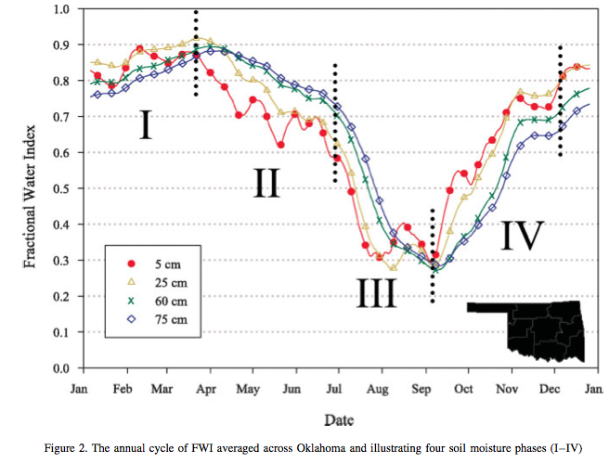
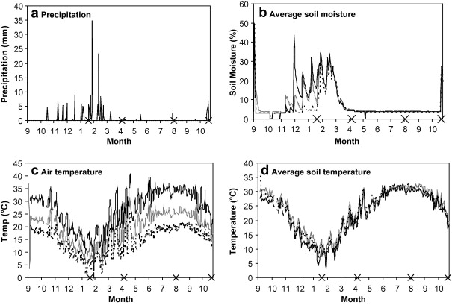
Soil Moisture Comparison
Annual Oklahoma Soil Moisture
(Illston et al. 2004)
Semi-arid Israeli Soil Moisture
(Xie, Steinberger 2001)

Slide 7
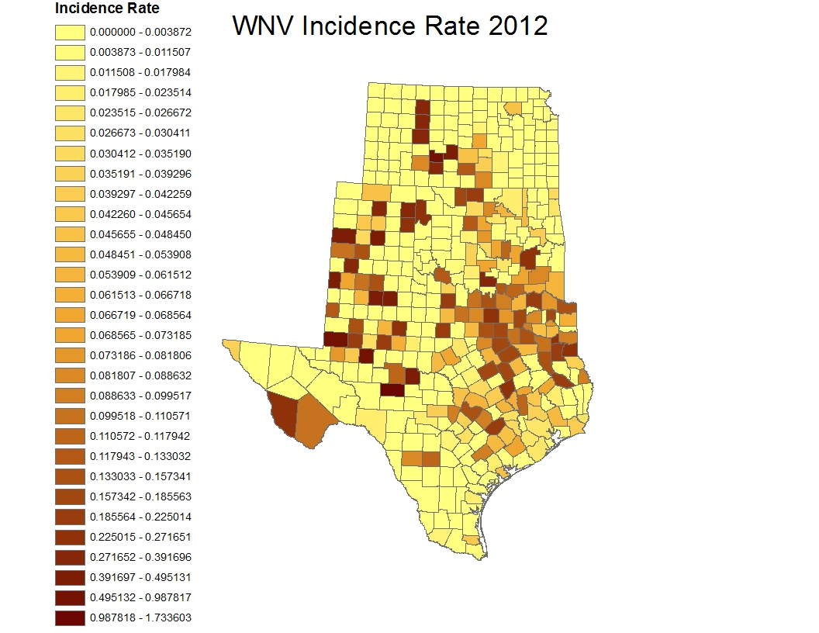
Plain incidence rate of three states of 2012

Slide 8
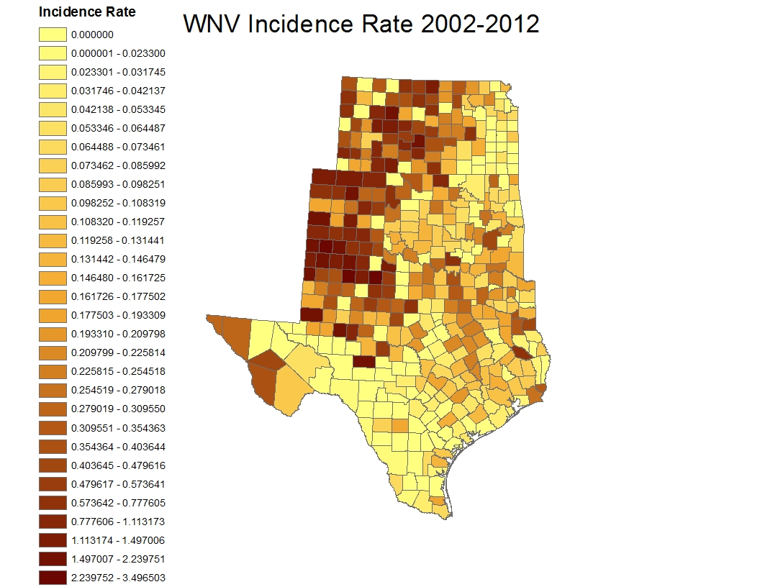

Slide 9
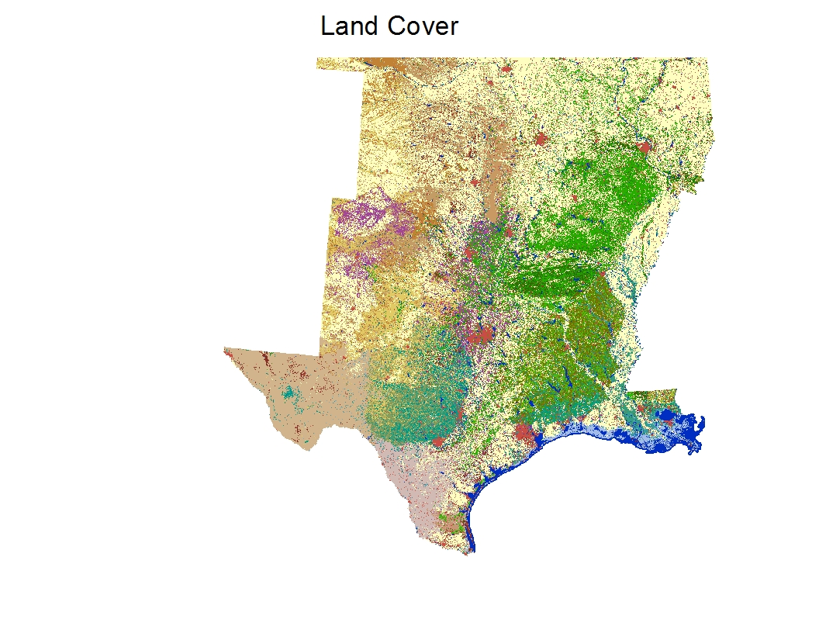
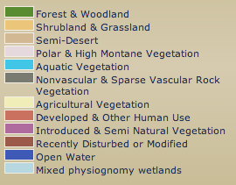

Slide 10
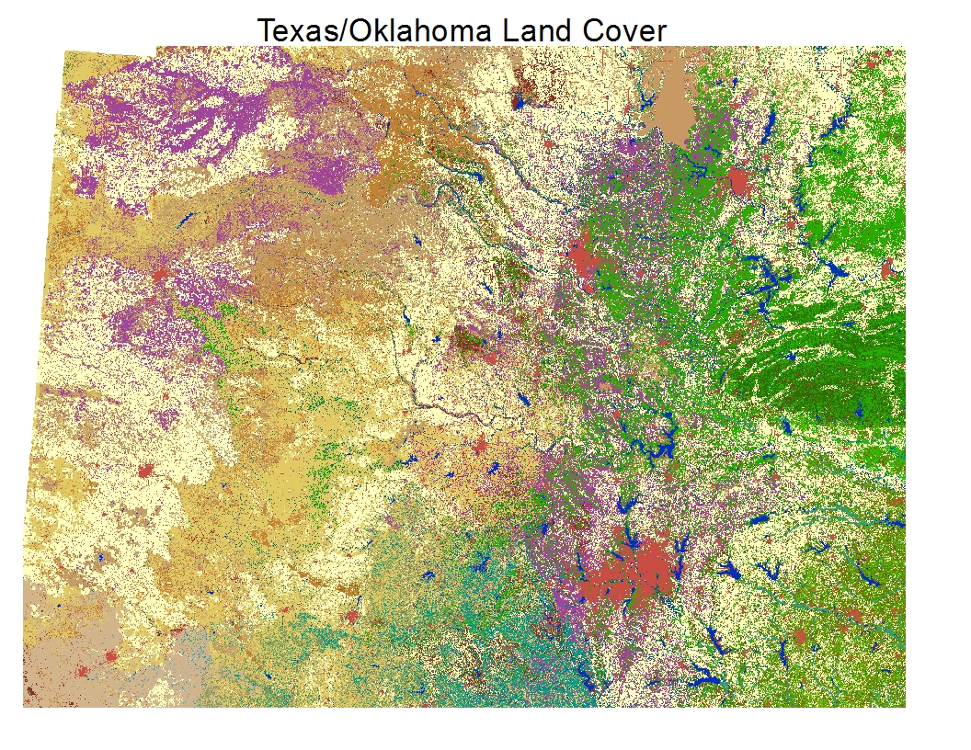
Tulsa
Amarillo
Oklahoma City
Dallas

Slide 11
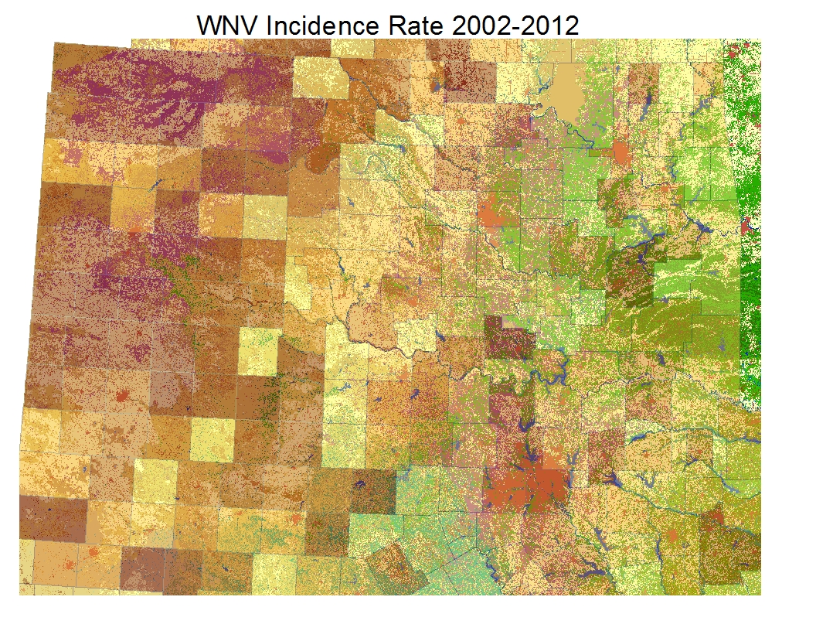

Slide 12
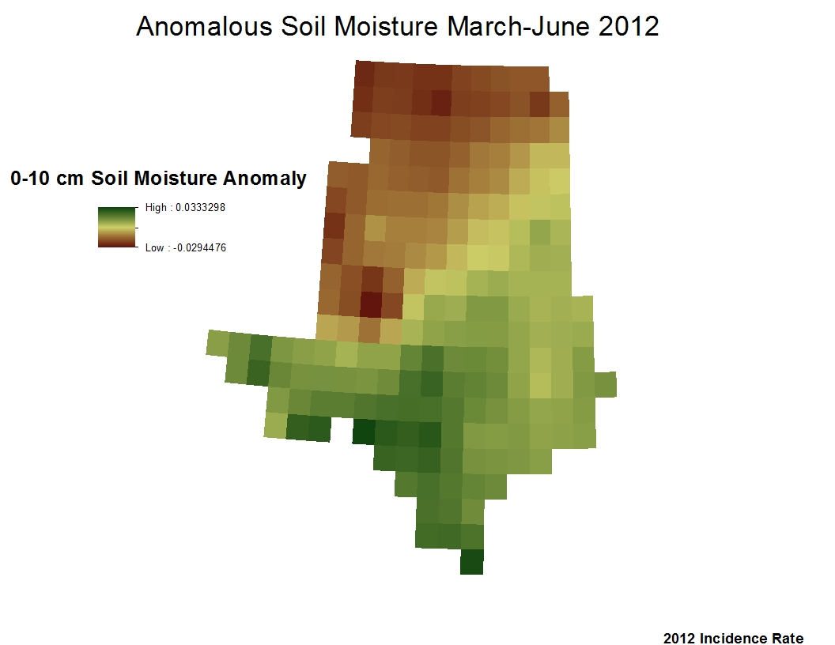

Slide 13
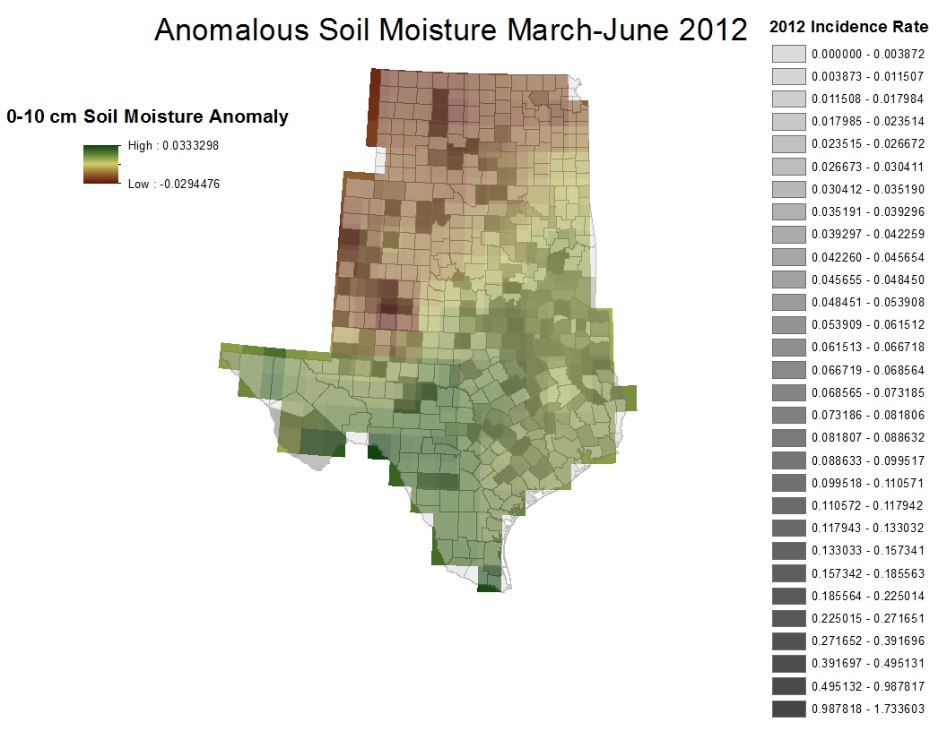

Slide 14
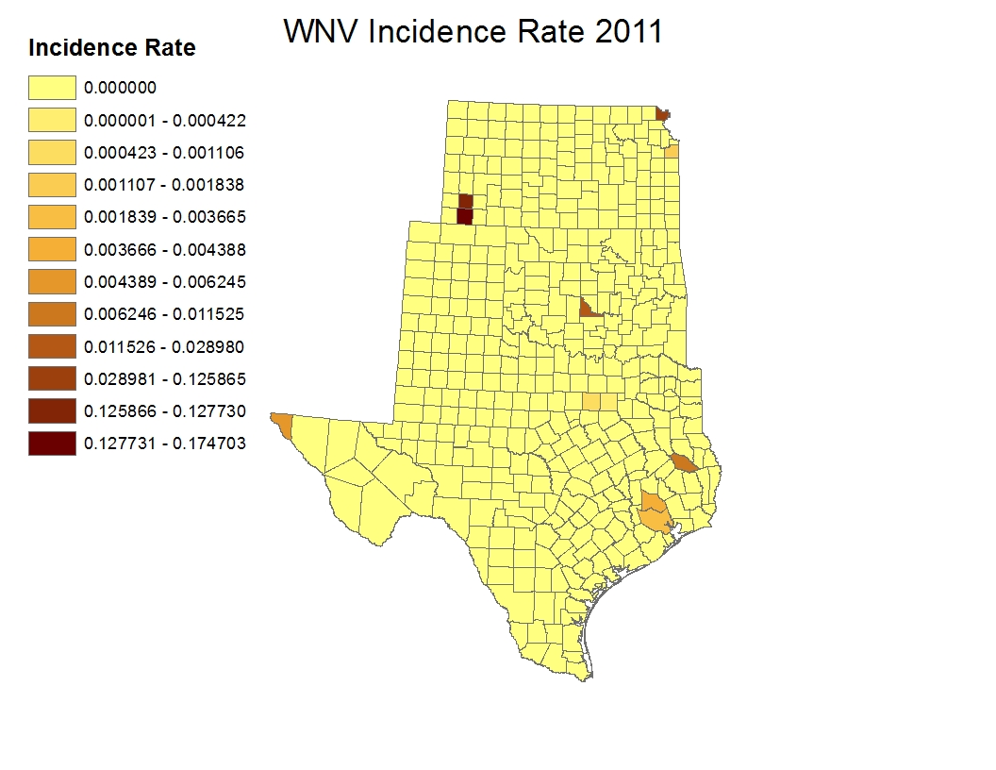

Slide 15
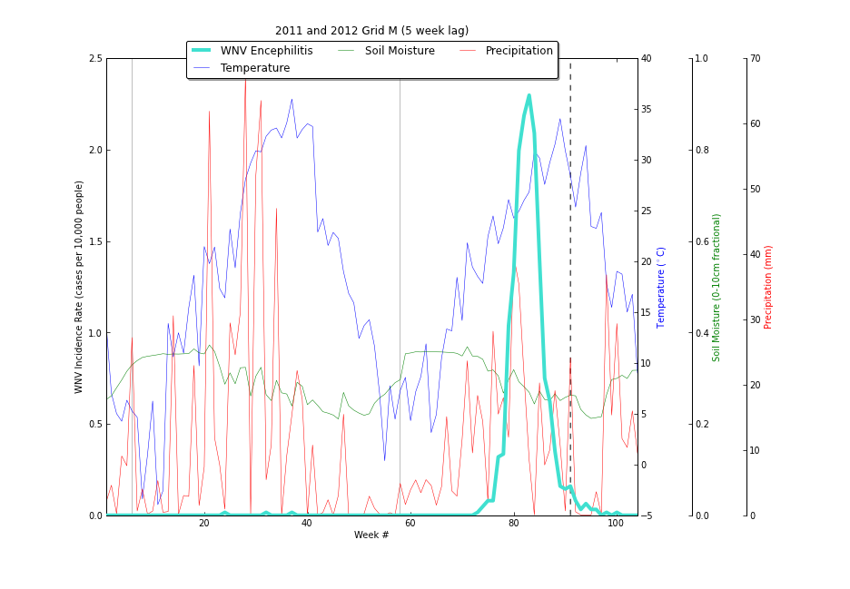
Temperature Spike
Below Freezing
Precipitation Spike

Slide 16
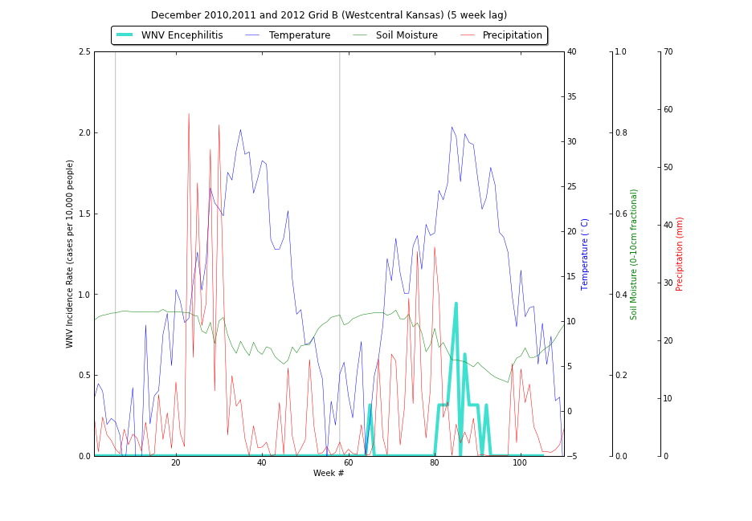

Slide 17
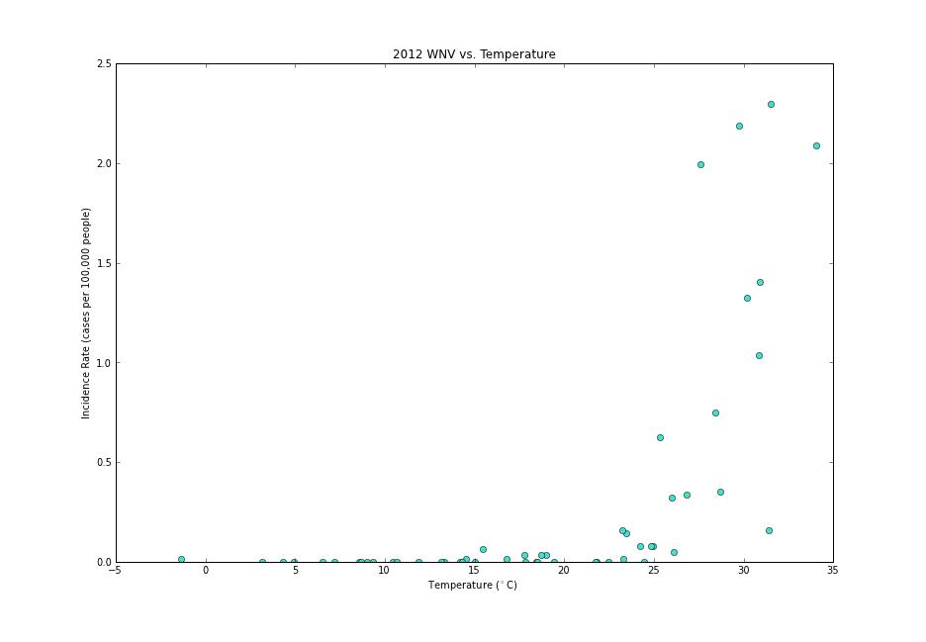
Dallas

Slide 18
Where we stand
Current work
Next Steps
Began data analysis and plotting
Currently drawing conclusions from the data
Literature has been thoroughly reviewed
Code and run regression for quantifiable results
Perform GIS raster analysis for geographical results

Slide 19

Questions?

